Slide 1
PRAMP BoD Meeting Tech Support Slides
May 5, 2024

Slide 2
New Purple Air Deployments
Holy Family (Grimshaw)
Rosary (Manning)
Good Shepherd (Peace River)

Slide 3
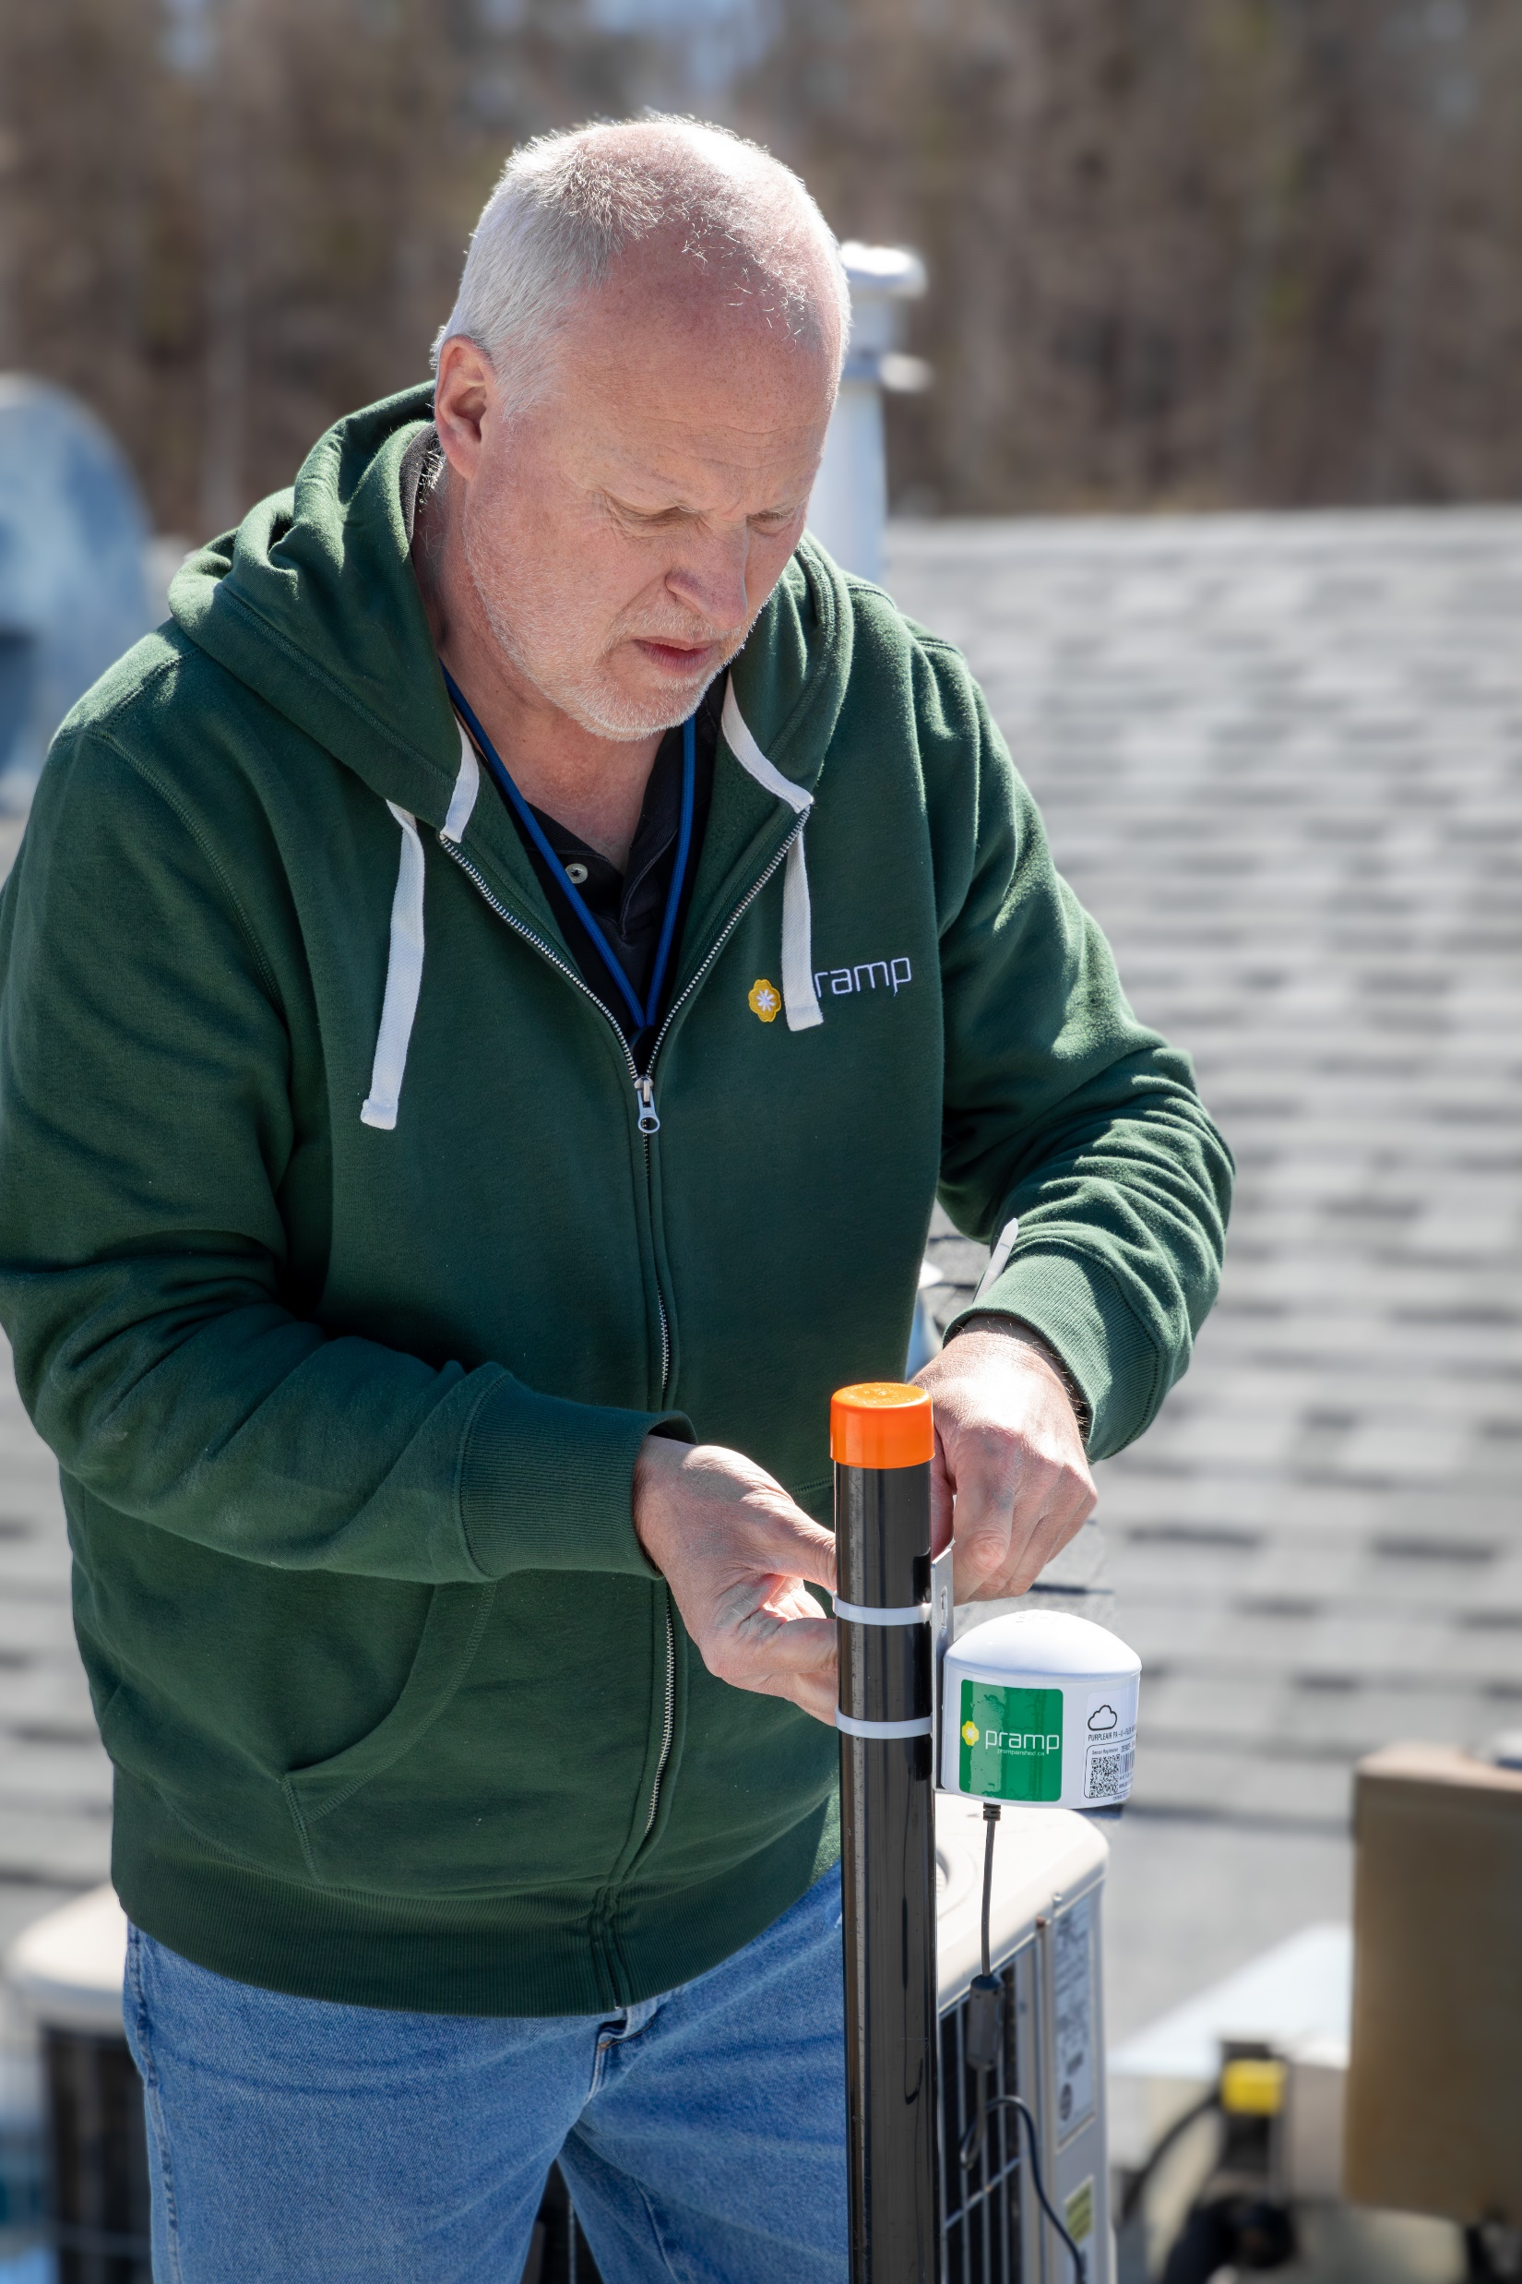
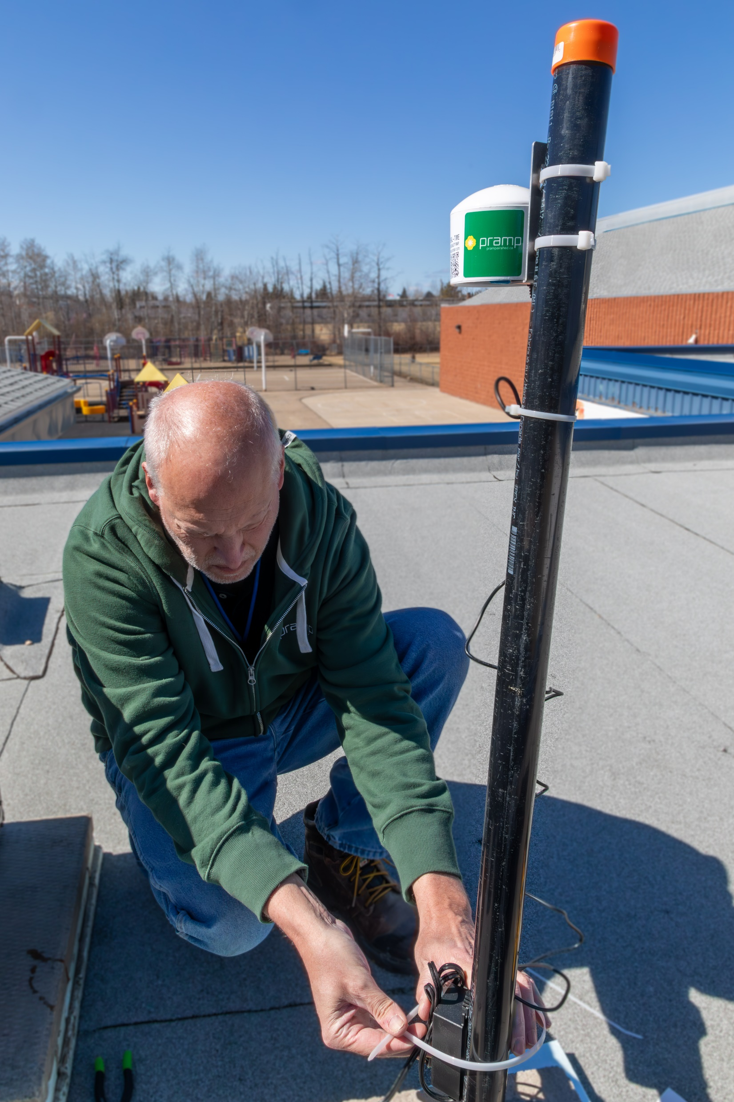

Slide 4
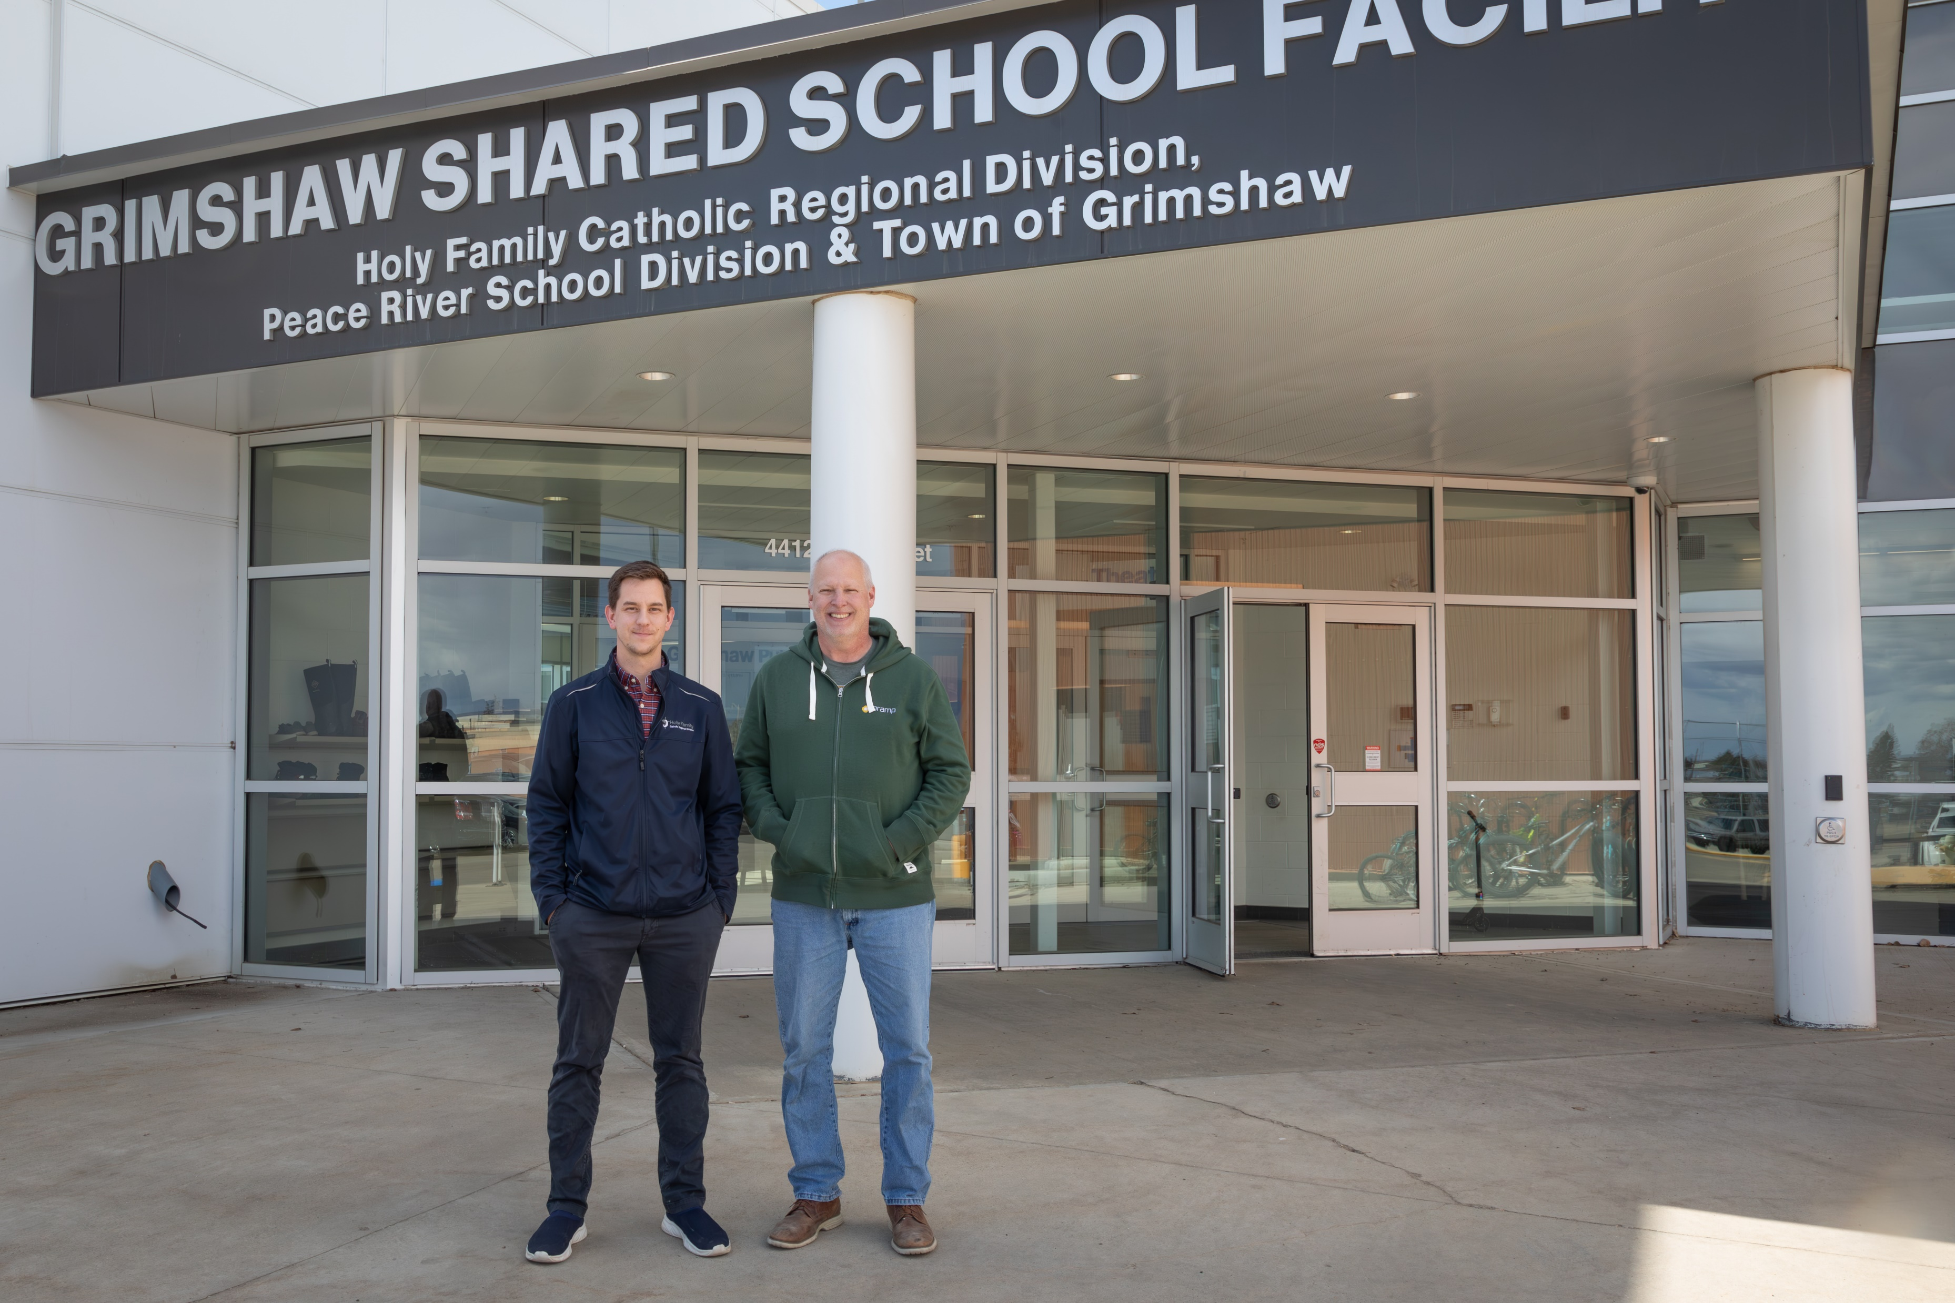

Slide 5
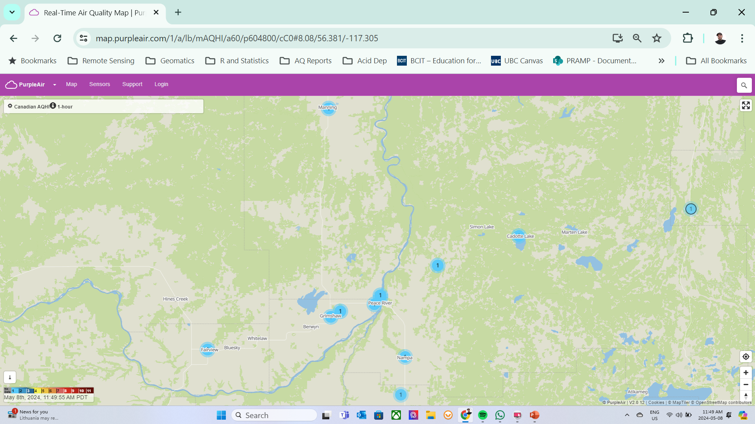

Slide 6
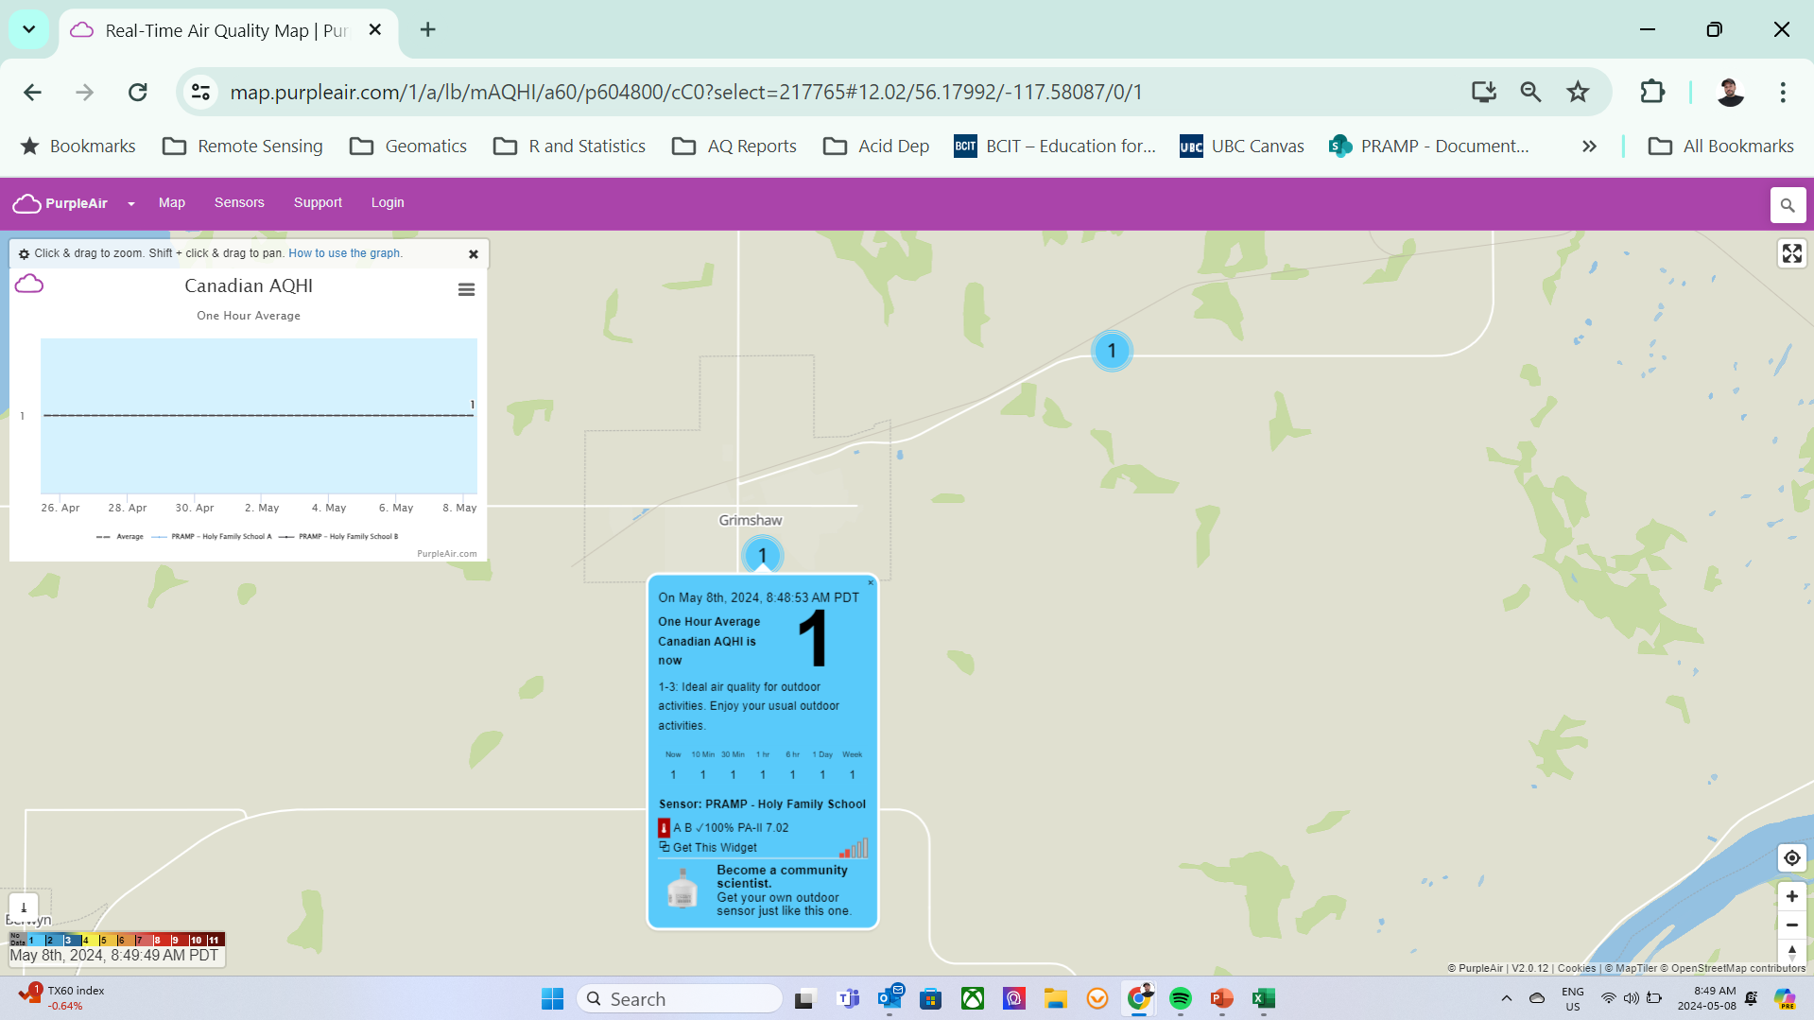

Slide 7
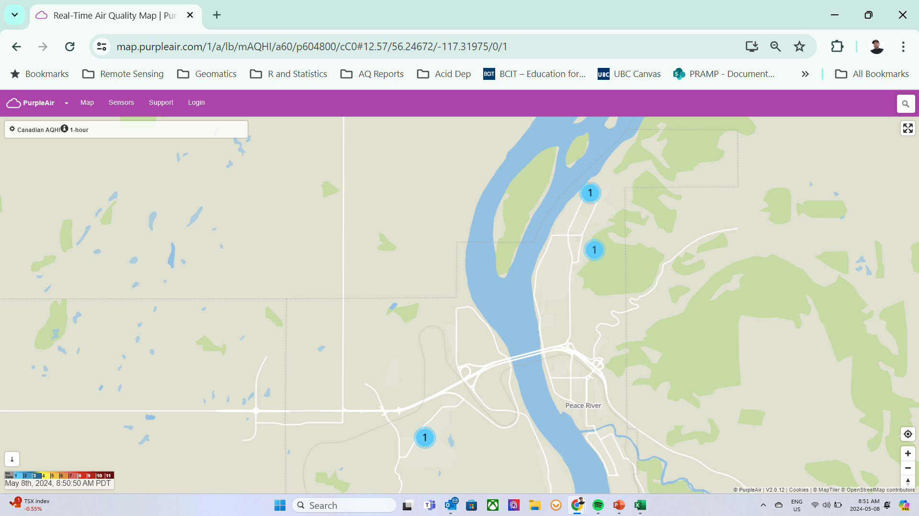

Slide 8
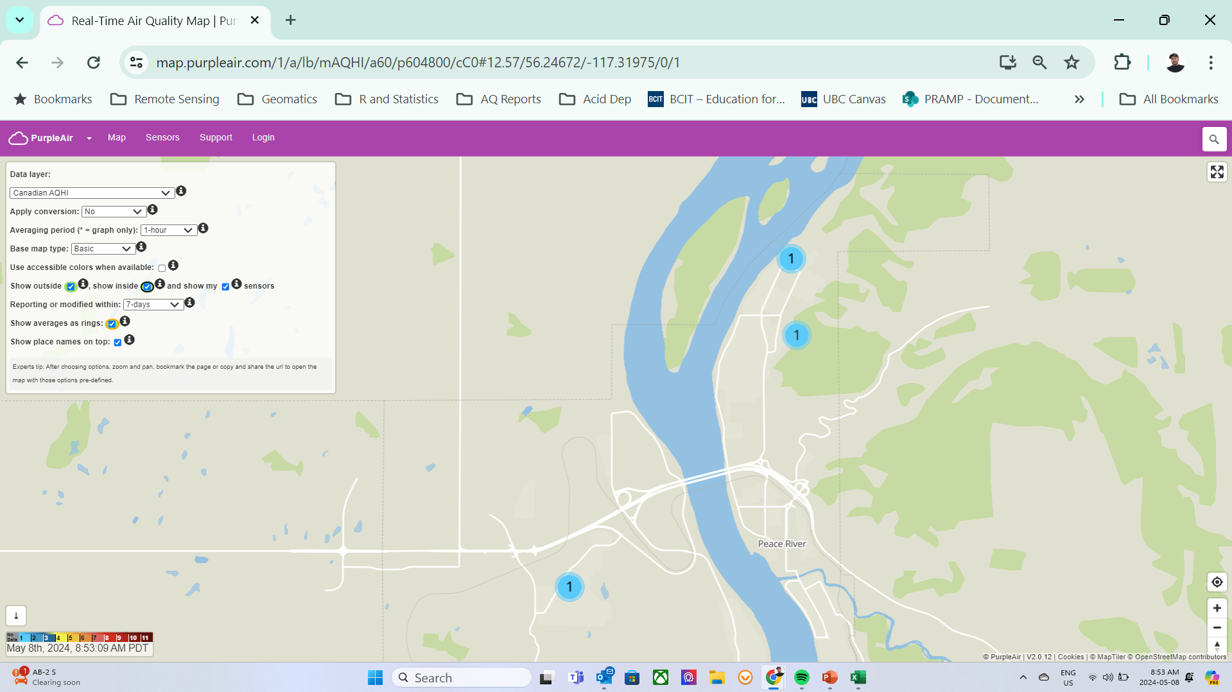

Slide 9
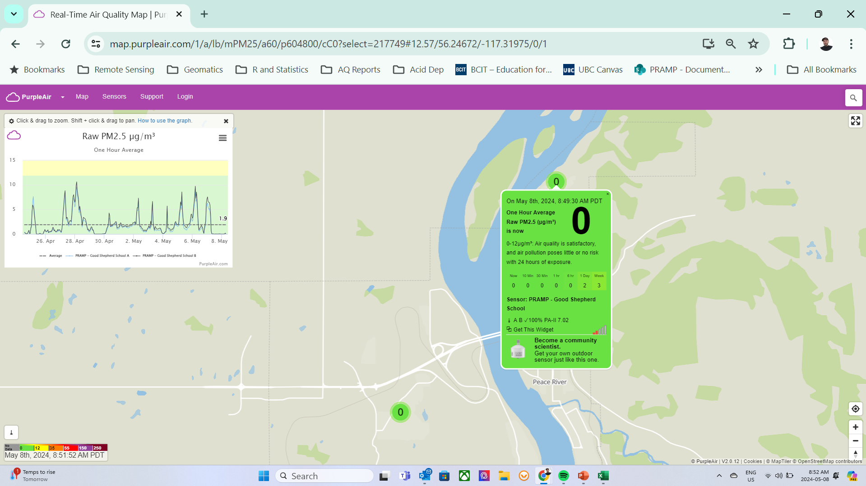

Slide 10
Looking Ahead – Purple Air
Developing new ‘static’ map showing location of all monitoring locations.
Potential integration of sensor-linked AQHI lanterns.
Looking into more schools, Indigenous communities, and population centres for host sites.
Evaluating indoor sensors. Improve our collective understanding of:
The functionality of the sensors in indoor settings.
Potential correlations between data from indoor and outdoor sensors.
Baselines for typical levels of particulate matter in public indoor spaces.

Slide 11
Looking Ahead – Technical
QAP audit follow-up
Annual data review
TWG Meeting (early June)
Terms of Reference
Energy Audit Findings
CNRL Passives
Portable – AQHI Station relocation discussion

