Slide 1
AQHI Lantern Sponsorship
PRAMP Board Meeting
May 8, 2024

Slide 2
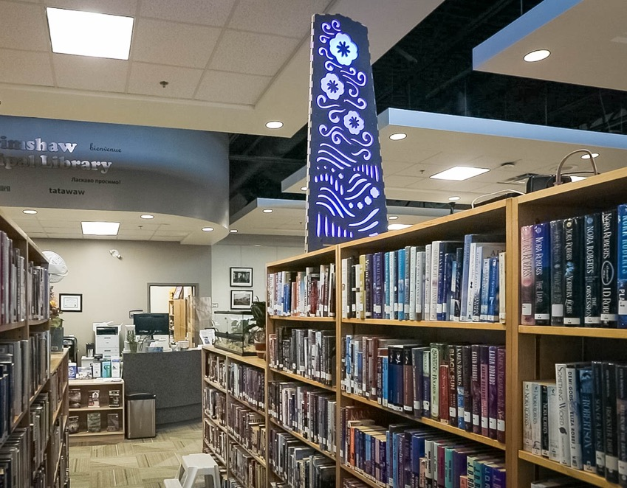
Background
In Feb 2024, the Board indicated an interest in a possible sponsorship program for AQHI lanterns
AQHI lanterns have been well-received
Currently have 4 in the region and 6 more ready to set up in new locations
Notes:
AER Proceeding into Odours and Emissions in the Peace River Area

Slide 3
Criteria for Lantern Locations
Access to reliable power and WiFi
Visible to the public
Set back or in a spot where they are not likely to be jostled
A keen host organization
Distributed throughout the PRAMP region (ideally)

Slide 4
Sponsorship Considerations
Maintaining AQHI lanterns will not be dependent on sponsorship
Sponsorship could be a small revenue stream for PRAMP and would facilitate increasing the number of lanterns and enhancing the program
Table-top lanterns cost ≅ $400*
Maintenance: occasional trouble-shooting; light bulb replacement
*If needed, internet connectivity may be enhanced for an annual fee of $150-$200 per year

Slide 5
Benefits for Sponsor
Plaque or sign acknowledging the sponsor with each sponsored lantern
Visible support for air quality and health awareness
Option to request a location for the sponsored lantern

Slide 6
Sponsorship Cost
Option 1:
$500 per year for 1 lantern
$2000 per year for 5 lanterns
Option 2:
$750 per year for 1 lantern
$2000 per year for 3 lanterns

Slide 7
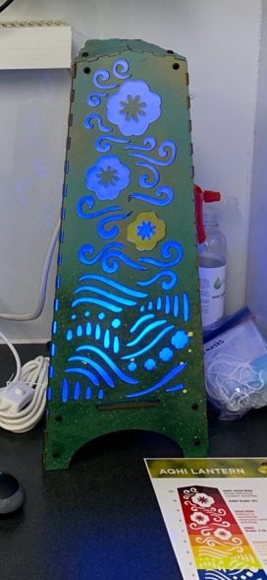
Program Enhancement
PRAMP is working toward having the AQHI lantern able to draw air quality data from PurpleAir sensors
This will allow an AQHI Lantern to show the air quality colour based on a PurpleAir sensor that is very close, rather than from the Portable AQHI Station in Grimshaw

Slide 8
Board Decision
What are the Board’s views on:
Establishing a sponsorship program for AQHI lanterns?
Costs and benefits for a program? (if the Board wants to proceed with a sponsorship program)

