Slide 1
Outreach Update
Board Meeting
May 8, 2024

Slide 2
New Resources
Displays at events
Interactive presentations at schools and organizations
Shared with Alberta Airsheds Council and Airsheds for use across Alberta

Slide 3
Know your air quality and protect your health

Slide 4
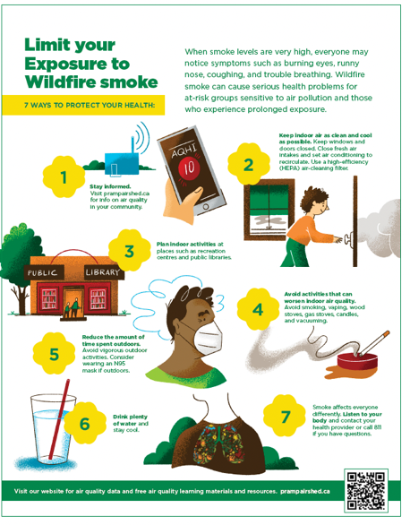
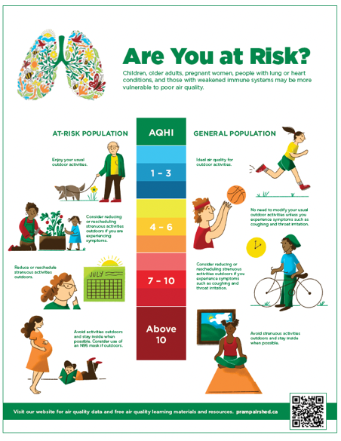

Slide 5
Trade Shows
Peace River, Grimshaw

Slide 6
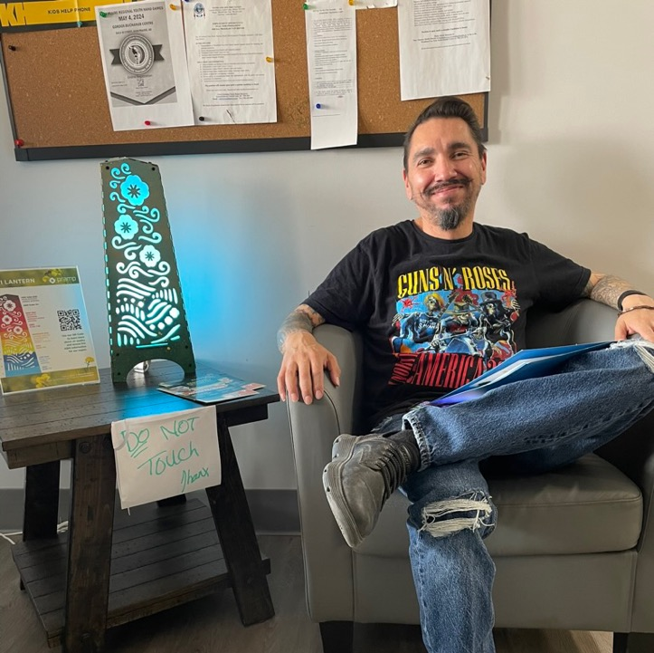
Community Visits
Duncan’s First Nation
Little Buffalo First Nation
Woodland Cree First Nation
Manning
Red Earth Creek

Slide 7
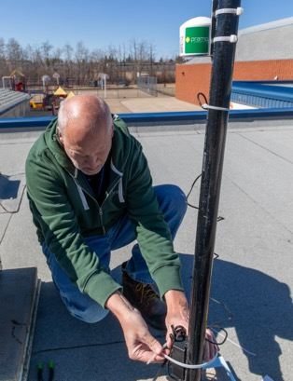
School Partnerships

Slide 8
Sample Slides for New Presentation

Slide 9
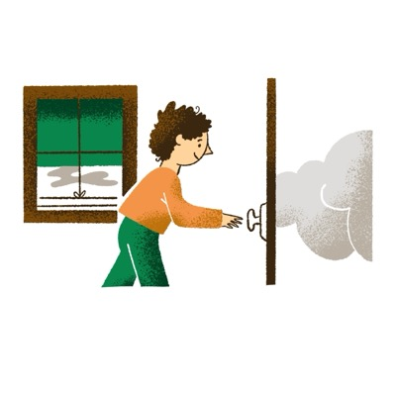
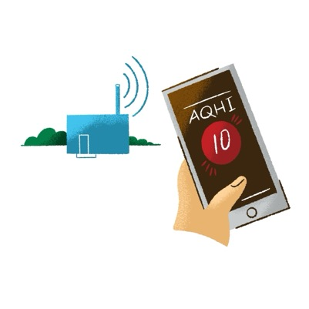
Limit your Exposure to Wildfire smoke
1. Stay informed. Visit prampairshed.ca for info on air quality in your community.
2. Keep indoor air as clean and cool as possible. Keep windows and doors closed. Close fresh air intakes and set air conditioning to recirculate. Use a high-efficiency (HEPA) air-cleaning filter.

Slide 10
4. Avoid activities that can worsen indoor air quality. Avoid smoking, vaping, wood stoves, gas stoves, candles, and vacuuming.
3. Plan indoor activities at places such as recreation centres and public libraries.

Slide 11
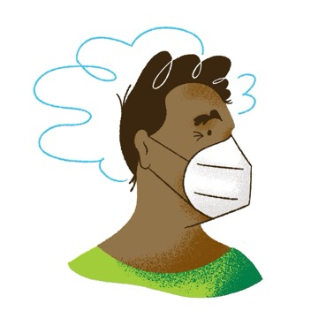
Limit your Exposure to Wildfire smoke
6. Drink plenty of water and stay cool.
5. Reduce the amount of time spent outdoors. Avoid vigorous outdoor activities. Consider wearing an N95
mask if outdoors.
7. Smoke affects everyone differently. Listen to your body and contact your health provider or call 811 if you have questions.

Slide 12
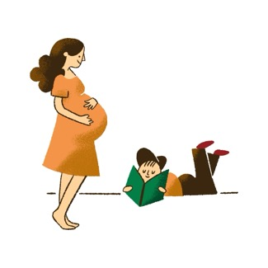
Are you at Risk
Children, older adults, pregnant women, people with lung or heart conditions, and those with weakened immune systems may be more vulnerable to poor air quality.

Slide 13
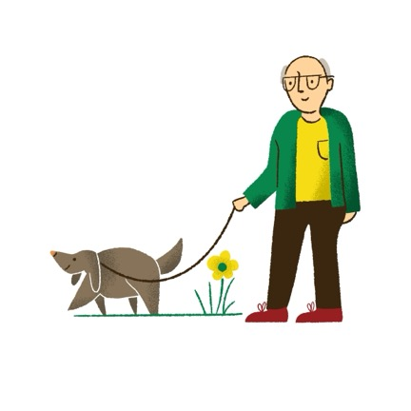
Protect your pet from Wildfire smoke
Limit Exposure
Keep pets indoors as much as possible and provide plenty of fresh water
Keep indoor air clean: close windows and doors, set air conditioning to recirculate, use a HEPA air filter
Avoid activities that worsen air quality: smoking, wood burning, and vacuuming
Limit activities when outdoors

Slide 14
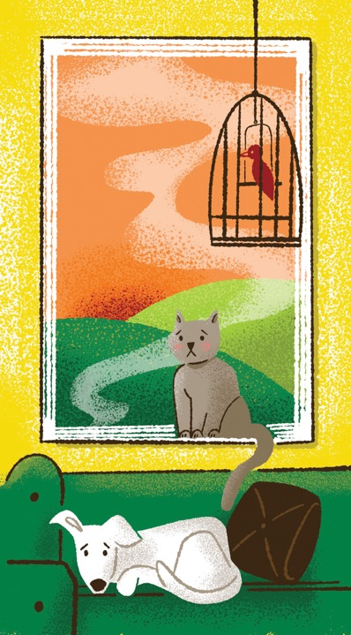
Protect your pet from Wildfire smoke
Know the signs
If your animals have any of these signs, call your veterinarian:
Coughing, gagging
Red or watery eyes, nasal discharge, inflammation of mouth
Trouble breathing
Fatigue, disorientation, uneven gait

