Slide 1
Network Assessment Introduction
Annual General Meeting
September 27, 2022

Slide 2
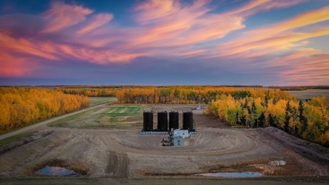
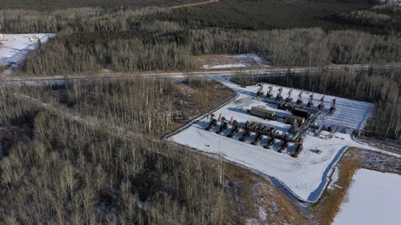
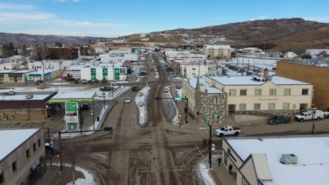
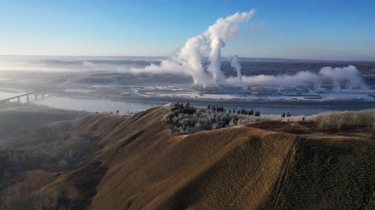
Strategic Planning 2021: Looking Back, Looking Forward

Slide 3
Strategic Planning 2021: New Direction
Three planning discussions were held March, April and May 2021. By consensus, PRAMP decided its future includes the following:
Work with Mercer; assess integration of Mercer monitoring
Conduct a Network Assessment with consideration of:
the level of monitoring appropriate for heavy oil production in light of the current conditions
Optimized integration of Mercer and PRC monitoring activities
Continued use of micro-sensors

Slide 4
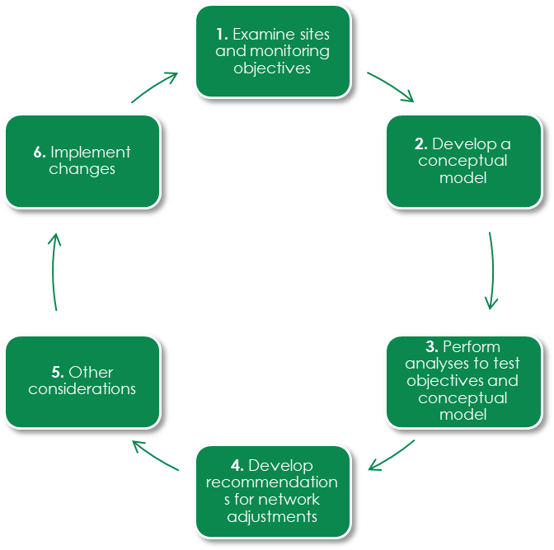
Network Assessment: Big Picture
Are we monitoring:
the appropriate suite of parameters?
at suitable locations?
at an acceptable frequency?
for the right duration?
using the best methods?
with the correct technology?
Continuous Improvement
& Adaptive Management

Slide 5
Network Assessment: Design Considerations
US EPA Network Assessment Guidance Document
PRIMARY MONITORING OBJECTIVES
data trends, spatial distribution, community monitoring needs, cumulative effects
SECONDARY MONITORING OBJECTIVES
air quality management obligations, modeling and remote sensing, regulatory compliance, transboundary transport, source identification
Emerging Issues for PRAMP
TIER ONE
The change in regional air quality, regional air quality improvements, AER Directive 84
TIER TWO
Optimized integration of Peace River Complex monitoring program
Optimized integration of Mercer Peace River Mill monitoring program
TIER THREE
Consideration of air quality monitoring‐deficient areas adjacent to PRAMP.
New technologies, including micro‐sensors.

Slide 6
Network Assessment: Design Considerations
US EPA Network Assessment Guidance Document
PRIMARY MONITORING OBJECTIVES
data trends, spatial distribution, community monitoring needs, cumulative effects
SECONDARY MONITORING OBJECTIVES
air quality management obligations, modeling and remote sensing, regulatory compliance, transboundary transport, source identification
Emerging Issues for PRAMP
TIER ONE
The change in regional air quality, regional air quality improvements, AER Directive 84
TIER TWO
Optimized integration of Peace River Complex monitoring program
Optimized integration of Mercer Peacer River Mill monitoring program
TIER THREE
Consideration of air quality monitoring‐deficient areas adjacent to PRAMP.
New technologies, including micro‐sensors.

Slide 7
Network Assessment: Priority Areas
PRAMP prioritized the monitoring objectives and emerging issues as follows:
Priority 1: Tier One Emerging Issues
Priority 2: Tier Two Emerging Issues
Priority 3: Primary Monitoring Objectives, Secondary Monitoring Objectives, Tier Three Emerging Issues.
This prioritization was intended to help inform the amount of time and resources allocated to evaluating each of the priority areas.

Slide 8
Network Assessment: Project Administration
The network assessment
is being conducted by a qualified 3rd party
is a project of the Technical Working Group (TWG); the TWG provides input and guidance over the life of the project.
is managed by PRAMP staff
There has been input from external organizations as needed.
Board of Directors is responsible for decisions related to
evaluation of network assessment recommendations,
implementation strategy for network assessment recommendations, and;
financial matters.

Slide 9
Network Assessment: Timeline
Nov 10, 2021 Network Assessment project introduced to TWG.
Nov 23, 2021 TWG provides feedback project plan.
Dec 1, 2021 Board of Directors approves project plan and budget.
Dec 17, 2021 Request for proposal is approved by TWG.
Jan 11, 2022 Request for proposal is released, posted, and distributed.
Jan 24, 2022 Proposals received, staff begin screening.
Feb 4, 2022 TWG makes recommendation to BoD, contract awarded.
Feb 14, 2022 Project kickoff with consultant.
Spring 2022 Priority 1 & 2 assessment results presented to TWG
Summer 2022 Priority 3 assessment results presented to TWG
September 27 Network Assessment is presented at PRAMP AGM
October 2022 Network Assessment Report is Finalized
Fall 2022 Begin implementation planning

Slide 10
Network Assessment: Today
Presentation of:
“Peace River Area Monitoring Program (PRAMP) - Air Quality Monitoring Network Evaluation”
​Network Assessment results and recommendations
Are there any other factors that should be considered in the assessment?

