Slide 1
Technical Working Group
April 14, 2022 Meeting

Slide 2
2.0 Standing Business

Slide 3
2.1 Administration and Planning
OSM Planning Process for 2022-23

Slide 4
2.2 Continuous Monitoring Program
Review Dashboard Reports

Slide 8
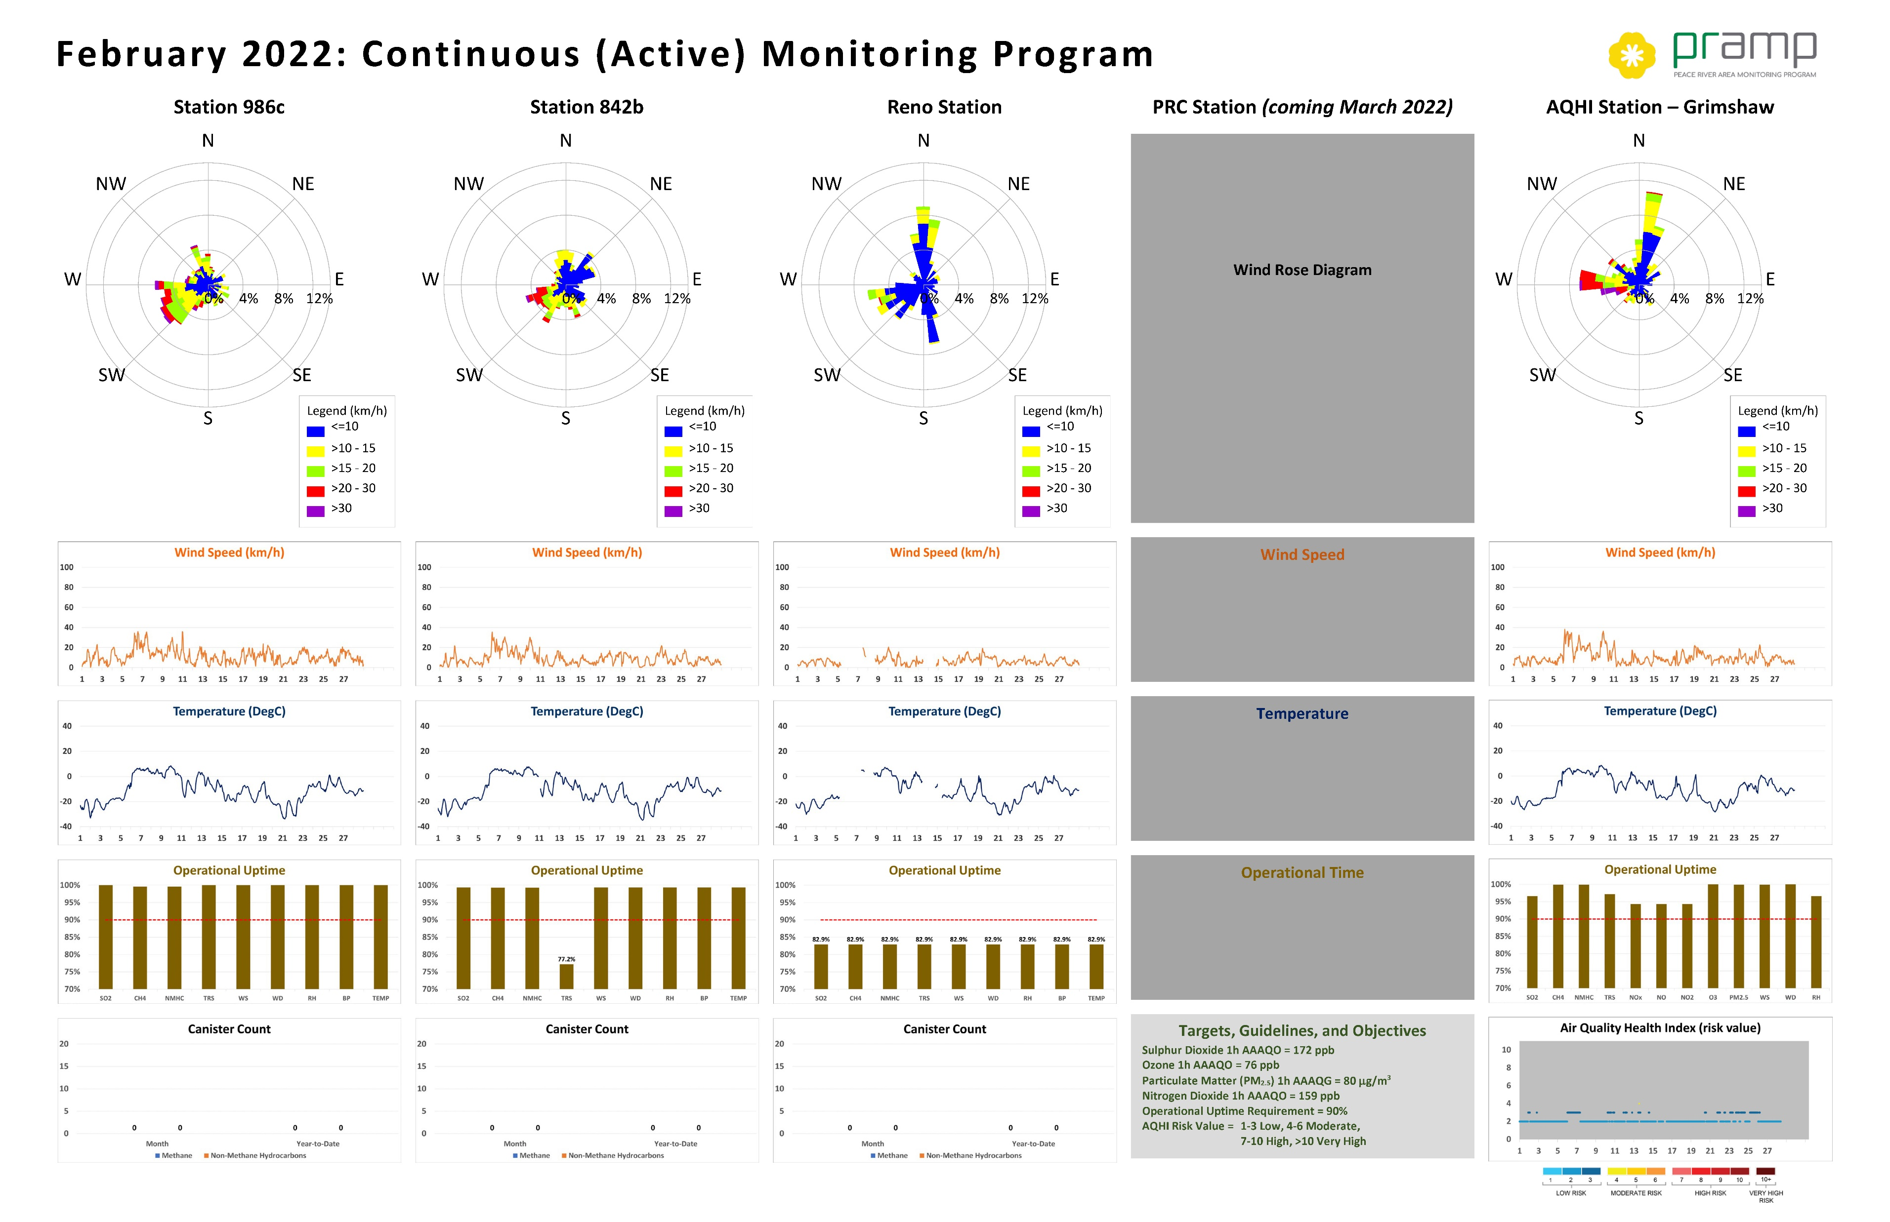

Slide 9
Reno Deployment
Licence of Occupation nearly complete – final review
Site preparation scope defined and agreed to by landowner
ATCO Proposal for power upgrade received
Anticipating early- to mid-May site preparation completion with station operational in late May

Slide 10
3.0 New Business

Slide 11
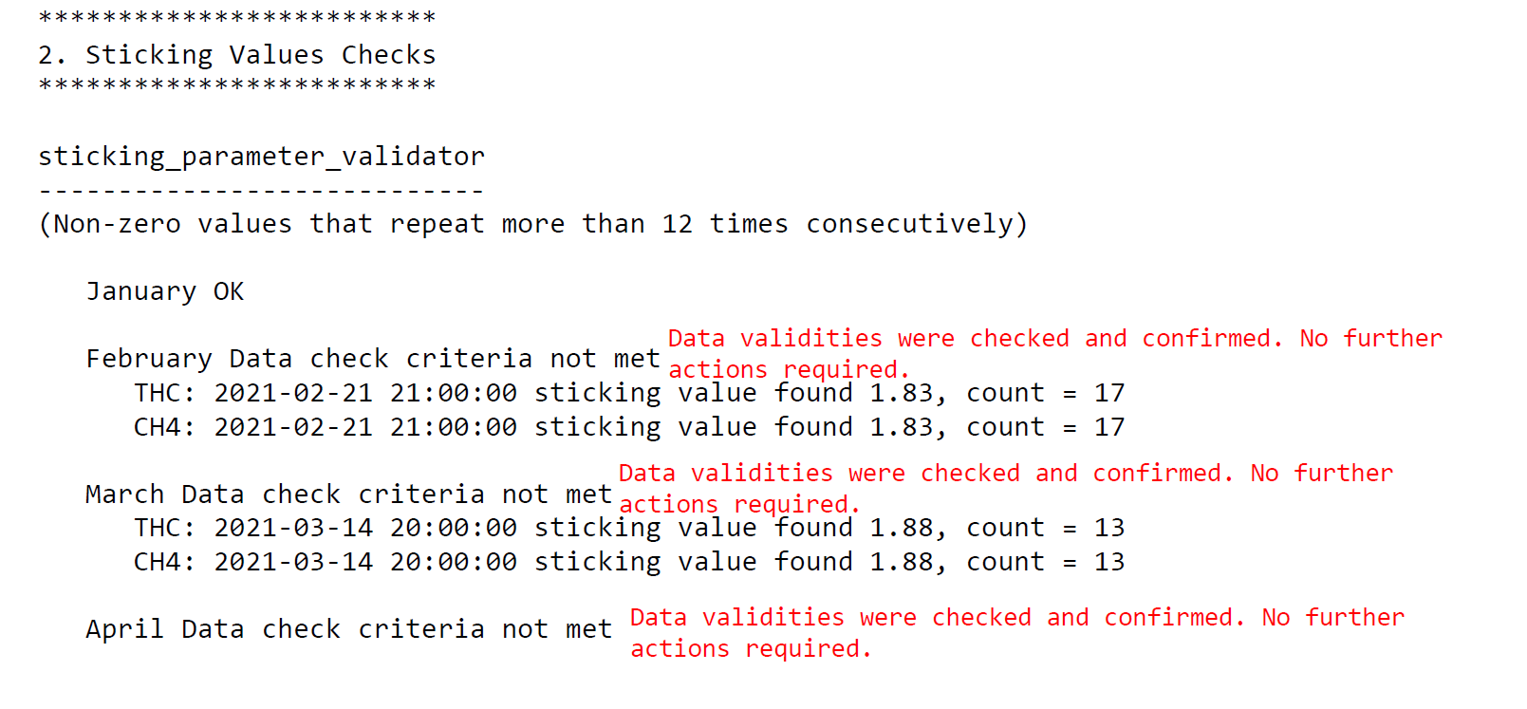
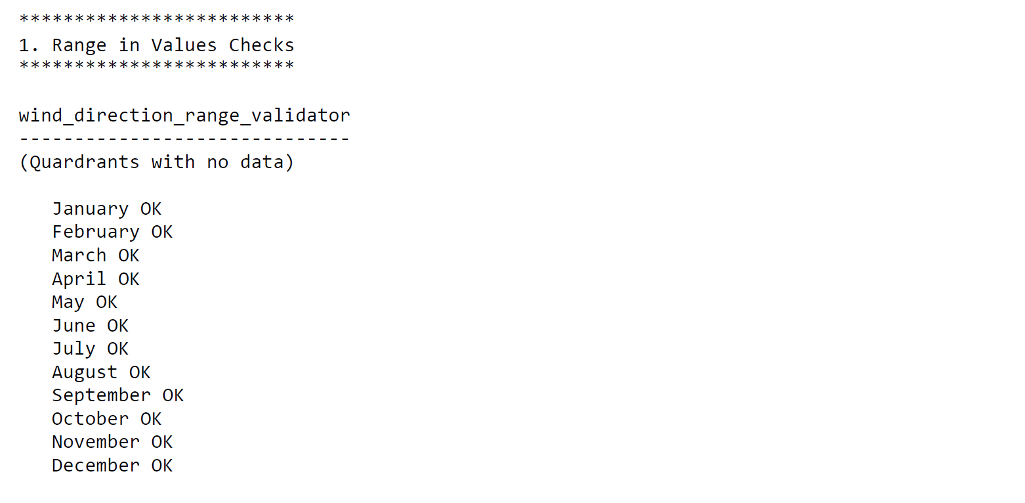
3.1 Project: 2021 Annual Data Review
Examples from Reno 2021 Data Set

Slide 12
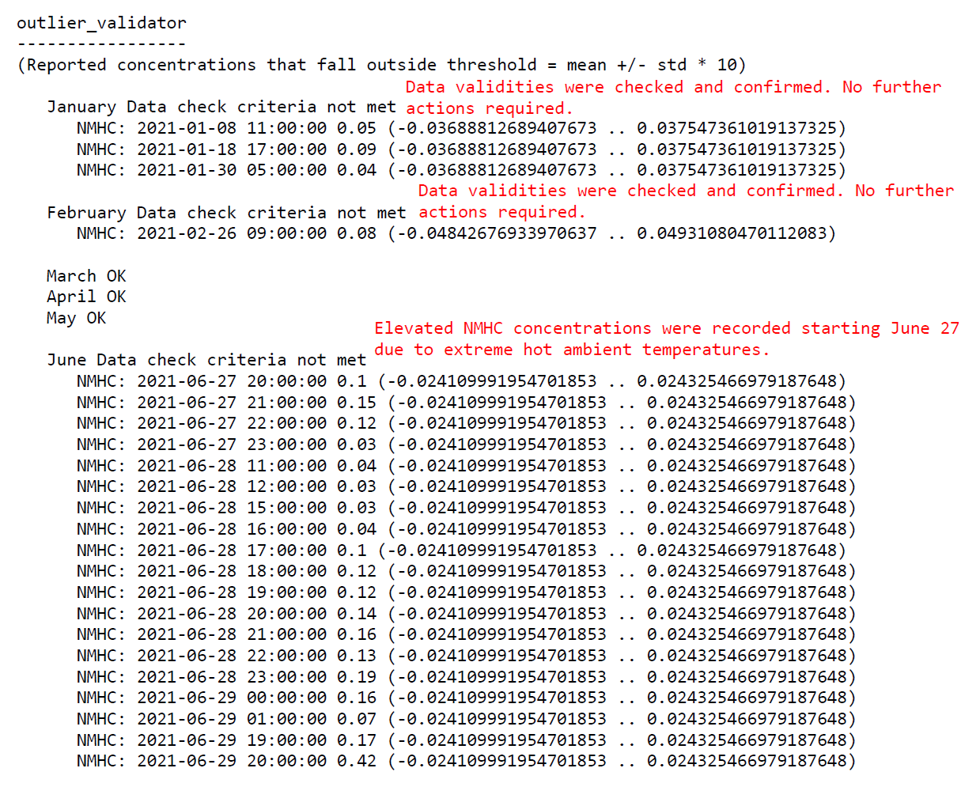
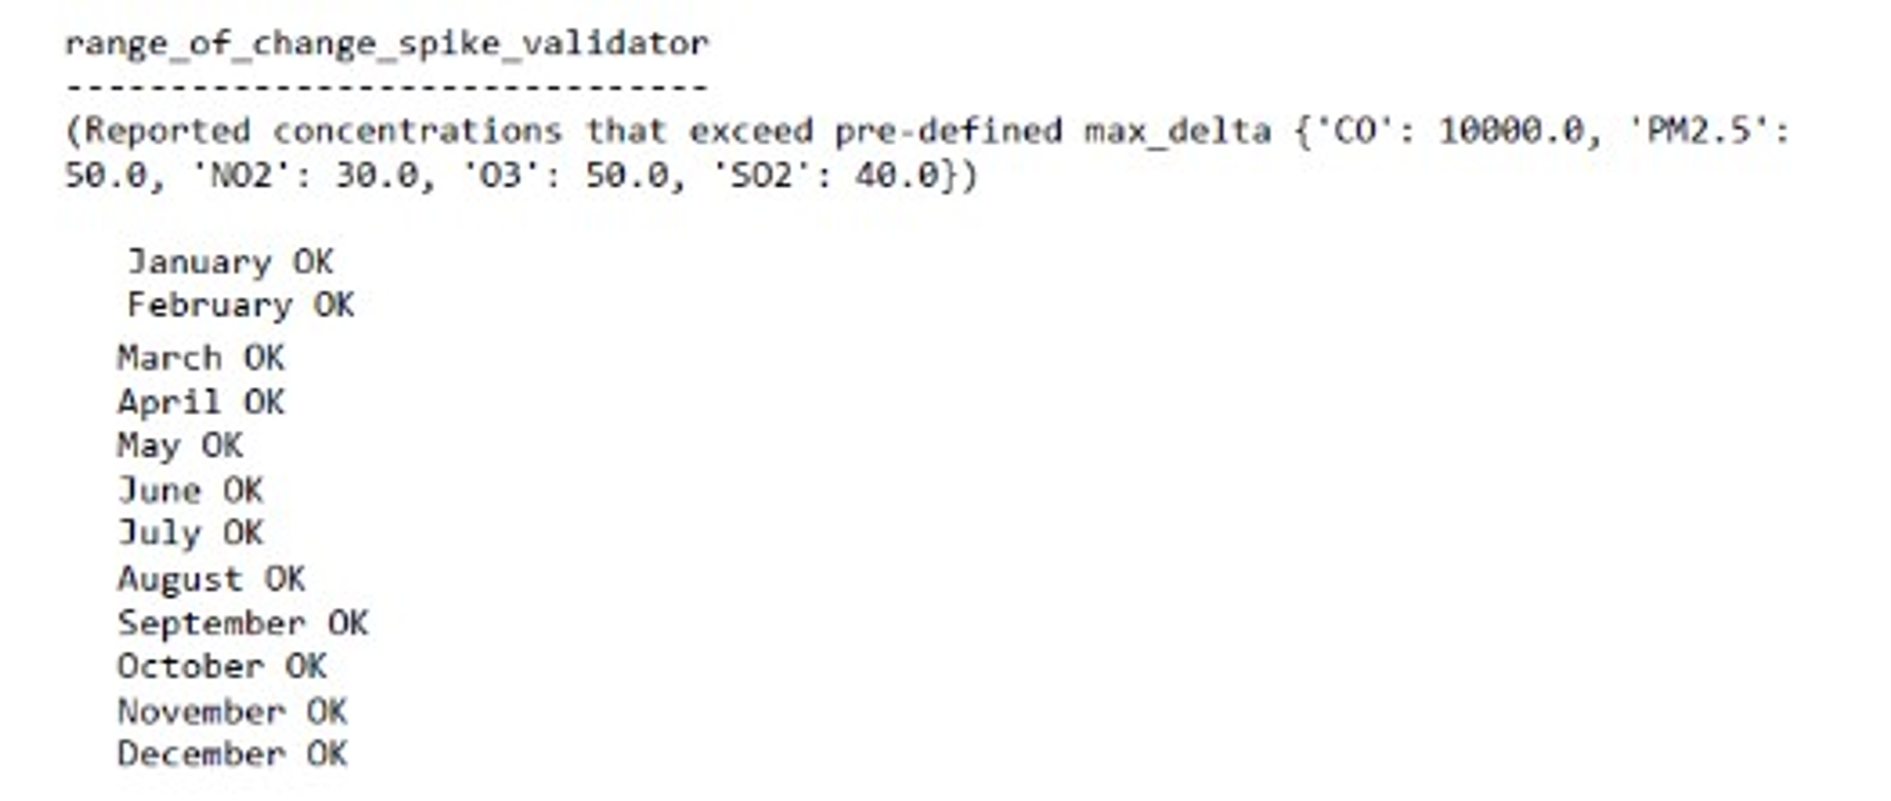
Examples from 986c 2021 Data Set

Slide 13
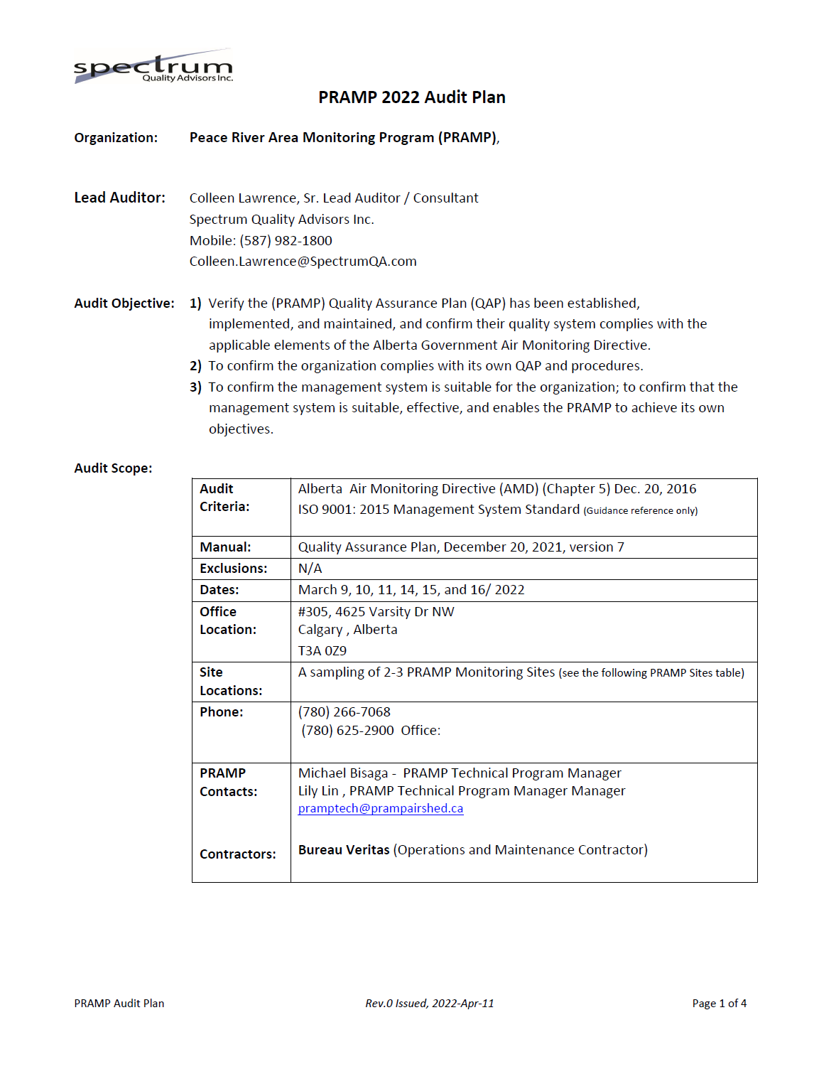
3.2 Project: Quality Assurance Plan Audit

Slide 14
3.3 Project: Network Assessment - Phase One

