Slide 1
2018-2019: Annual Data Review Highlights
PRAMP Board of Directors Meeting
July 16, 2020

Slide 2
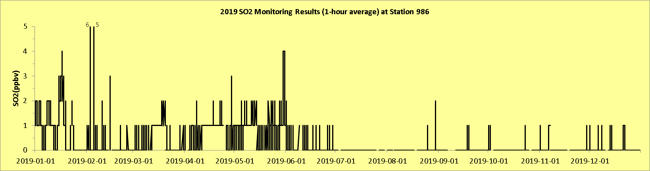
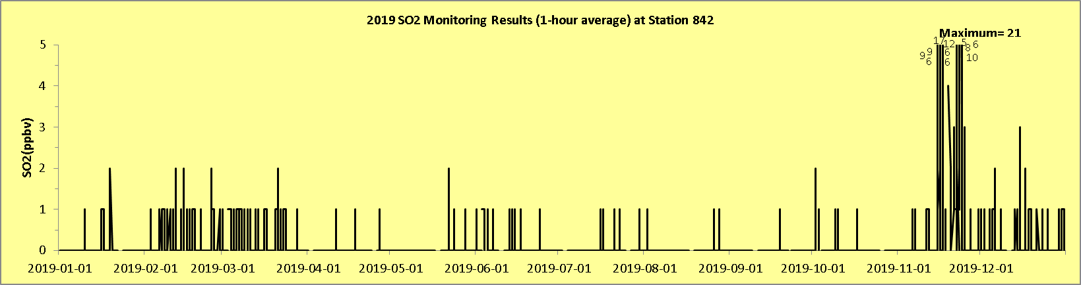
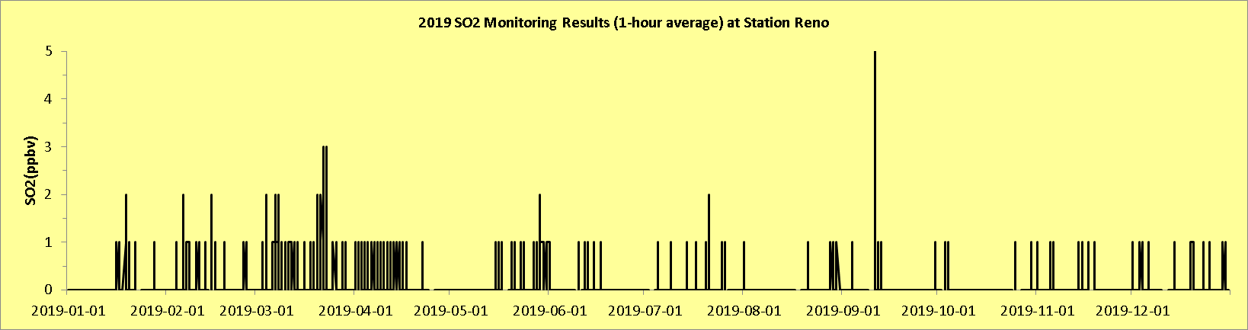
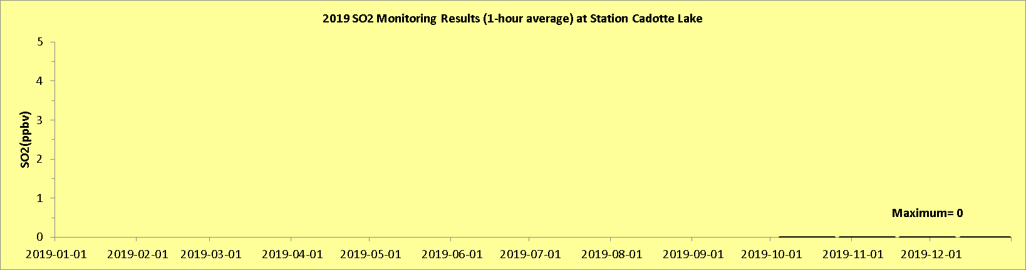
Sulphur Dioxide: 2019
All locations: Concentrations remain low.
1-hour Ambient Air Quality Objective: 172 ppb

Slide 3
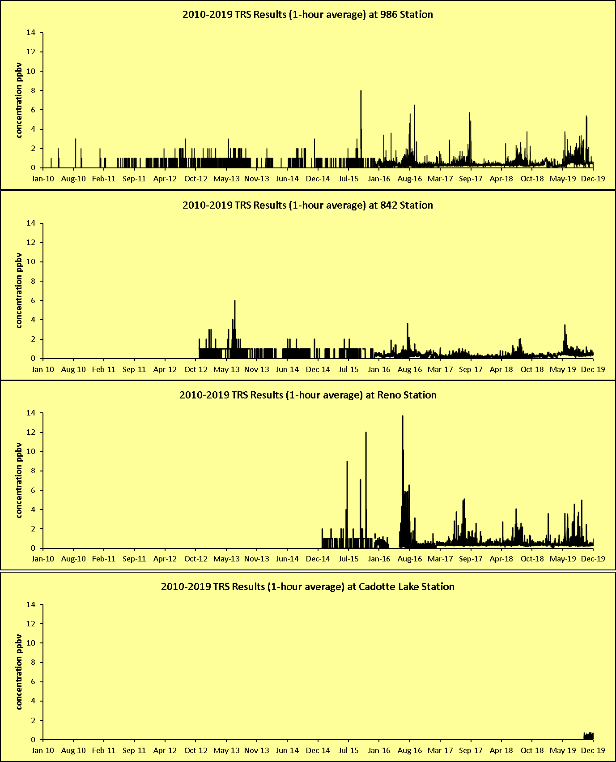
Total Reduced Sulphur Compounds: Historical
Concentrations remain low relative to historical measurements

Slide 4
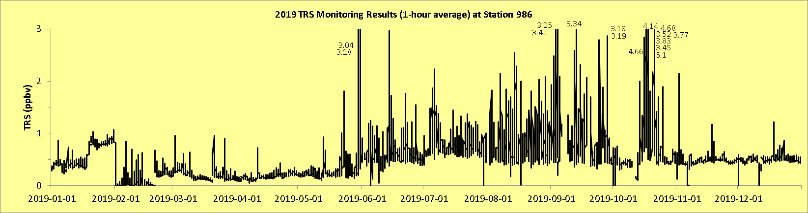
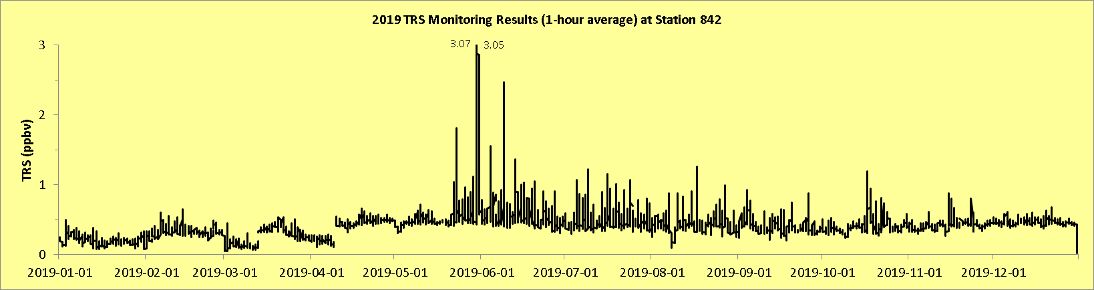
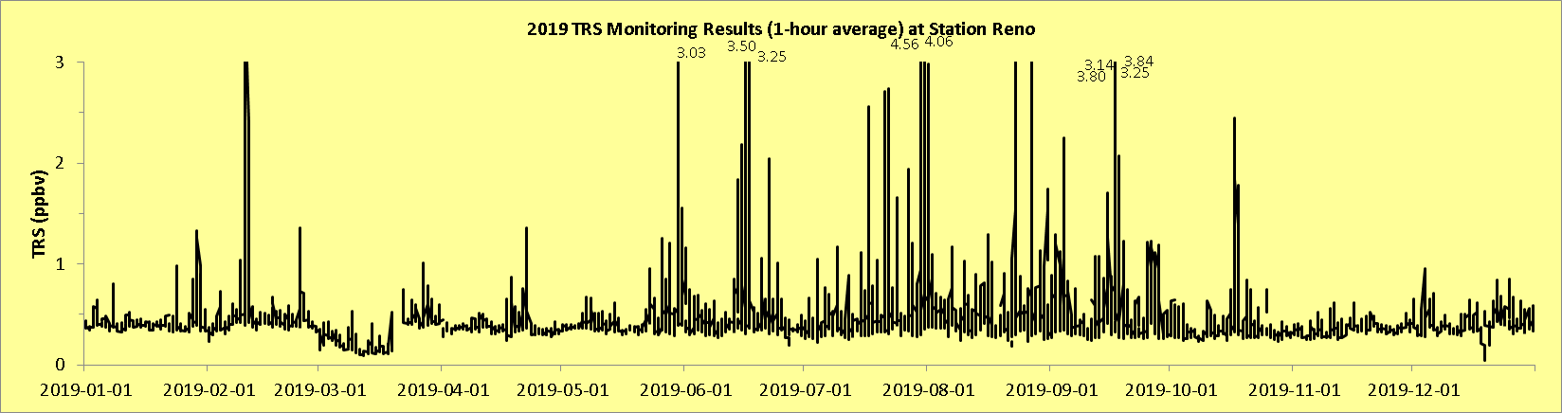
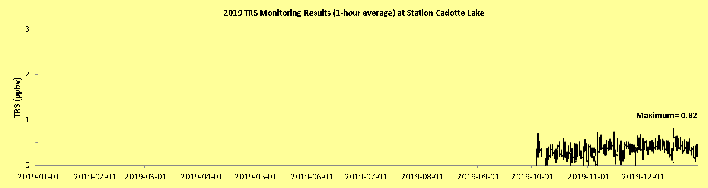
Total Reduced Sulphurs: 2019
986, 842, Reno: The slight increase in maximum concentrations that started in about May, decreased by the end of 2019

Slide 5
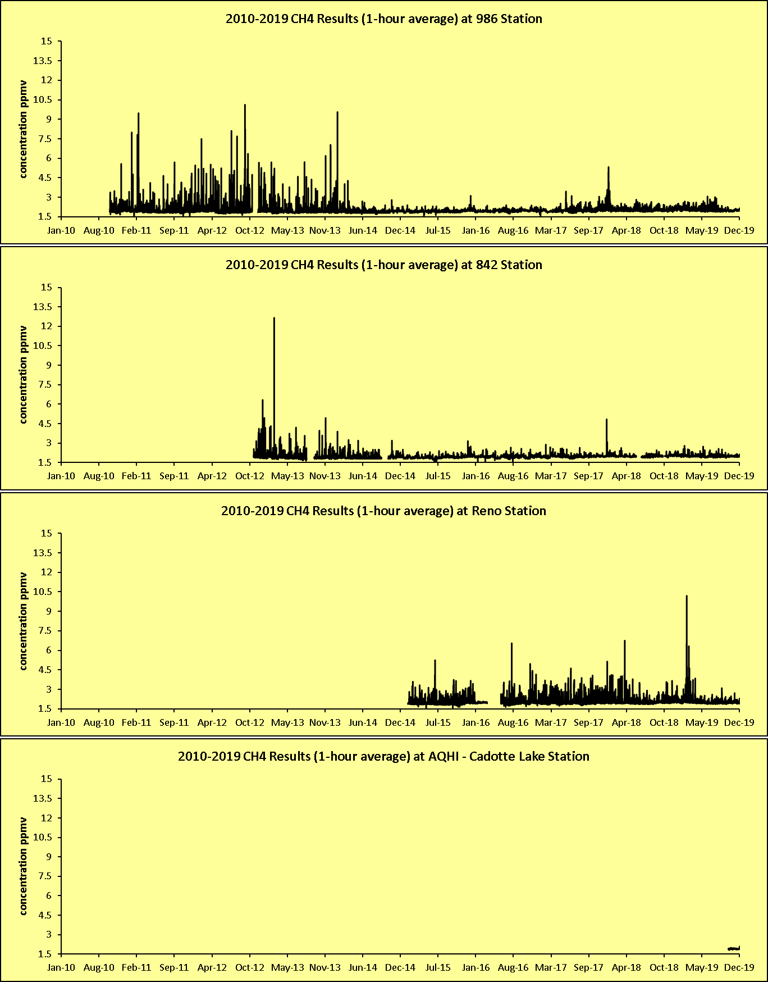
Methane: Historical
Concentrations remain low relative to historical measurements
Notes
  Elevated readings in February 2019 at Reno
  Change in concentrations at 986 after move
  Very low concentrations at Cadotte Lake relative to the other stations in the network

Slide 6
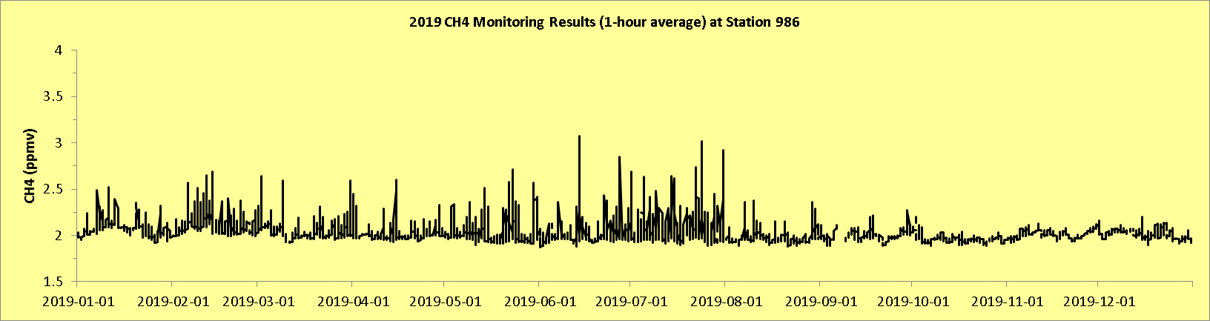

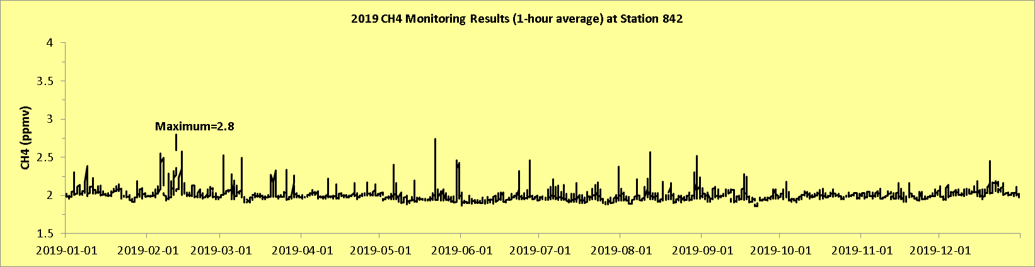
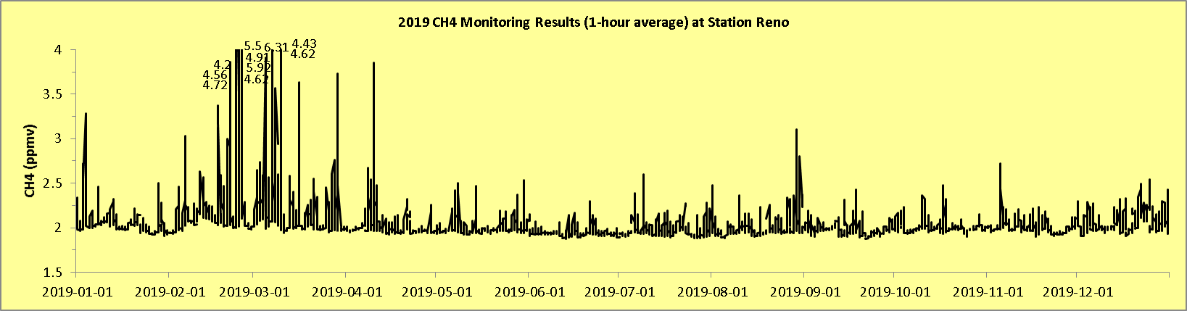
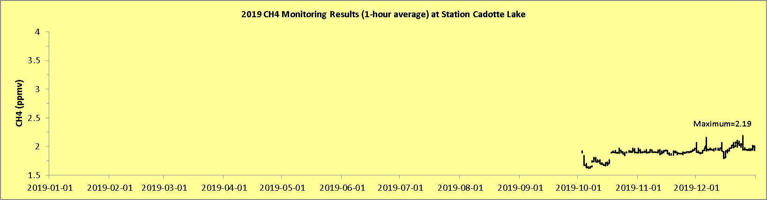
Methane: 2019
986: Drop in concentrations after move (August 2019). New site is more open; nothing impeding air flow. No cows.
842: Remains consistently low.
Reno: Elevated concentrations in February 2019 at Reno may be related to rapid temperature drop
Cadotte Lake: Consistently low.

Slide 7
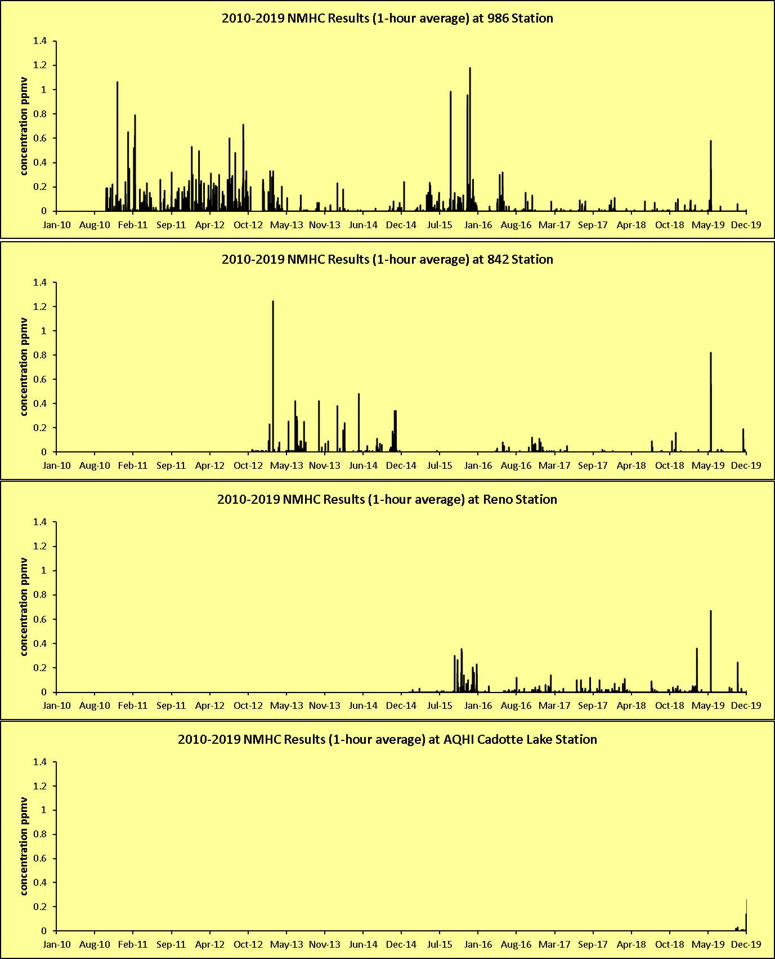
Non-Methane Hydrocarbons: Historical
Concentrations remain low relative to historical measurements

Slide 8
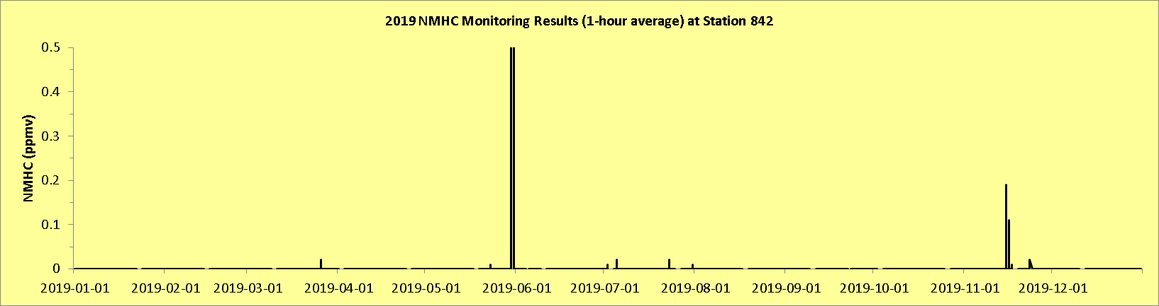
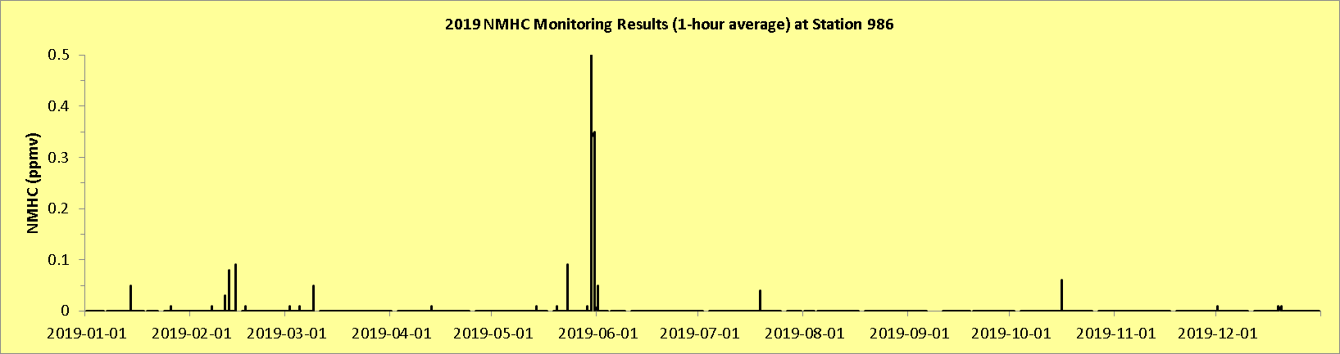
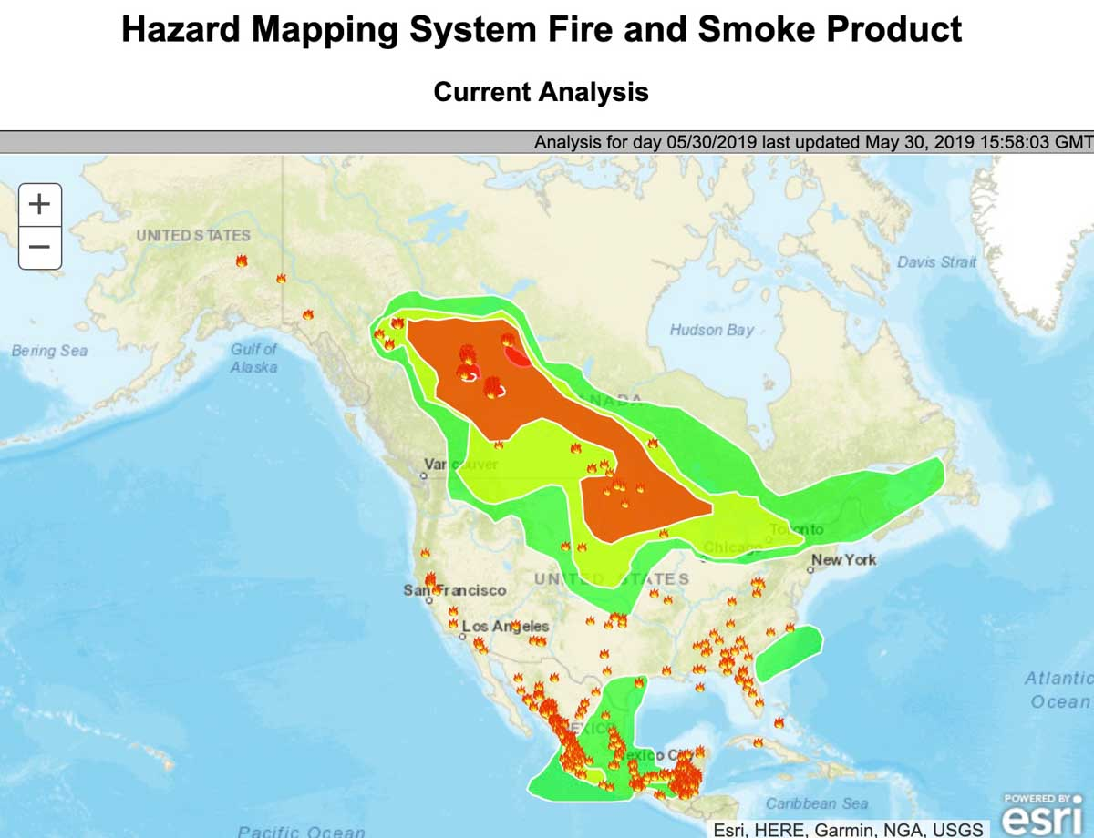
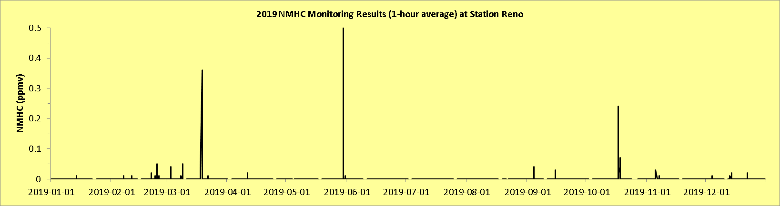
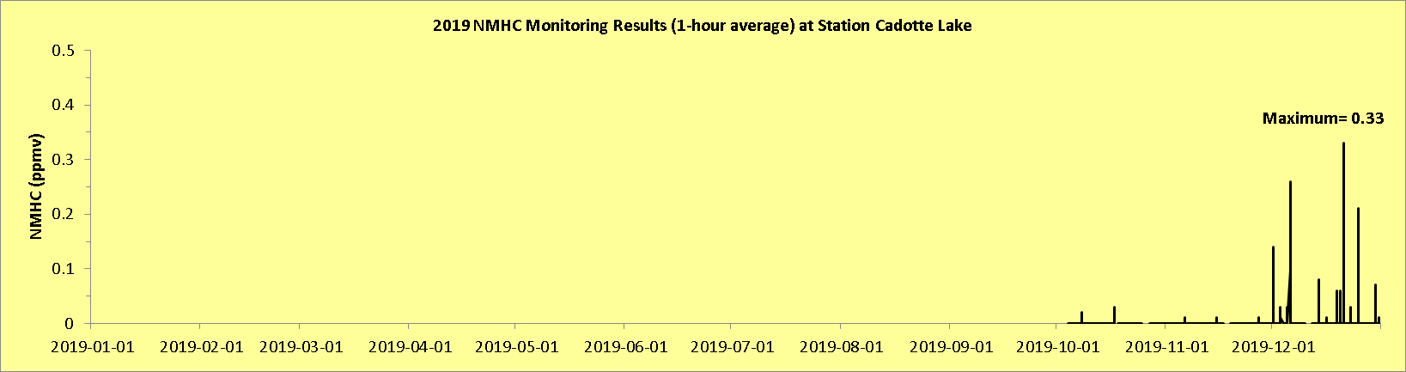
Non-Methane Hydrocarbons: 2019
986, 842, Reno: Region-wide spikes in May 2019 coincide with Chuckegg Creek Wildfire
Cadotte Lake: intermittent spikes

Slide 9
Notes
Missing complaints data. Commencing formal data request.
Canisters
  2018: 3 NMHC Collected
  2019: 9 NMHC Collected
Consolidated facilities map

