Slide 2
2.1 Annual Data Review
Two rounds of review completed by the TWG
Any feedback from the Board?
Decision: Approval of Annual Data Review 2016-17
Next Steps
  EMSD Review and ‘Approval’

Slide 3
2.2 Canister Sampling Program
Update on Implementation of Methane Based Triggers
  Additional canister system will run in parallel with current NMHC program
  Carbon isotope analysis will be completed on samples collected using the new methane trigger
  Sample chain of custody forms, and canister sampling protocol have been modified to capture the new regime
  Awaiting confirmation of laboratory logistics

Slide 4
2.3 New Station
“Portable” station locating procedure (highlights):
  Sections
    Usage Guidelines
    Scheduling
    Location Intake
    Site Selection Approval Process
    Decision Criteria
    Public Engagement
    Scoring Guide
  The Portable station will be placed in a single location for a minimum period of 18 months initially. This timing will be reviewed once a track record for deployment and use of the portable has been established.
  Public Engagement
    On line survey that can be accessed via PRAMP’s website.
    Meetings in or near communities that do not have a continuous air monitoring station.
    Opportunity for written input from community organizations such as Agricultural Societies and municipalities.

Slide 5
Score Criteria | 0 | 1 | 2 | 3 | 4
Spatial data Gap | Data exists from that location | Data exists from a location <5km away | Data exists from location nearby: 5 to 10 km away | Data exists from location nearby: 10 to 20km | No continuous data exists from a nearby location
Temporal data gap | Recent data exists < 1yrs ago | Recent data exists < 3yrs ago | Data exists but is dated 3-5 yrs. ago | Data exists but is dated >5 yrs. ago | No continuous data exists at location
Transboundary | Not near a PRAMP boundary ~25km Significant local sources present Site not representative of incoming air mass | Not representative of a boundary, i.e. localized sources will likely confound the data | Within 20 km of a PRAMP boundary Limited local sources, low impact or moderate frequency expected | Within 10 km of a PRAMP boundary Very representative of a boundary air mass Possibility of occasional impact from local sources | Within 5 km of a PRAMP boundary No significant local sources
Population exposure | No one lives within 0.5 km of proposed monitoring site or identified source | One or 2 families live within 0.5 km of proposed monitoring site or identified source | 2 to 10 families live within 0.5 km of proposed monitoring site or identified source | 10-40 families line within 0.5 km of proposed monitoring site or identified source | >50 families live within 0.5 km of proposed monitoring site or identified source
Respond to issues identified by “public” (not a member of PRAMP) | No issue identified Capability to address the issues identified cannot be addressed with current capability/analyzer complement or realistically added. No action can be taken regardless of monitoring findings (i.e. PRAMP has no influence on decision makers) | Other parameters needed to address issue can be added with significant cost to PRAMP or funding is unlikely from other sources for additional parameters | Identified by some residents (i.e. one family) Relatively new Issue with minimal impact, has only recently appeared on PRAMP radar Other parameters needed to address issue can be added with some cost to PRAMP Some consequences to not addressing it If source is identified, some likely hood action will be taken | Issue identified by group of residents or several complaints to AEP, local councils Other parameters needed to address issue can be added with likely or promised funding from other sources | Issue identified by an NGO, or government body Has been ongoing for some time, PRAMP has previously not been able to address it or it has escalated recently Potentially serious, concerning/damaging Damaging to public perception if not addressed Issue can be directly addressed once monitoring data is available
Response to Issues identified by PRAMP | No issue identified Capability to address the issues identified cannot be addressed with current capability/analyzer complement or realistically added. No action can be taken regardless of monitoring findings (i.e. PRAMP has no influence on decision makers) | PRAMP is pre-emptive and thinks this may become an issue Other parameters needed to address issue can be added with significant cost to PRAMP or funding is unlikely from other sources for additional parameters | Relatively new Issue with minimal impact, has only recently appeared on PRAMP radar Other parameters needed to address issue can be added with some cost to PRAMP Some consequences to not addressing it If source is identified, likely hood action will be taken | Other parameters needed to address issue can be added with likely or promised funding from other sources | Has been ongoing for some time, PRAMP has previously not been able to address it or it has escalated recently Potentially serious, concerning/damaging Damaging to public perception if not addressed Issue can be directly addressed once monitoring data is available

Slide 6
TWG recommendation on station name
  Portable, but not in name!
  “Air Monitoring Station”
Update on station construction and potential sites

Slide 7
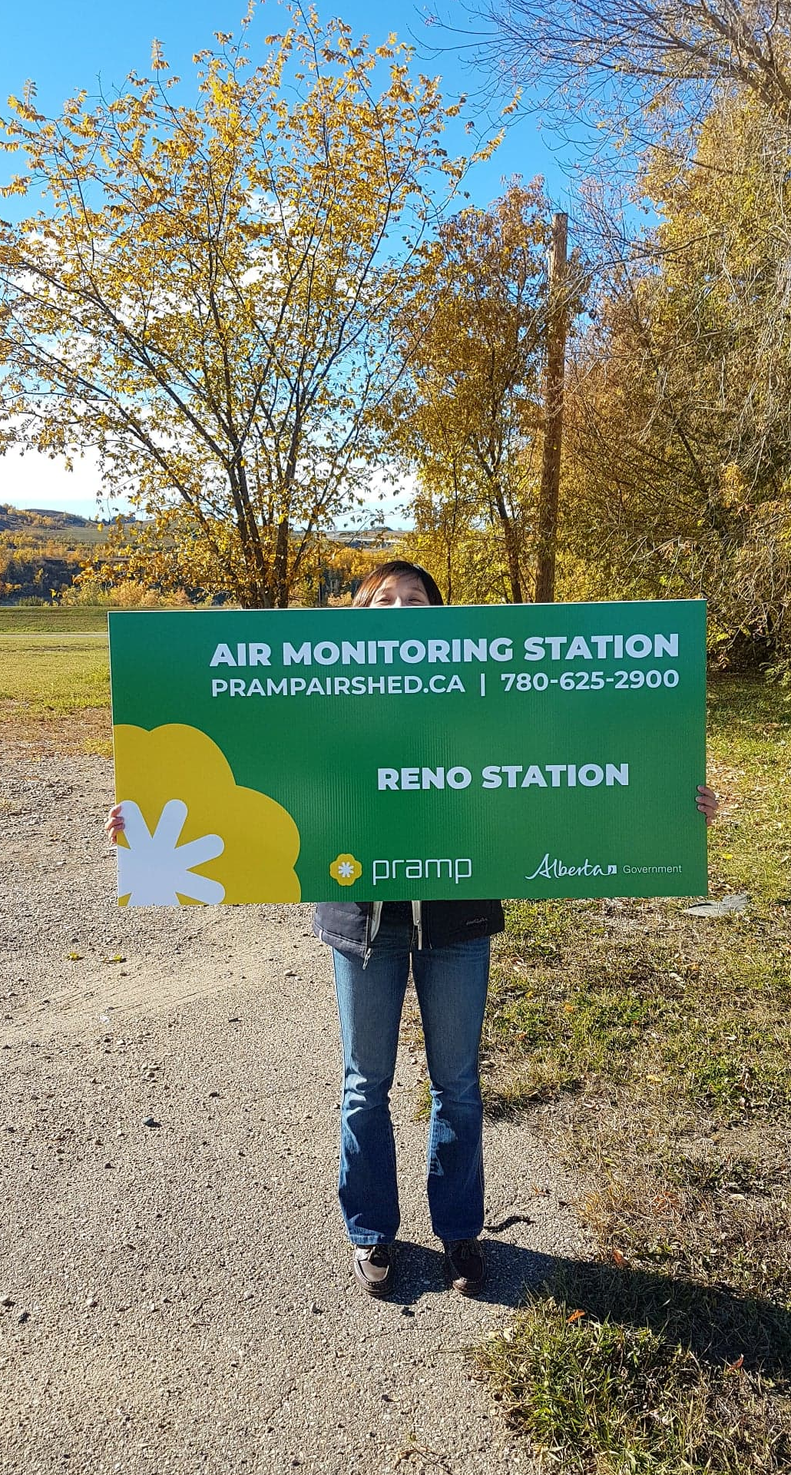

Slide 8
Decision: Approval of “Portable” Station Locating Procedure and station name

Slide 9
2.4 986 Station
Recommendation from TWG on new location for 986
Three sites being considered (order of suitability)
  1km SE of its current location (private land, Bouchard Family)
  Regional drinking water treatment facility (New Water)
  Communications tower approximately 10km SW of its current location
Budget estimate for relocating station ($17,000)
  $10k Electrical and Site Preparation
  $4k Fencing
  $3k Startup/Shut Calibration, Towing

Slide 10
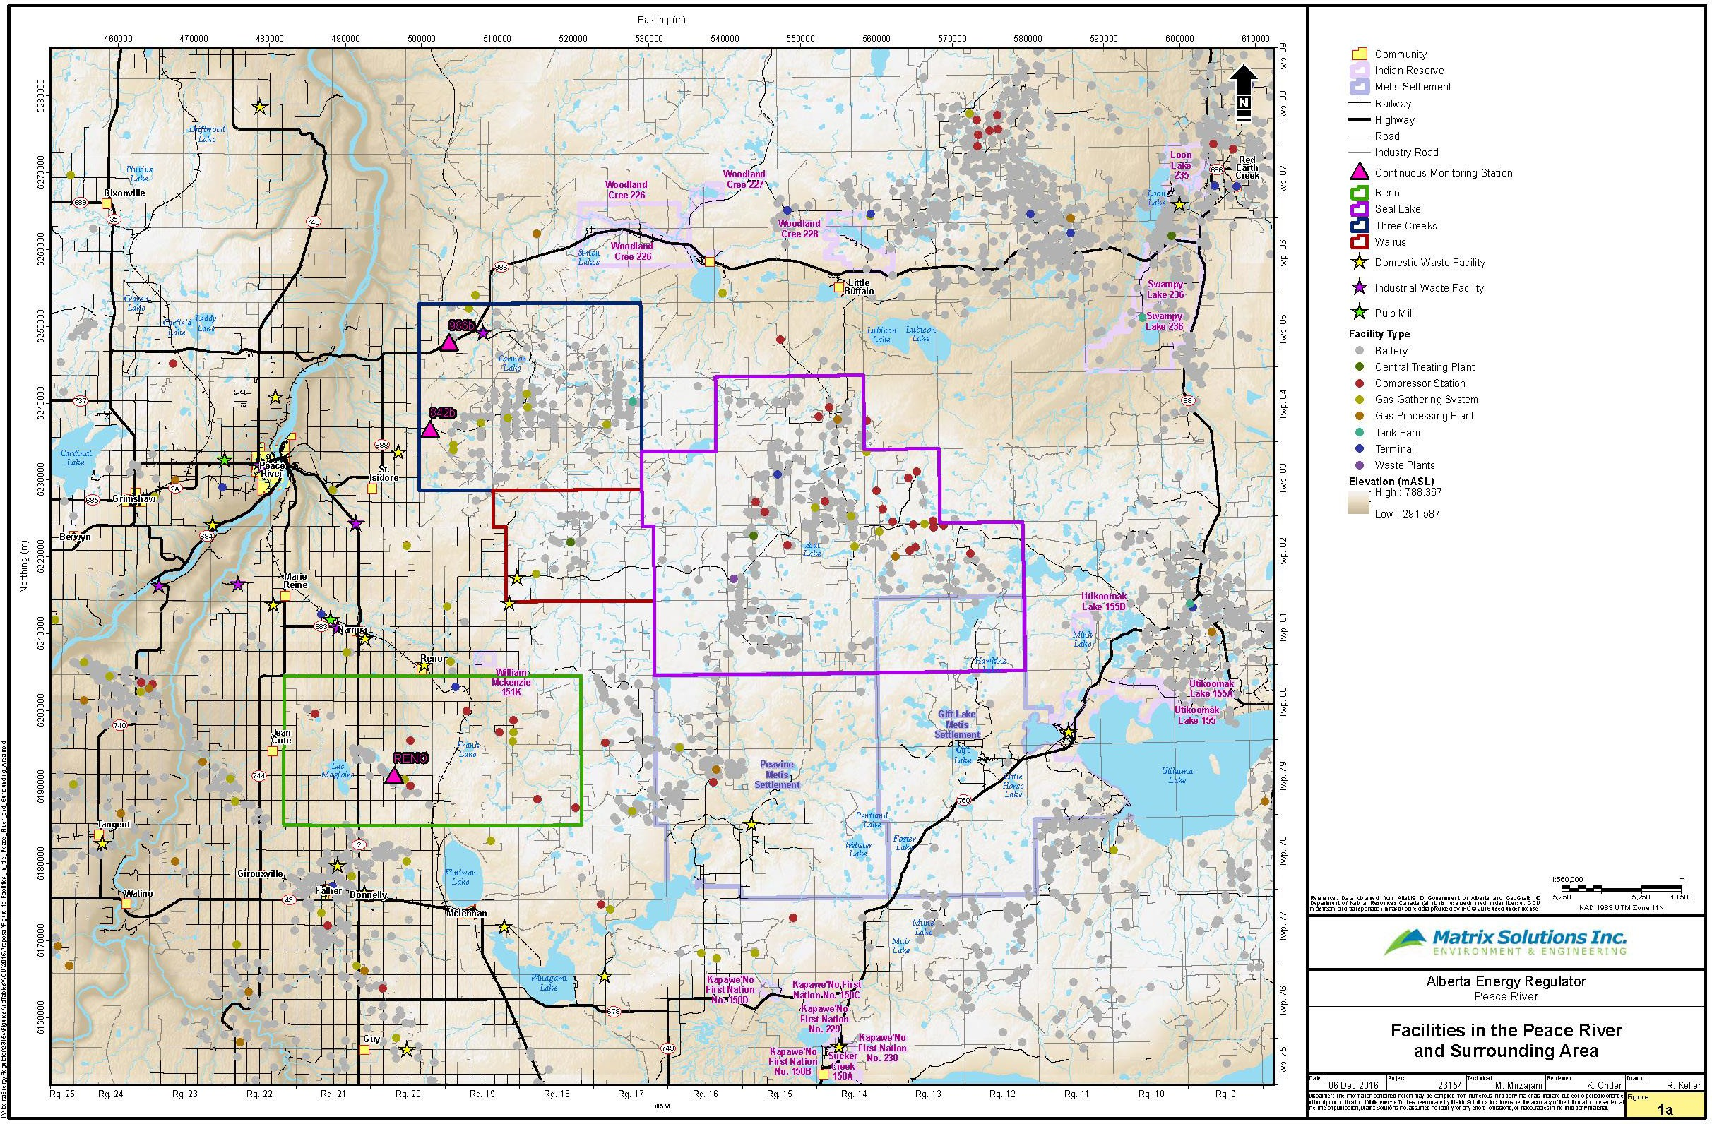
Site 2
PRC Network
}
Site 1
Site 3

Slide 11
Site 2
}
PRC Network
Site 1
Site 3

Slide 12
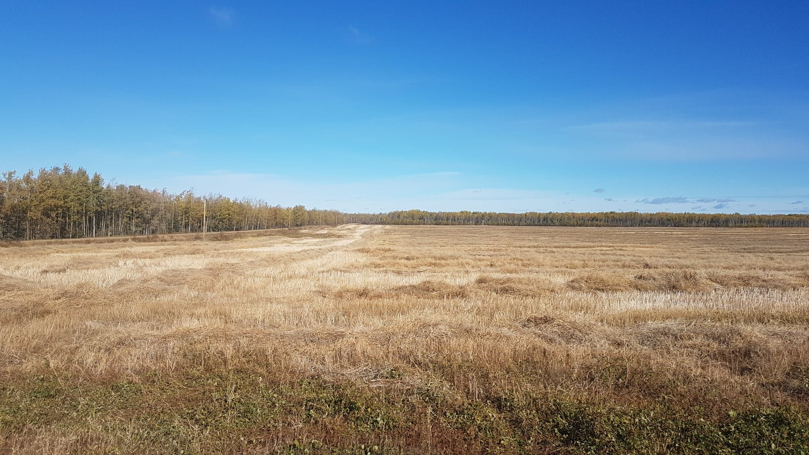
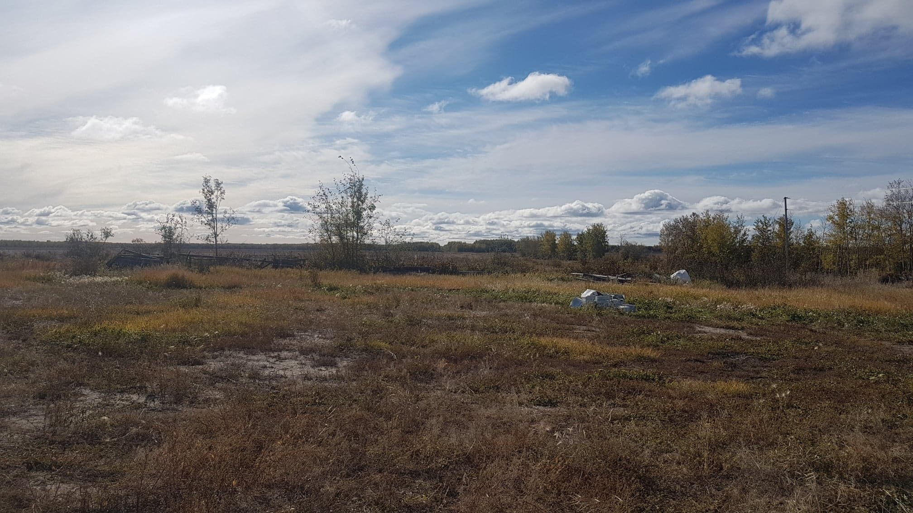
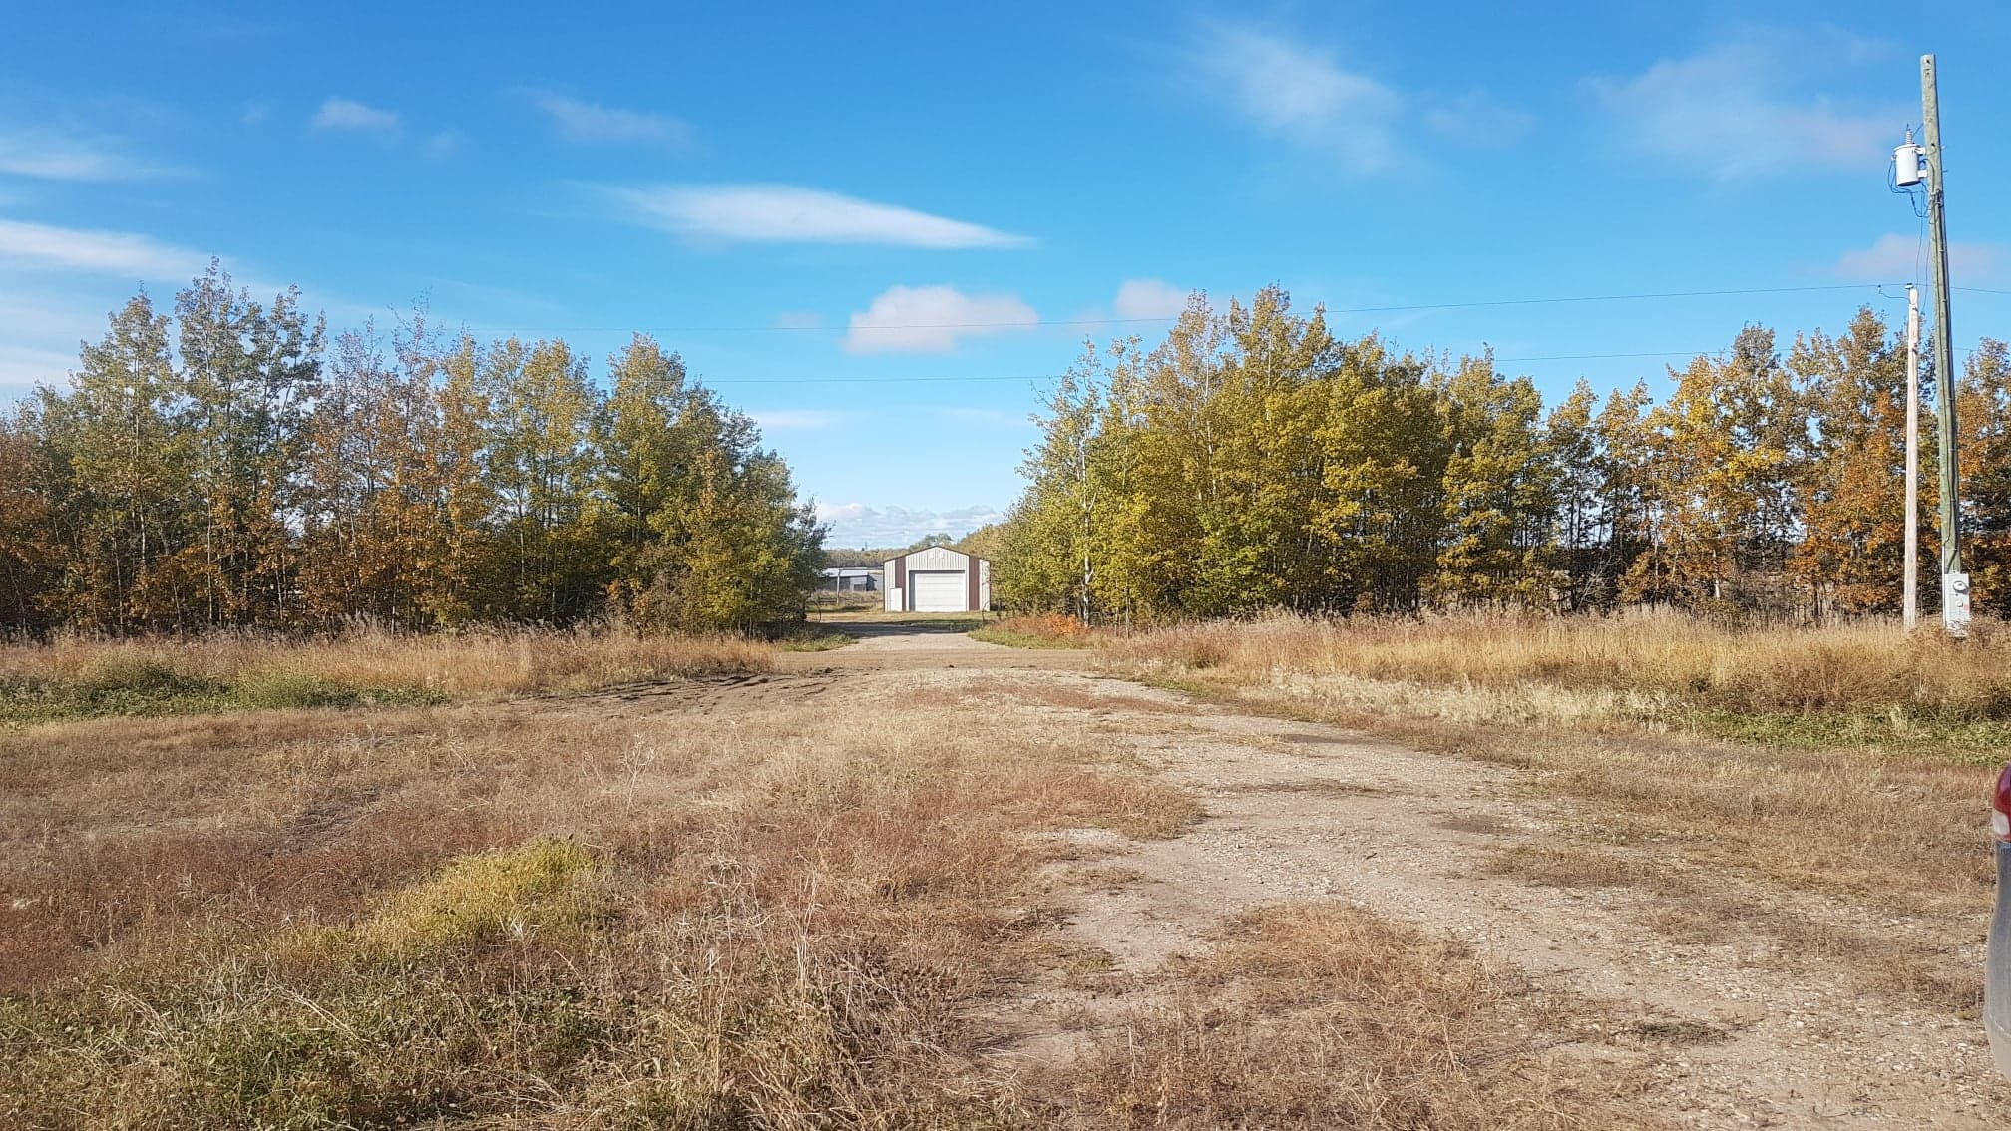
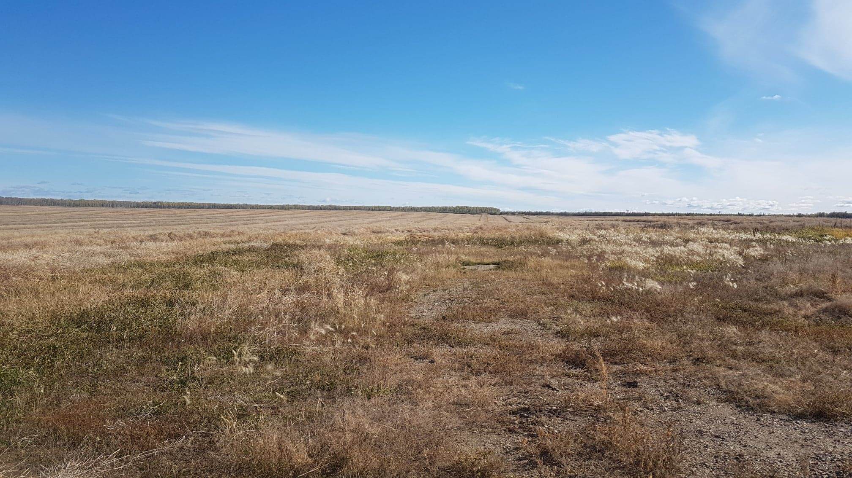
Site 1
N
E
W
S

Slide 13
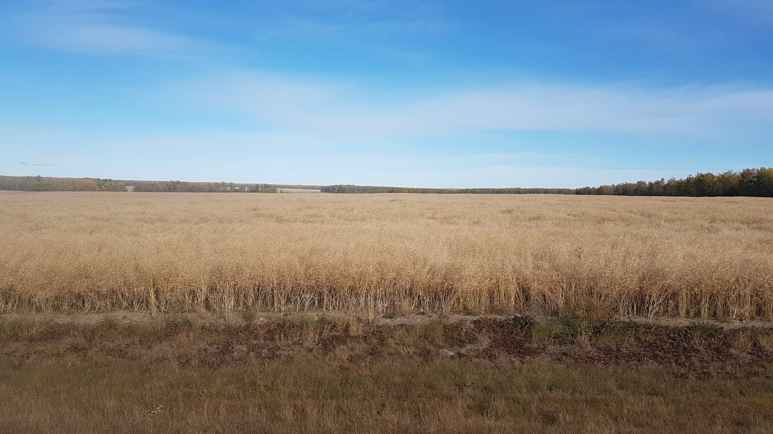
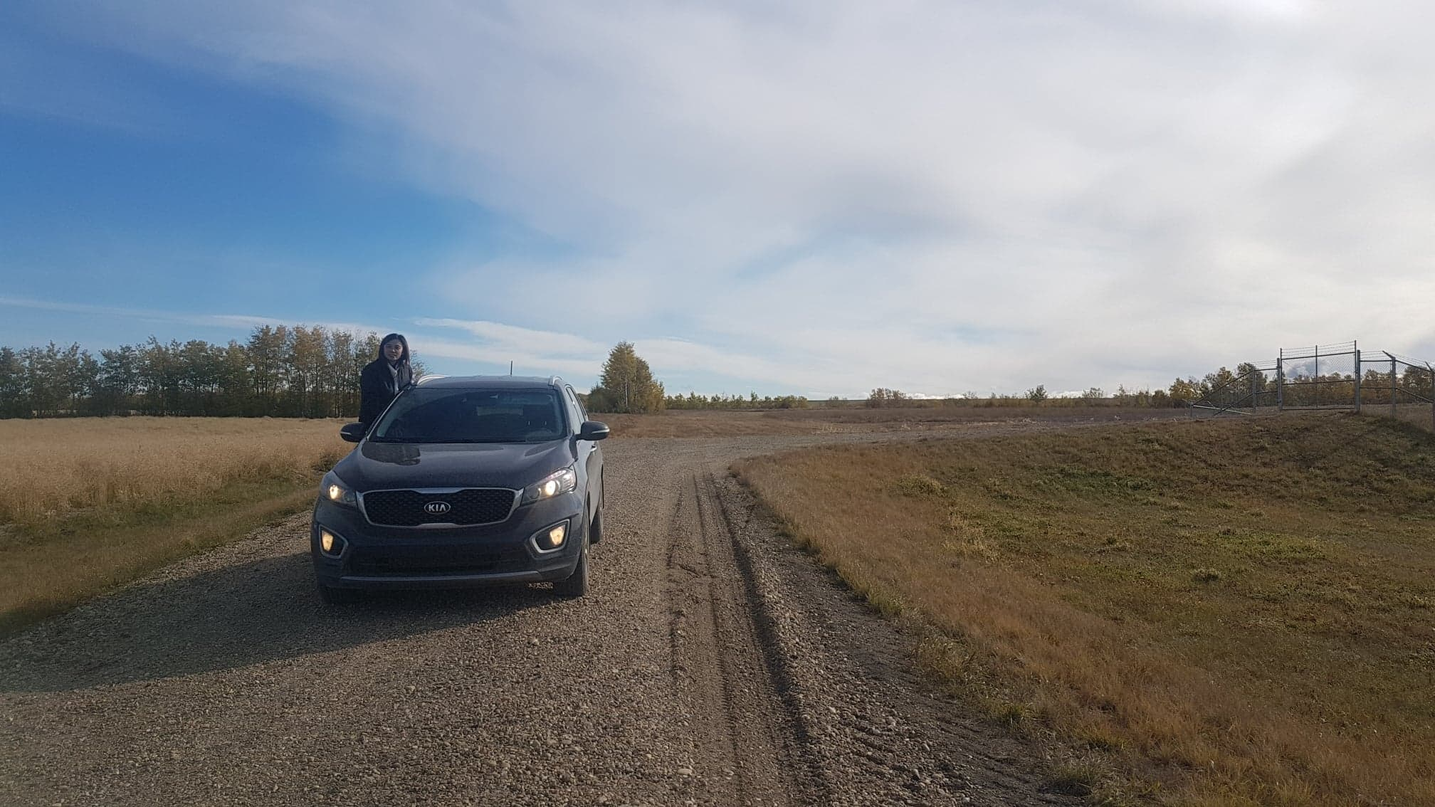
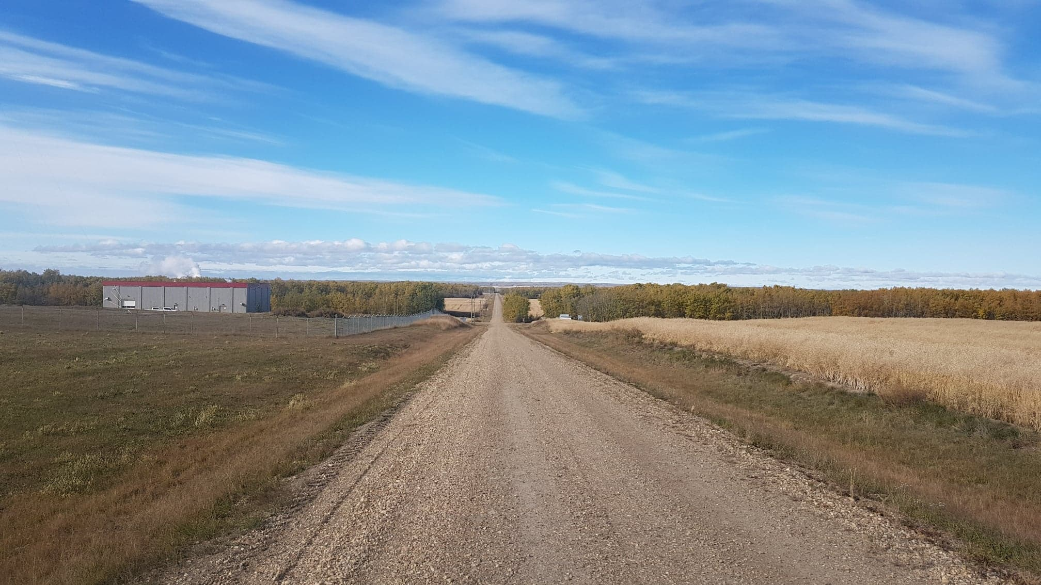
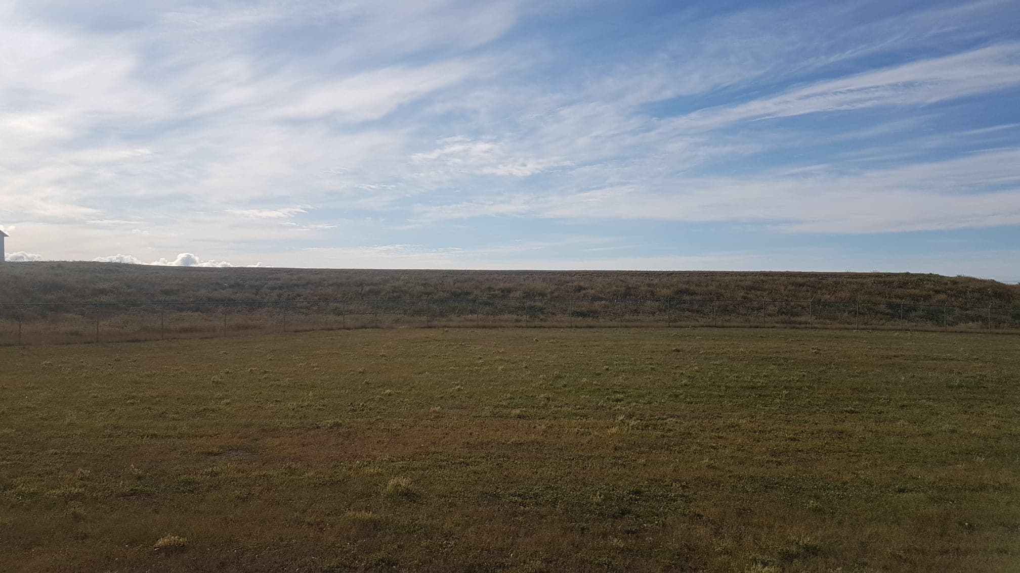
Site 2
N
E
W
S

Slide 14
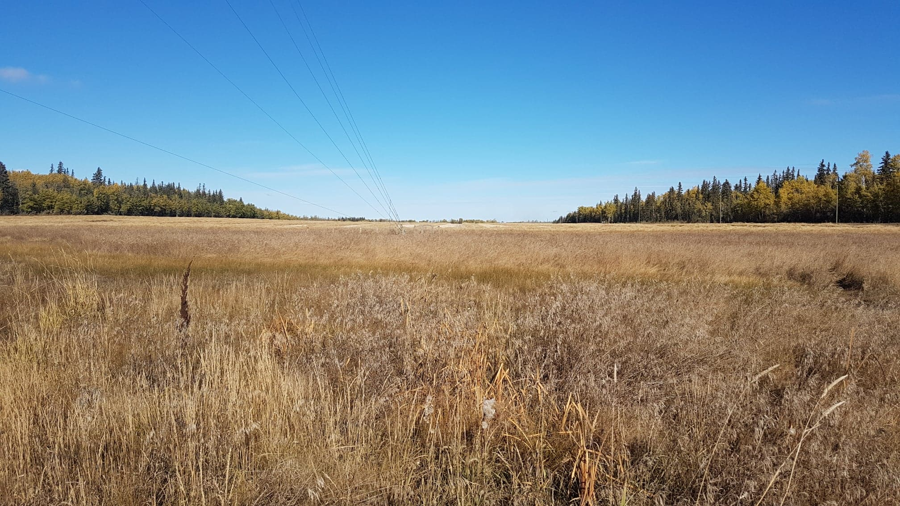
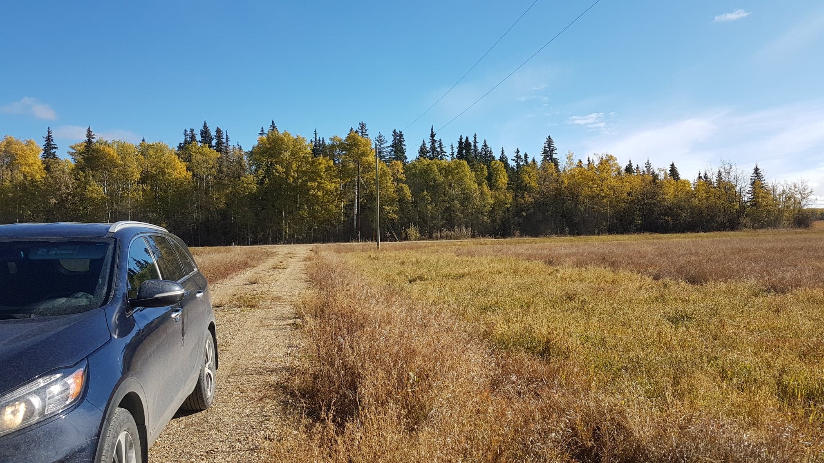
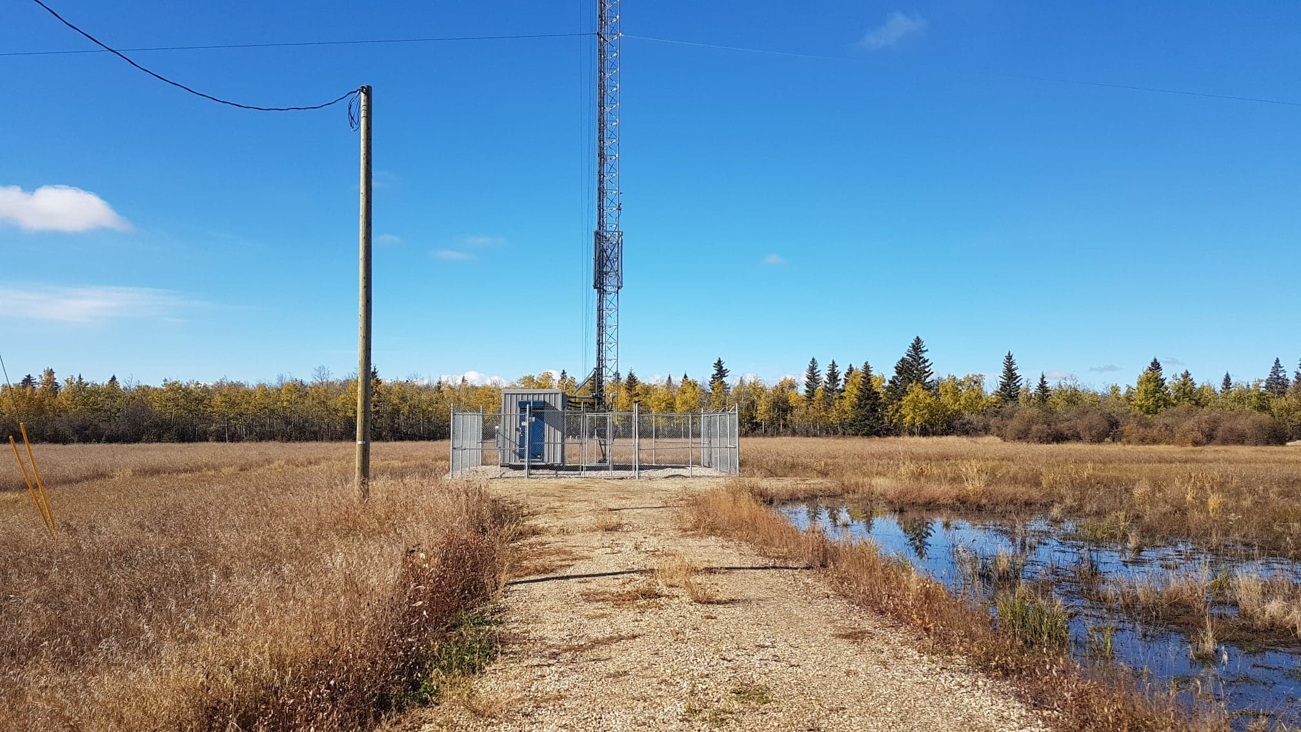
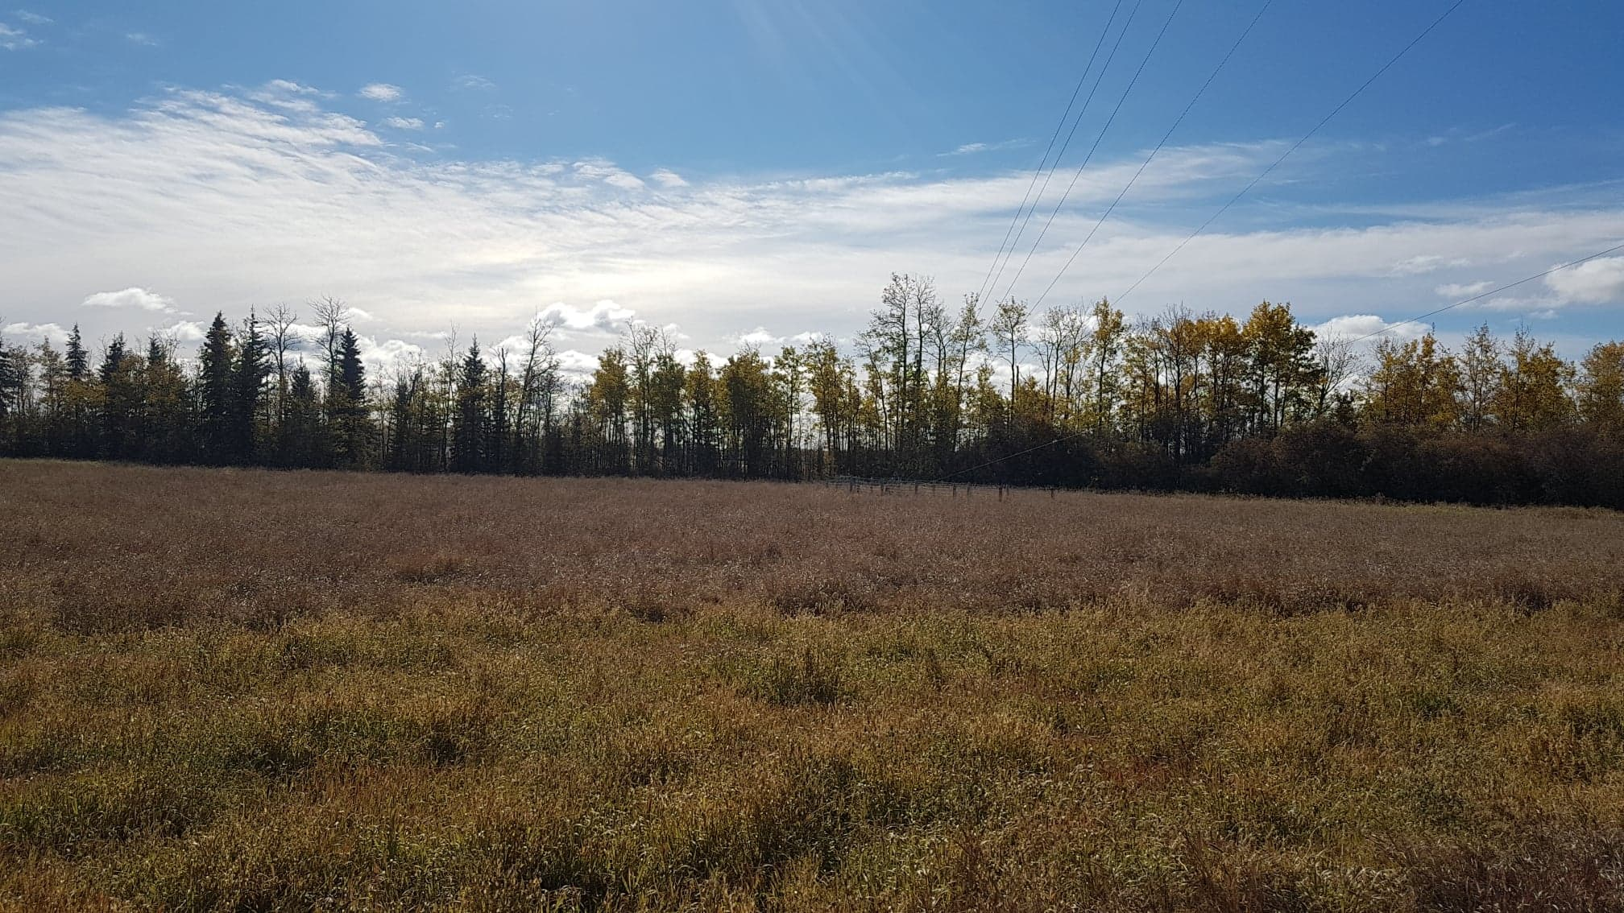
Site 3
N
E
W
S

Slide 15
Decision: Approval of location and relocation cost for 986 Station.

