Slide 1
Station 986 Relocation Portable Station Deployment Portable Station Naming

Slide 2
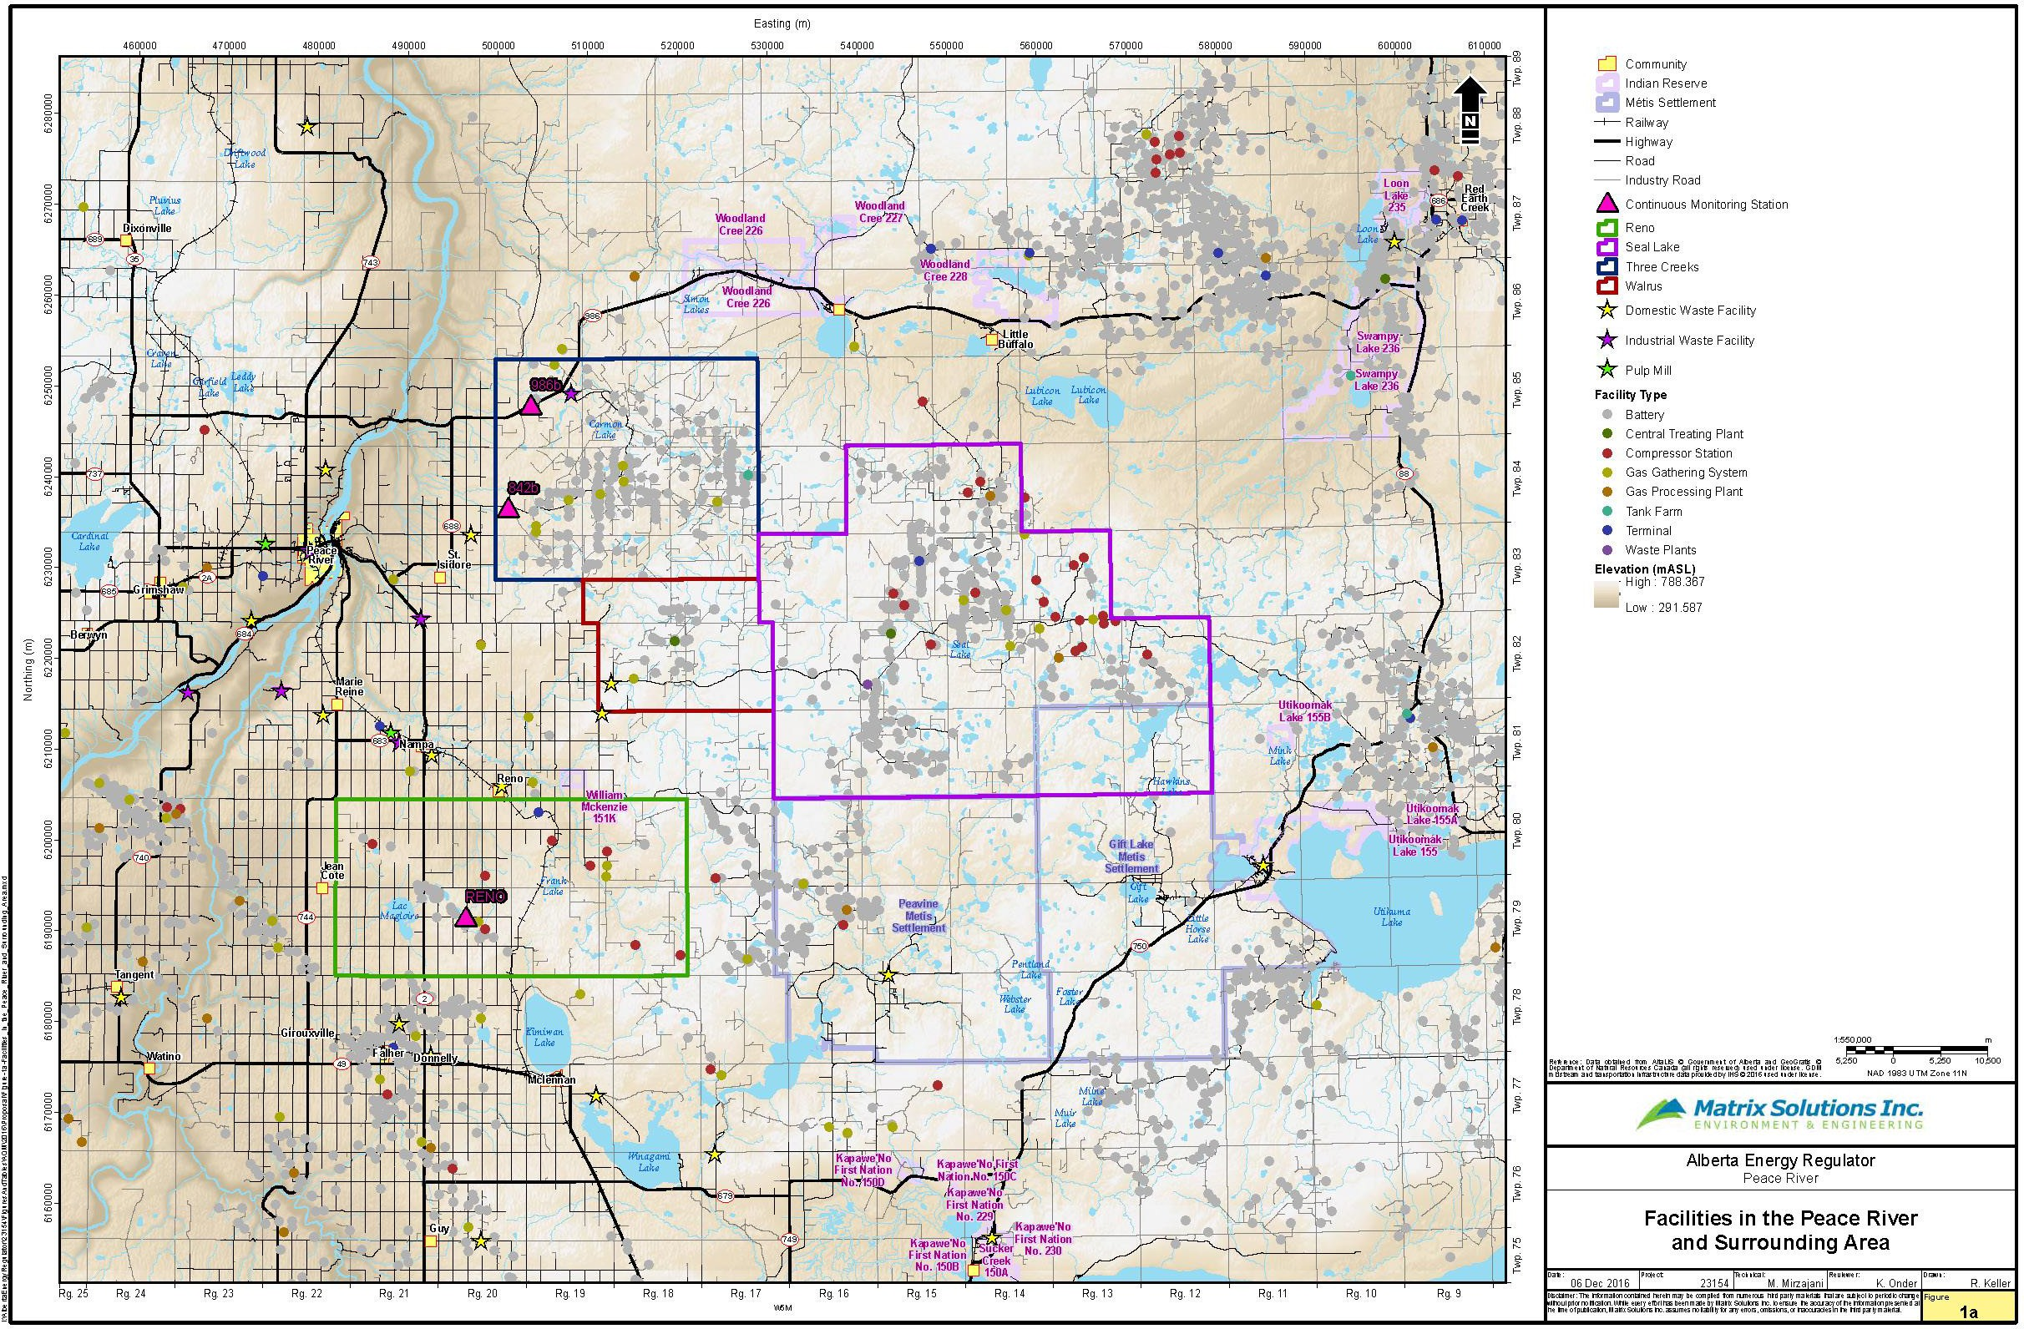
Site 2
PRC Network
}
Site 1
Site 3

Slide 3
Site 2
}
PRC Network
Site 1
Site 3

Slide 4
?

Slide 5
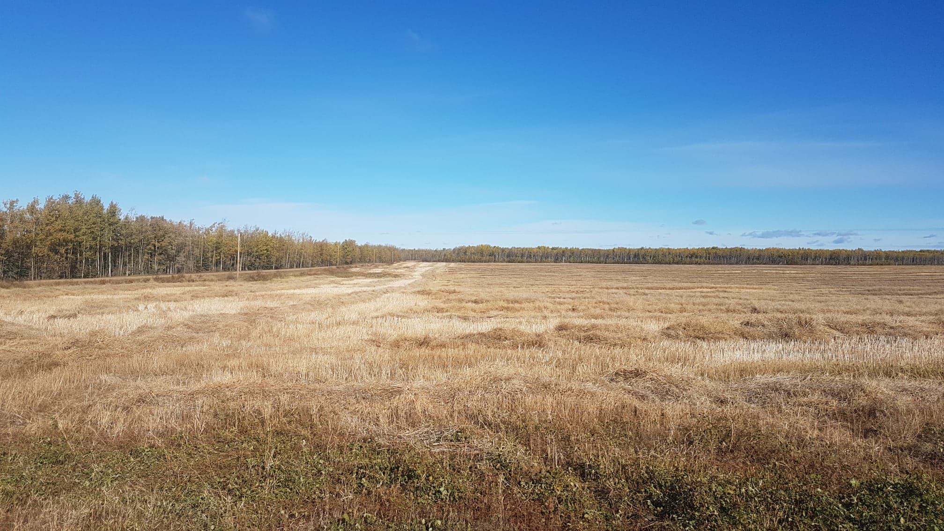
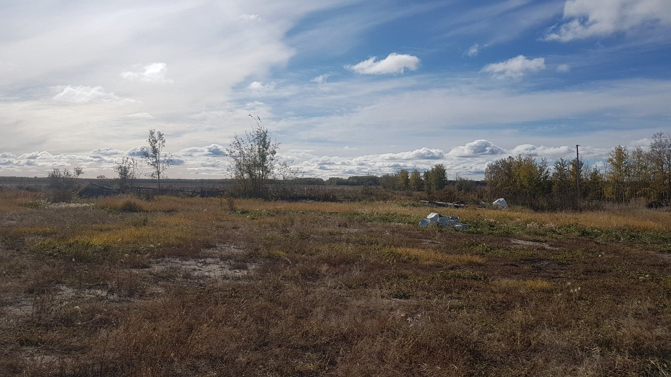
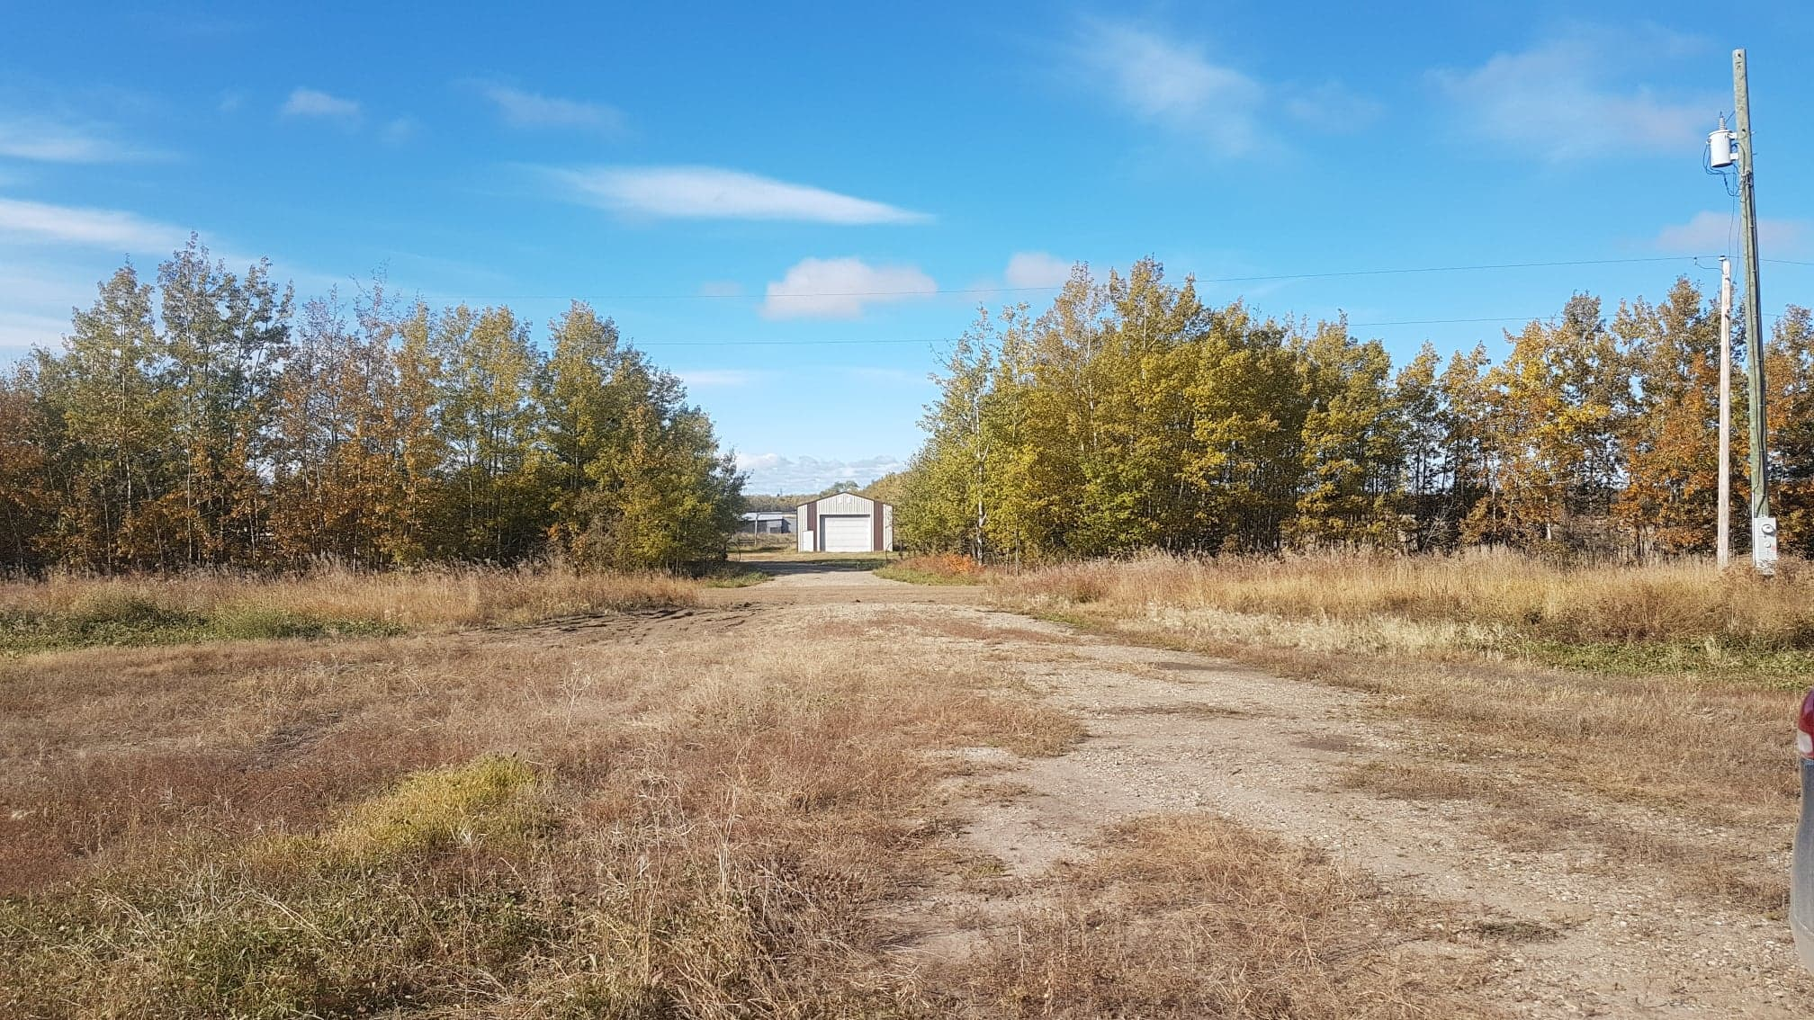
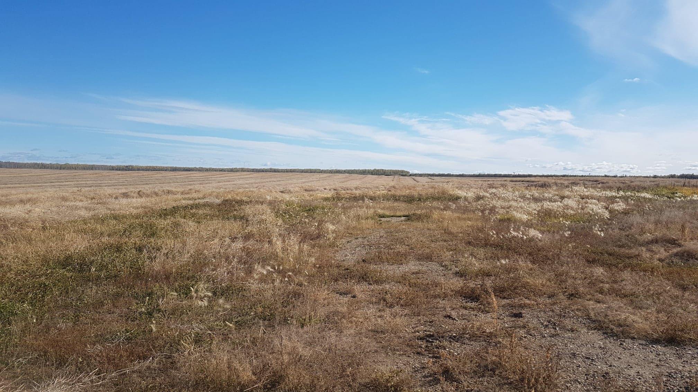
Site 1
N
E
W
S

Slide 6
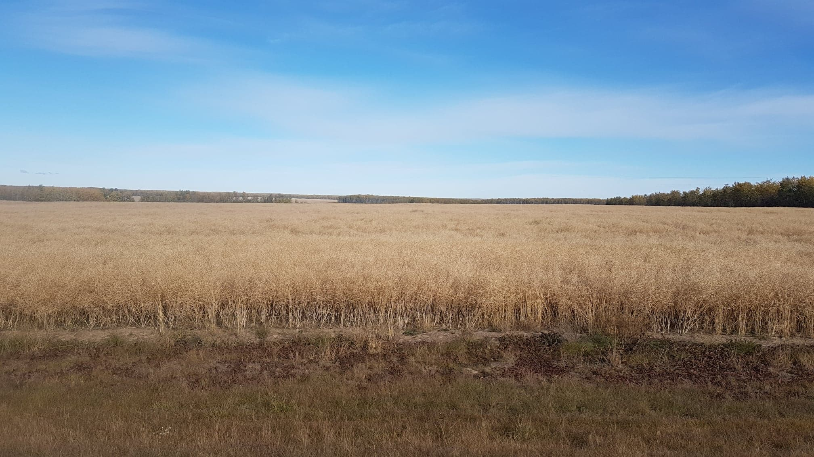
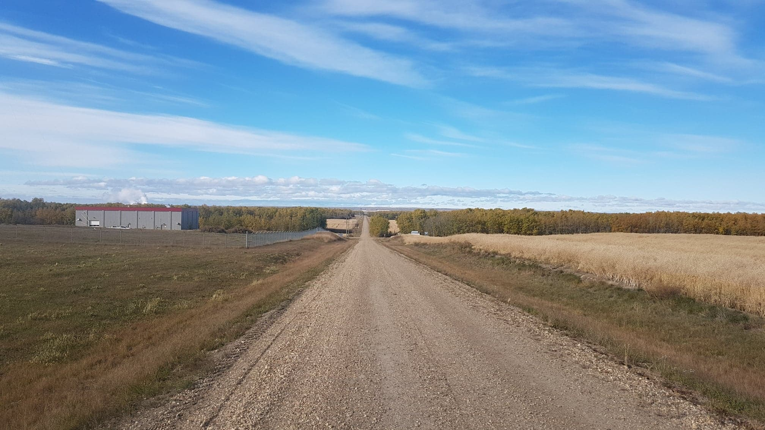
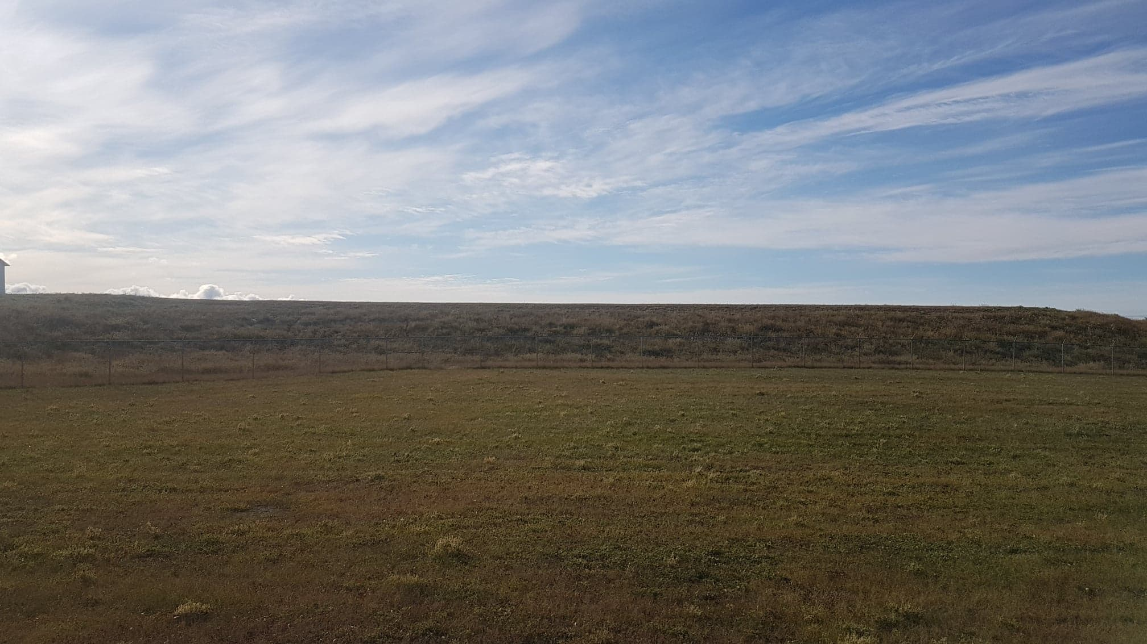
Site 2
N
E
W
S

Slide 7
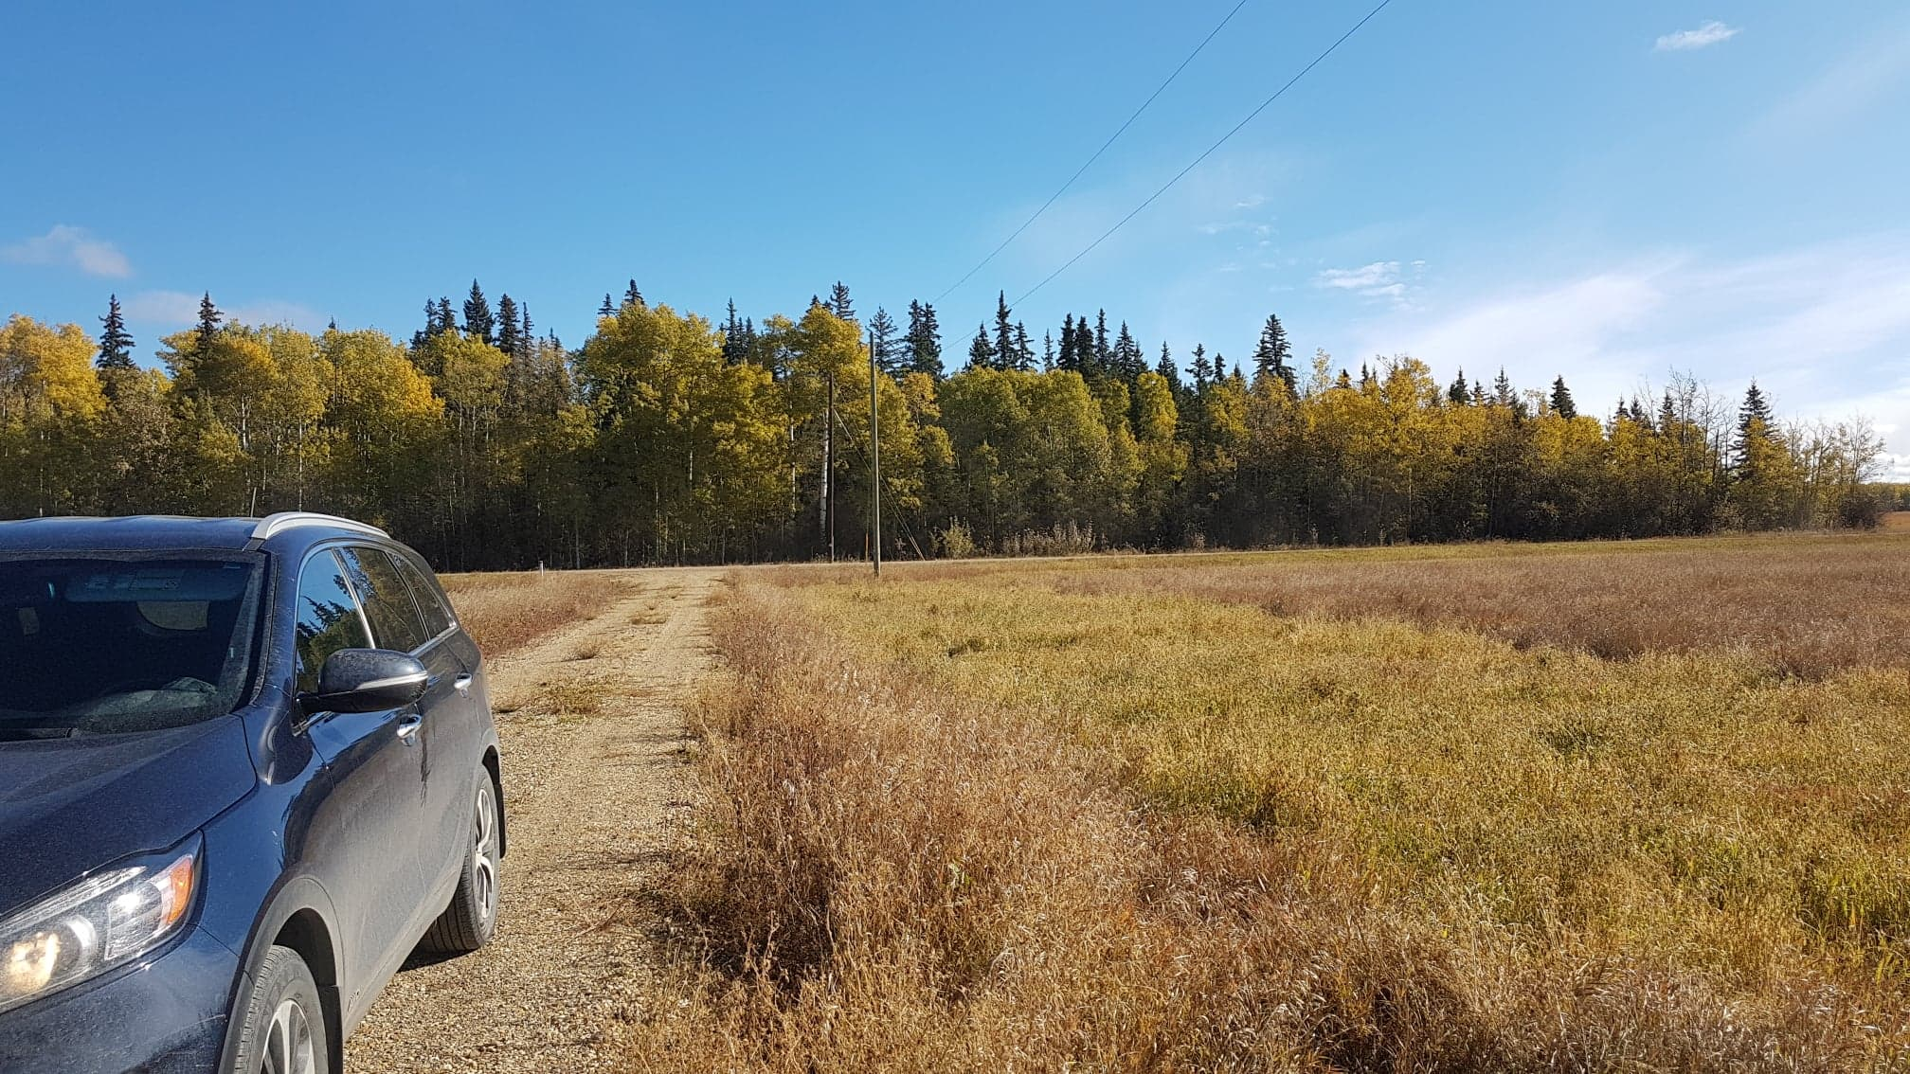
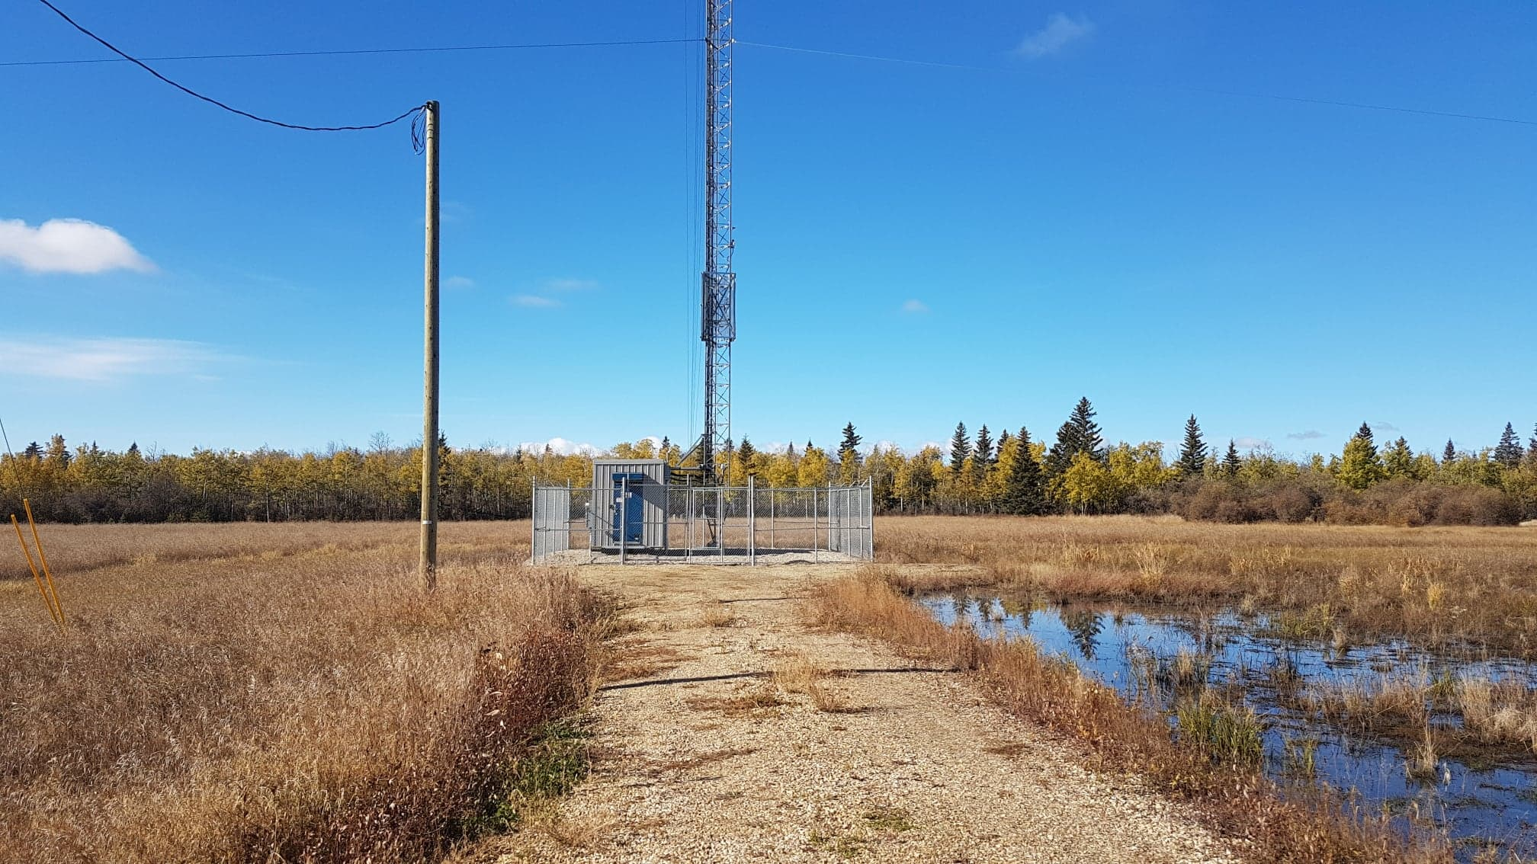
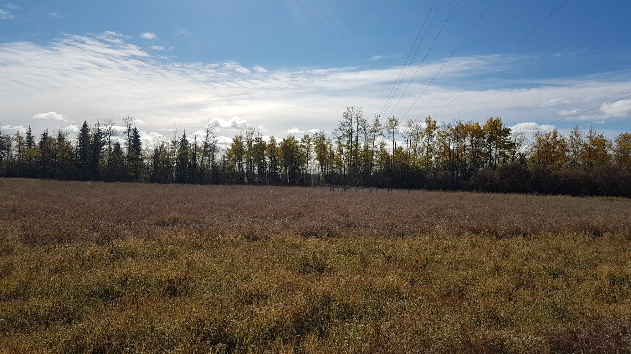
Site 3
N
E
W
S

Slide 8
Signage and Portable Station Wrap
Names:
Portable Air Monitoring Station
PRAMP AQHI Station #1
Northern Lights
Air Monitoring Station
Peace Country
Air Monitoring Station
Spirit of the North
Air Monitoring Station

