Slide 1
‘Daily’ Zero / Span Checks
What?
A check of the analyzer’s accuracy
Uses an ‘internal’ source of zero air
Uses an ‘internal’ source of test gas
Qualitative not quantitative!

Slide 2
‘Daily’ Zero / Span Checks
Why?
Quality Control
Demonstrates that analyzer continues to work as intended
Identifies potential equipment failure
Can be used to determine ‘point of failure’

Slide 3
‘Daily’ Zero / Span Checks
How?
Zero Air source
Analyzer
Test gas source
Sample
Detector
Valve
Exhaust

Slide 4
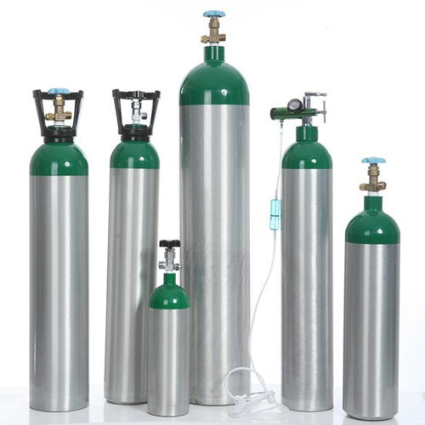
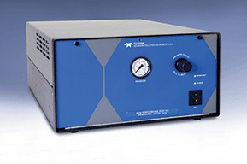
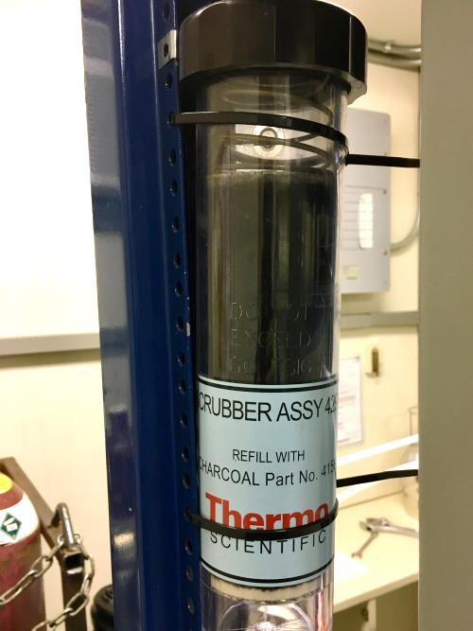
‘Daily’ Zero / Span Checks
Zero Air Source:
Compressed gas (cylinder)
Scrubber
Zero Air Generator

Slide 5
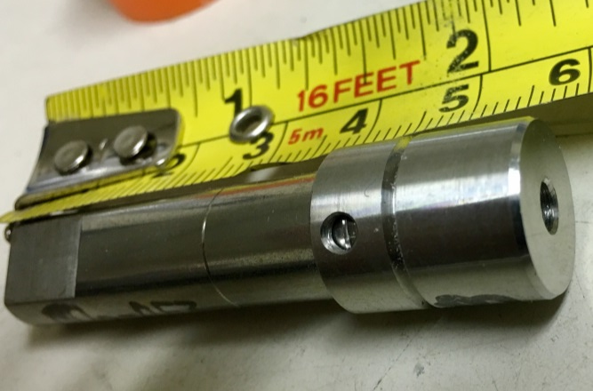
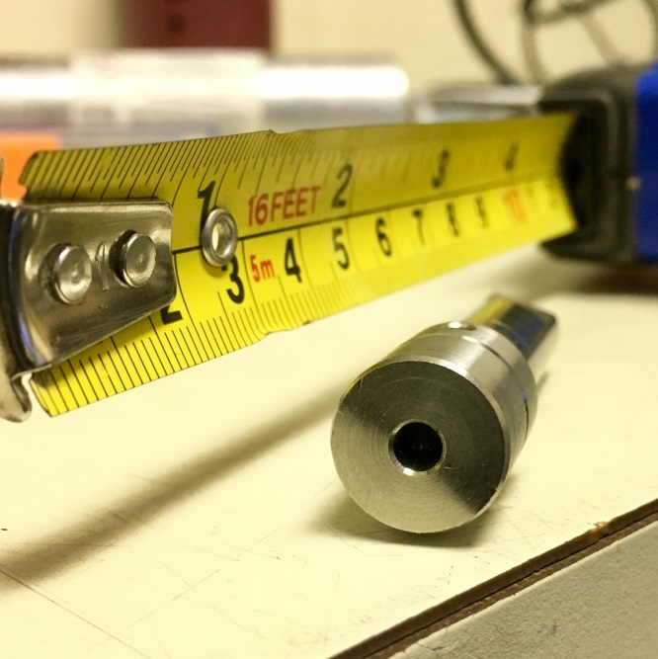
‘Daily’ Zero / Span Checks
Test Gas Source:
Compressed gas (cylinder) Permeation (Perm) Tube and Oven

Slide 6
‘Daily’ Zero / Span Checks
When?
After multi-point calibration
After span gas exchange
Sets Expected (reference) value
Daily
Zero ± 3% of full scale; Span ± 10% of reference (AMD)
Unscheduled (repeat) if suspected problem
To bracket ‘events’ (e.g. power)
Demonstrates good recovery

