Slide 1
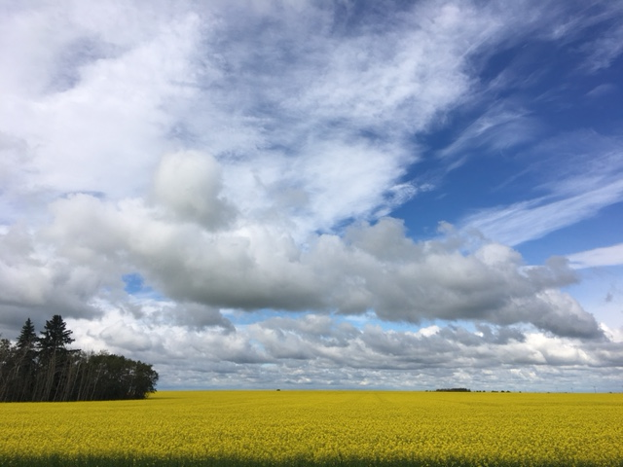
Daily Monitoring Report Review
October 26, 2017

Slide 2
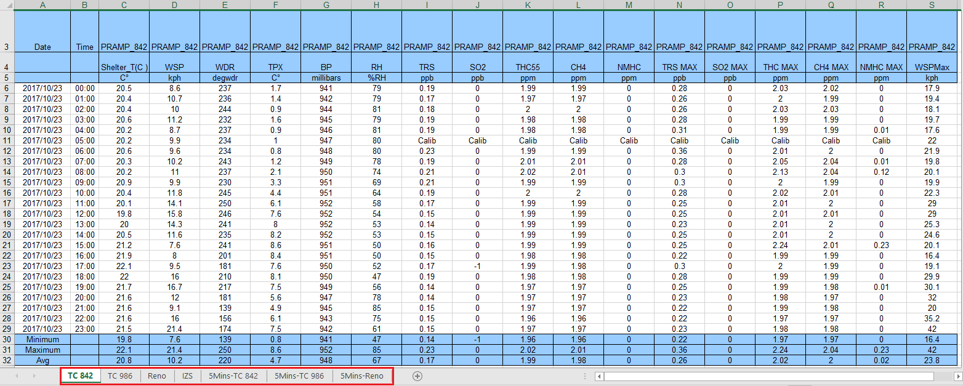
PRAMP Daily Report
Internal Zero Span

Slide 3
Something You Need To Know
Alberta Ambient Air Quality Objectives for SO2:
1-hour average: 172ppb
24-hour average: 48.0ppb.
THC background concentration:1.5 ppm.
THC ≈ CH4 + NMHC
NMHC 5 minute average ≥ 0.3ppm => Canister event
Wind Direction represents where the wind was blowing from.

Slide 4
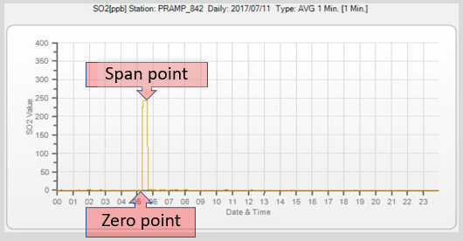
Something You Need To Know
Internal zero/span (IZS) test:
is required to be run on a daily basis;
shall not exceed 1 hour per calendar day;
contains one zero point check and one span point check; both points check must achieve a minimum of 10 minutes stability; and the check result must meet calibration acceptance criteria.
 | zero drift | span drift
TRS | +/- 3 ppb Range: 0 - 100 ppb | +/- 10 % | Drift (%)
SO2 | +/- 15 ppb Range: 0- 500 ppb | +/- 10 %
THC/CH4/NMHC | +/- 1.2ppm (THC) +/- 0.6ppm (CH4/NMHC) Range: THC/CH4/NMHC: 40/20/20 ppm | +/- 10 %

Slide 5
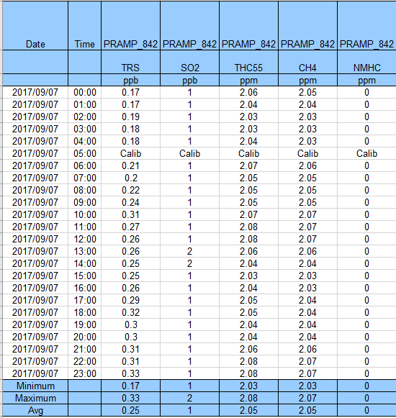
 | Reviews
TRS | Review Maximum, Minimum, and 24-hour average values Review data trend Hourly data recorded outside +/-3 ppb range (IZS zero requirement) during normal monitoring condition => analyzer failure
SO2 | Review Maximum, Minimum, and 24-hour average values Review data trend Check if there was any contravention (1-hr: 172ppb, 24-hr:48ppb)
THC/ CH4/ NMHC | Review Maximum, Minimum, and 24-hour average values Check if any THC < 1.5ppm was recorded THC ≈ CH4 + NMHC Check if NMHC > 0.1ppm or NMHCmax > 0.30ppm was recorded => canister event

Slide 6
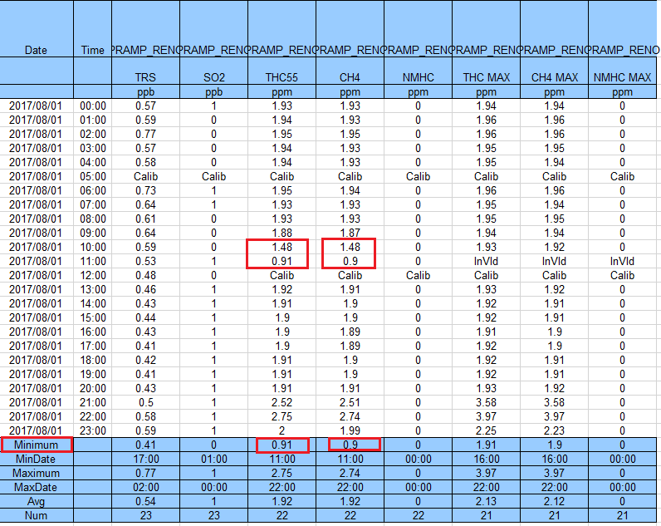
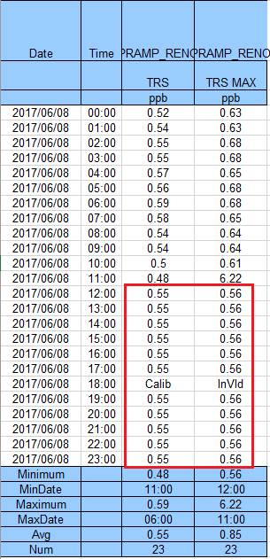
THC/CH4<1.5ppm TRS hourly data remains no change for hours

Slide 7
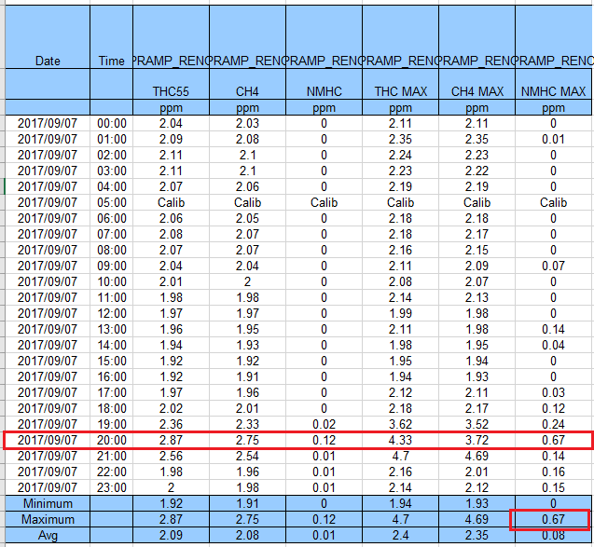
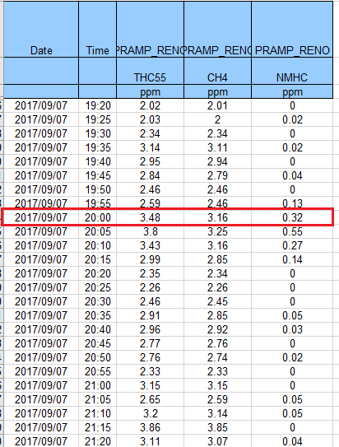
NMHC >0.1ppm & NMHCmax >0.3ppm 5-min data (canister event)

Slide 8
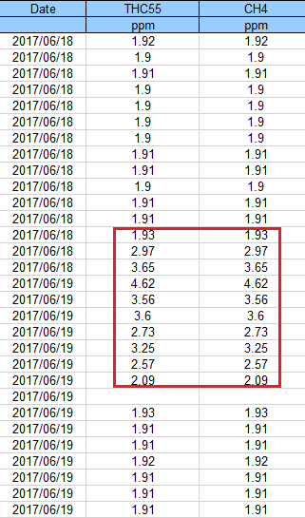
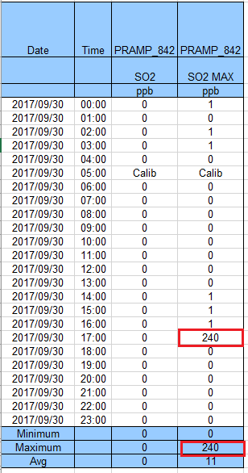
 | Reviews
Hourly max data | Check to see if there is abnormal A real event An abnormal spike

Slide 9
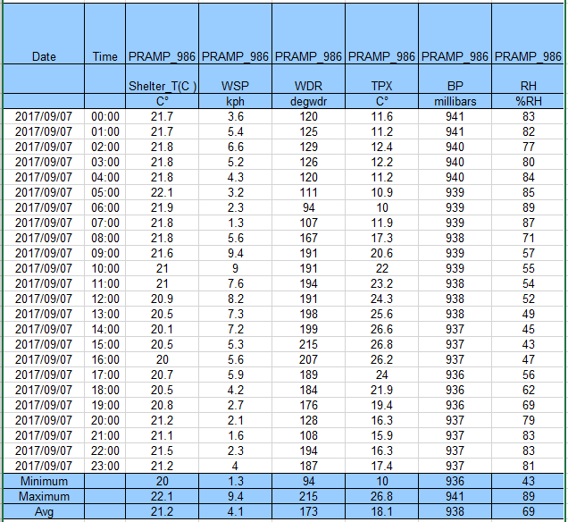
 | Reviews
WS/WD | If hourly data do not change a lot or if WS data is recorded <1.0kph for more than 5 hours => sensor failure
RH/BP/TPX (TPX: Temperature) | Hourly values are consistent for more than 5 hours => sensor failure Rule of Thumb: TPX and RH are generally inversely related.
STNTPX | STNTPX ideally should be kept in a range of 20 to 25 degC Temperature changes should not be more than 5 degC in a day.

Slide 10
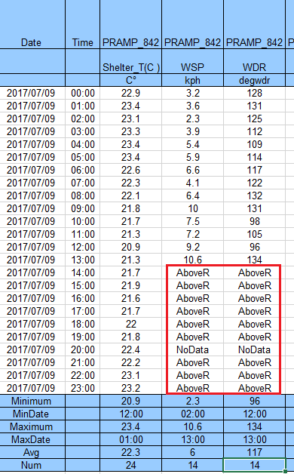
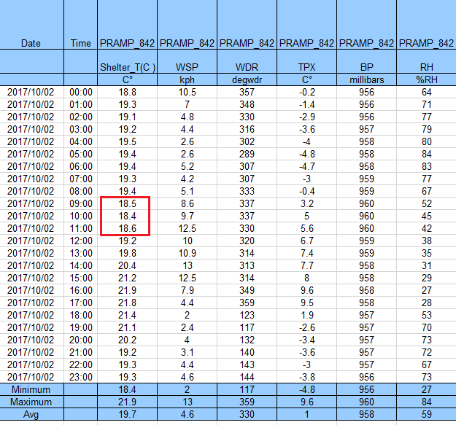
Wind System Failure Low Shelter TPX
Notes:
These are examples of the wind system failure and low shelter temperature.

Slide 11
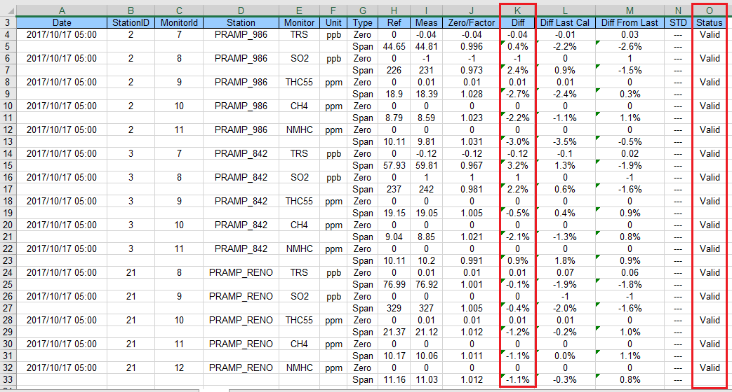
Diff (Column K): the difference between the Ref ( column H) and the Meas (measured) (column I)
e.g. Zero drift= (-0.04)-0=-0.04
Span drift=(44.81-44.65)/44.65*100
= 0.36%
Diff Last Cal (Column L): the ‘’Diff’’ value from the previous day
Diff From Last (Column M): the difference between the values in Columns K and L

Slide 12
TRS failed span check
NMHC span check failed

