Slide 1
WELCOME!

Slide 2
Air Monitoring Program Update
October 2017

Slide 3
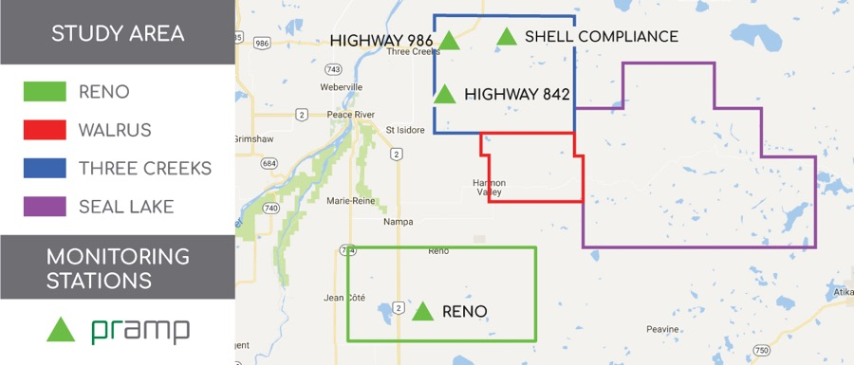
Monitoring Network
(future)
Continuously Monitored: Sulphur Dioxide, Total Reduced Sulphurs, Methane, Non-Methane Hydrocarbons, Wind Speed, Wind Direction, Relative Humidity, Temperature, Barometric Pressure
Intermittently Monitored: Volatile Organic Compounds

Slide 4
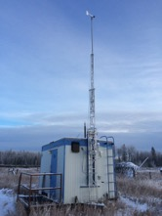
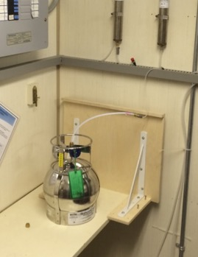
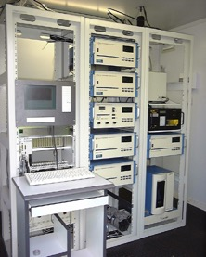
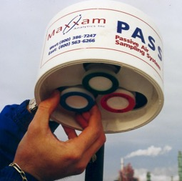
Monitoring Methods
Canister
Continuous
Passive (future)

Slide 5
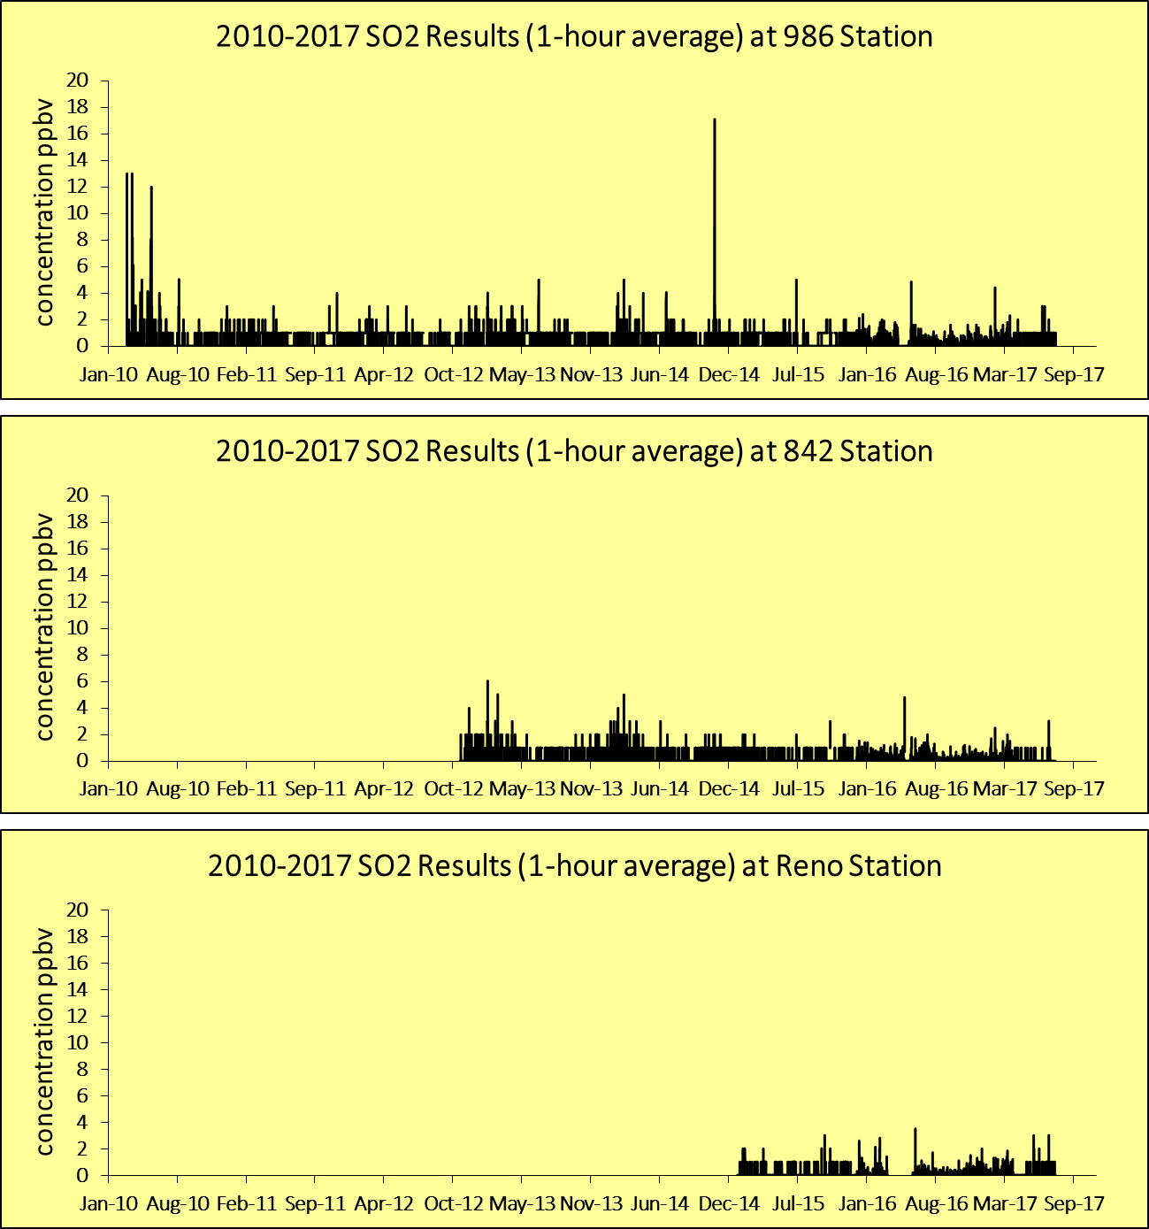
986
842
Sulphur Dioxide
Reno

Slide 6
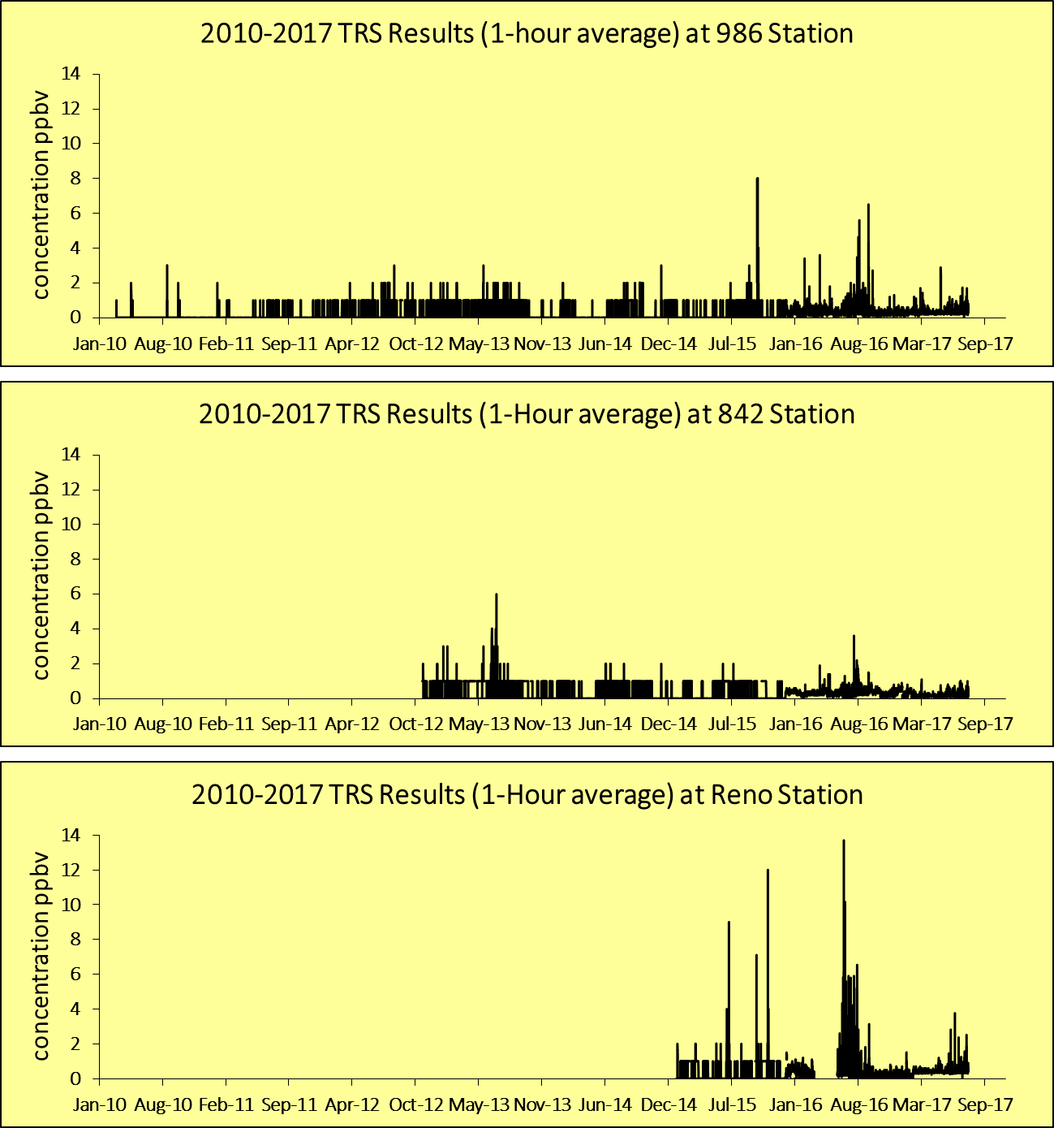
986
842
Total Reduced Sulphur
Reno

Slide 7
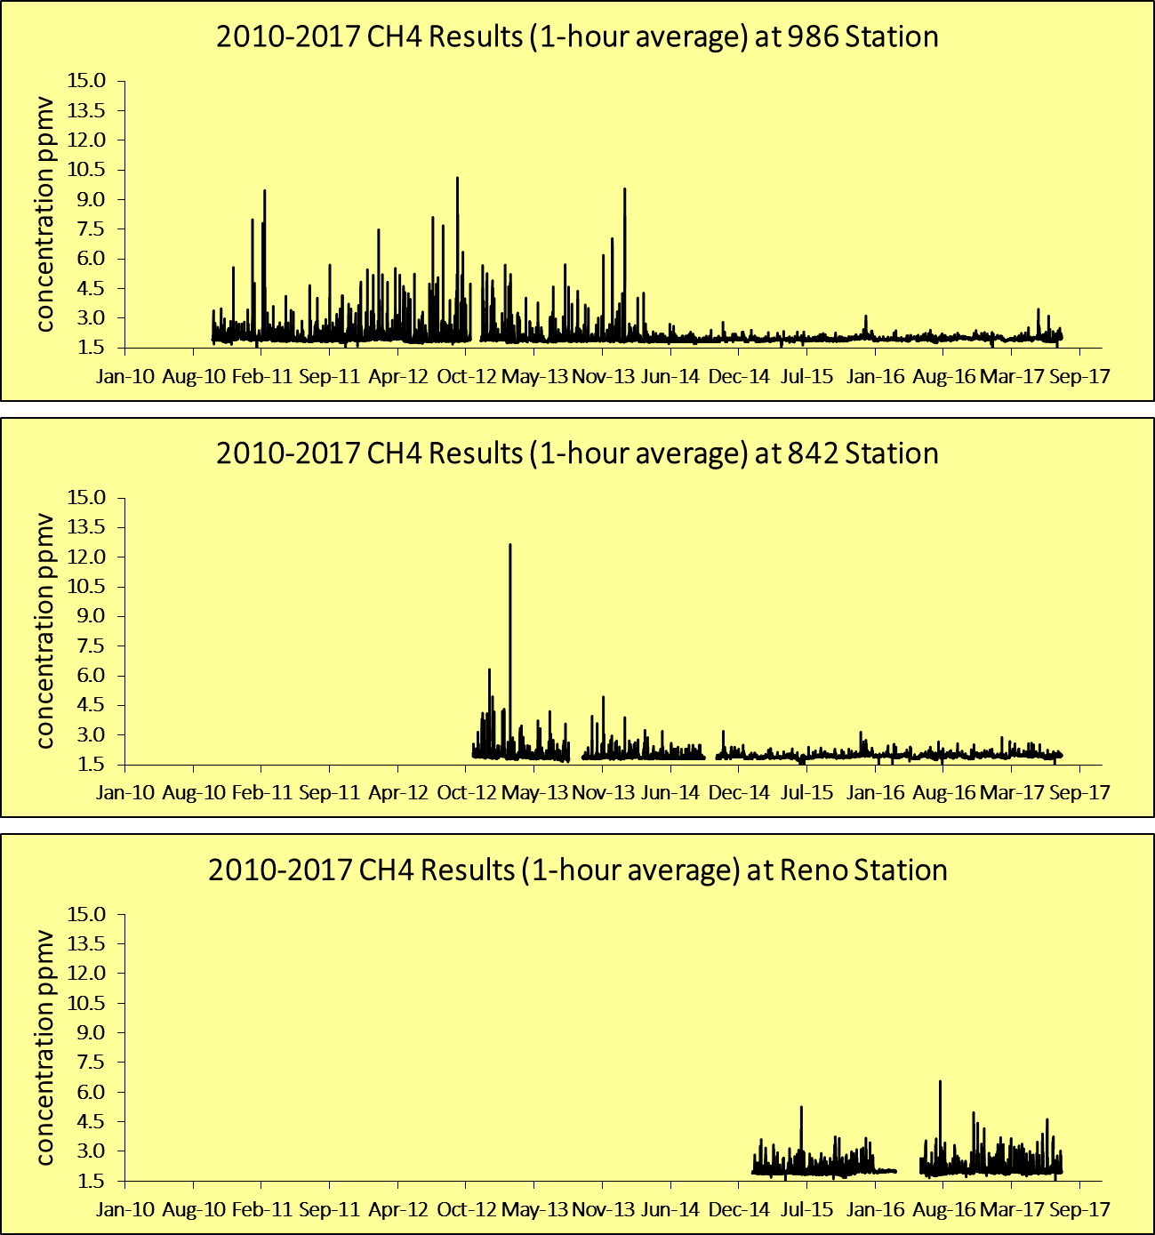
986
Methane
842
Reno

Slide 8
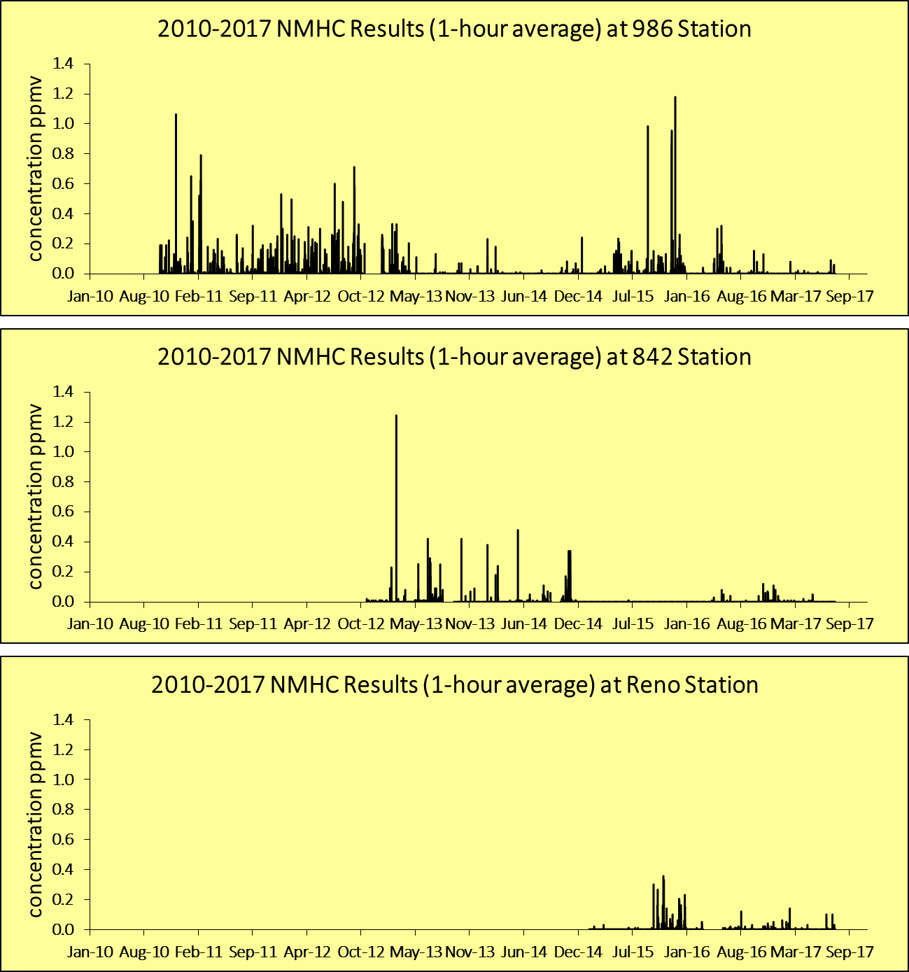
986
842
Non-Methane Hydrocarbons
Reno

Slide 9

Methane (1 hr):
All Measurements

Slide 10
Methane (1 hr):
Background Removed

Slide 11
Canister Trigger Events
 | 986 | 842 | Reno
2010 | 7 | NA | NA
2011 | 32 | NA | NA
2012 | 55 | NA | NA
2013 | 12 | 11 | NA
2014 | 1 | 10 | NA
2015 | 9 | 0 | 5
2016 | 9 | 0 | 3 (1)
2017 | 1 | 0 | 5 (3)

Slide 12
Canister Analysis Results

Slide 14
VOC Analysis: Looking Forward
Template for Presenting New Data:
  Alberta Environment and Parks (AEP). 2015. Study of Ambient Hydrocarbon Concentrations in Three Creeks, Alberta. Air and Climate Change Policy Branch. August 2015. ISBN No. 978-1-4601-2379-9.
  http://aep.alberta.ca/air/reports-data/documents/AmbientHydrocarbonThreeCreeks-Aug2015.pdf

Slide 15
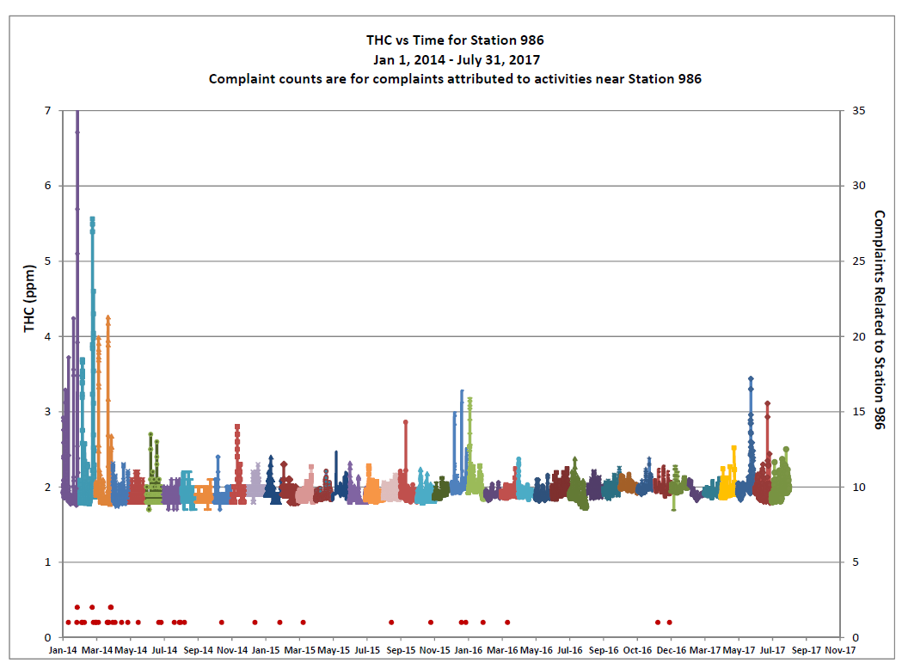
Station 986:
Complaints & Total Hydrocarbons
Concentration
Complaints

Slide 16
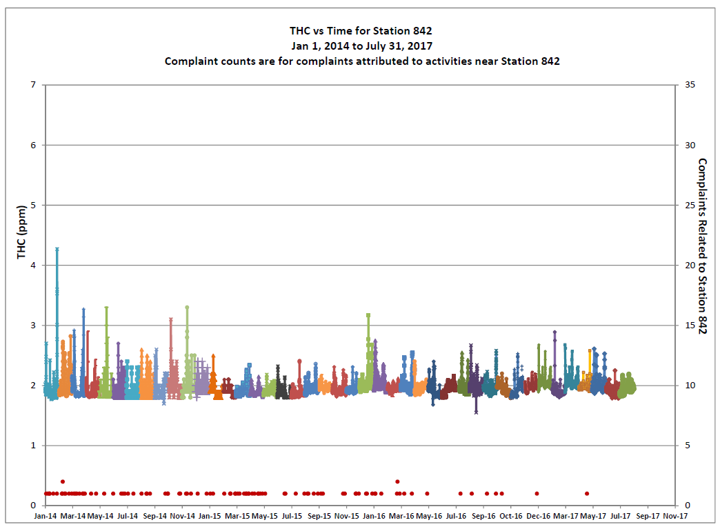
Station 842:
Complaints & Total Hydrocarbons
Concentration
Complaints

Slide 17
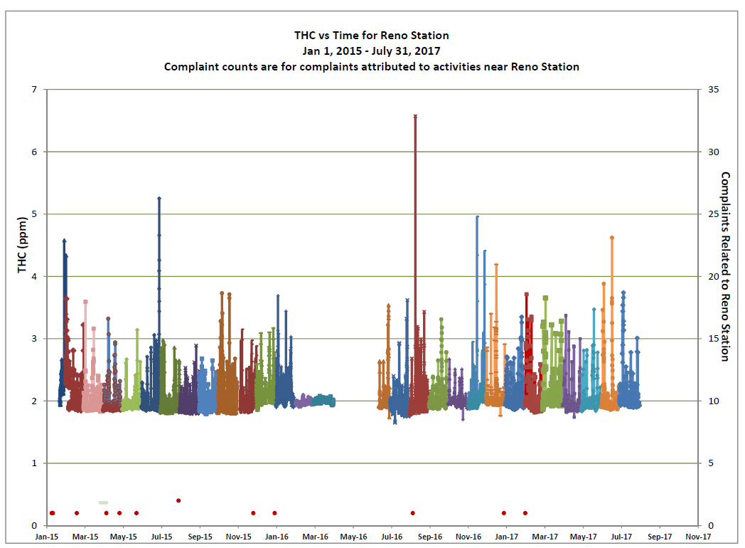
Reno Station:
Complaints & Total Hydrocarbons
Concentration
Complaints

Slide 18
Summary
The frequency of elevated hydrocarbon events has come down over time
The frequency of triggered canister events has come down over time
The number of complaints received by government agencies has come down over time
Both the place-based regulatory framework implemented by the AER and the process improvements and mitigation measures adopted by local industry have resulted in improvements in air quality
Ongoing monitoring and assessment is required
Further analysis of canister data is required
Review of the canister sampling protocol is underway

Slide 19
Looking Forward
Network Expansion
  CNRL Peace River Complex
  Passive Monitoring Network
Website – continuous improvement
    https://www.prampairshed.ca/
Outreach
  Peace River area schools
  Sign up for our newsletter
We want to connect – let us know about local events

Slide 20
Questions?

